Slide 1
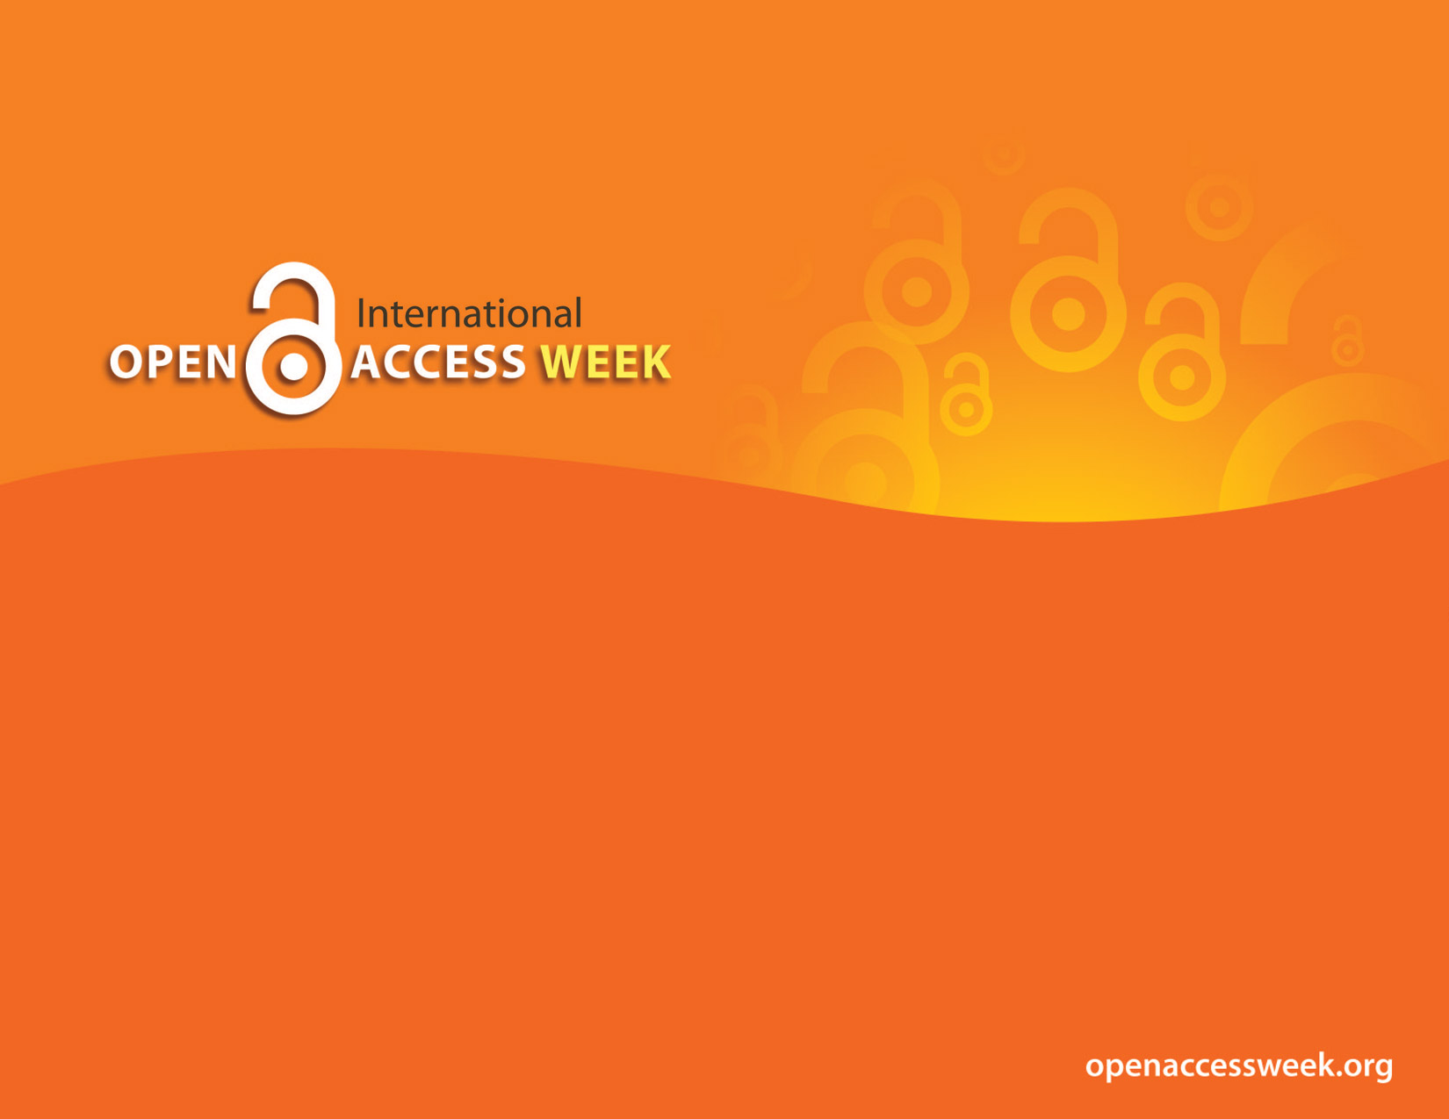
2017
OPEN IN ORDER TO:
Enable Global Participation in Research
Raise Research Visibility
Enable Public Health
Collaborate

Slide 2

Open Access (OA)
is free, immediate access to scholarly information online, along with the right to use and reuse that information (SPARC)
OA Week
is a global event to promote the potential benefits of Open Access and to help inspire wider participation in helping to make Open Access a new norm in scholarship and research

Slide 3

OPEN =
Free to read
Widely available
Unlimited peer-review/ sharing/ collaborating
Usually free to use/reuse
Shorter publishing cycle
Non-traditional publishing models

Slide 4



Searching & Selecting OA Literature
Stephanie Swanberg
Assistant Professor, Information Literacy & eLearning Librarian
OUWB School of Medicine
swanberg@oakland.edu
October 23, 2017

Slide 5
Objectives
Identify appropriate resources for searching open access literature
Describe strategies for selecting journals in which to publish your work
Identify appropriate resources for assessing the quality of publishers and journals

Slide 6

Searching OA Journals
Image from Pixabay - Public Domain

Slide 7
Why Search OA Literature?
Expand your result set
Promote sharing of research
  Reduce redundancy & promote new knowledge creation
Reduce bias & increase transparency
  Most traditional journals favor large scale studies with positive/significant results
  Most OA journals have the same quality and rigorous peer review process

Slide 8
Best Places to Find OA Literature
Directory of Open Access Journals (DOAJ): doaj.org
  Online directory of high-quality, peer-reviewed open access journals
  Journals must undergo a rigorous application process to be included in DOAJ
Google Scholar: scholar.google.com
  Not everything in Scholar is open access, but still a great place to locate OA literature

Slide 9
PubMed Central
ncbi.nlm.nih.gov/pmc
National Library of Medicine’s free archive of biomedical & life sciences literature
Designated open repository for publications resulting from publicly- (and some privately-) funded research:
  aka NIH Public Access Policy
  NIH, CDC, Gates Foundation, EPA, FDA, NASA, & more

Slide 10
Institutional Repositories
Directory of Open Access Repositories (OpenDOAR): opendoar.org
  Includes links to over 2600 academic and governmental repositories
  Searchable – search for repositories OR search the contents of all repositories using the site's Google custom search box
OUR@Oakland: our.oakland.edu
  Oakland University’s institutional repository maintained by OU Libraries

Slide 11
Selecting OA Journals
Image from Pixabay - Public Domain

Slide 12
How to Identify Journals
Check your manuscript’s reference list – what journals do you cite?
Conduct a search on your topic – what journals have published similar studies already?
Ask a mentor or colleague for recommendations

Slide 13

Journal/Author Name Estimator (JANE)
http://jane.biosemantics.org/
Copy & paste your manuscript’s abstract into JANE
Pulls a set of possible journals for you to publish in (traditional & open access)

Slide 14
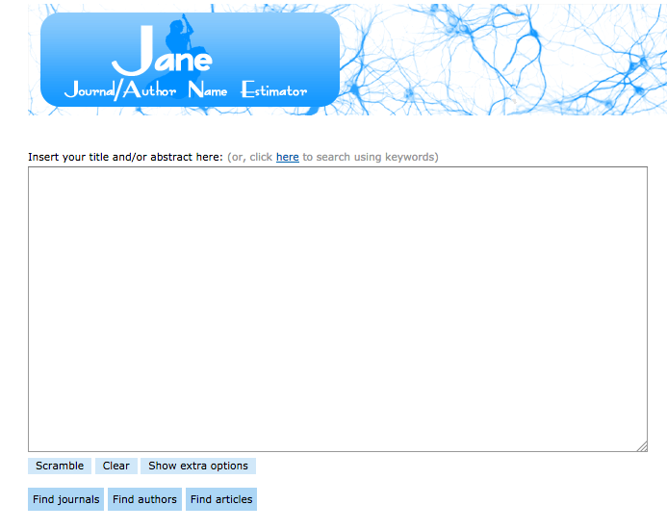

Slide 15
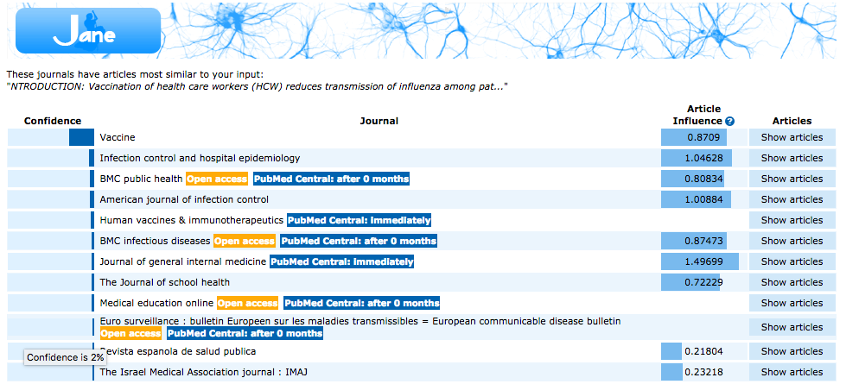

Slide 16
SCImago Journal Rankings (SJR)
http://www.scimagojr.com/
Free online portal ranking journals by subject area and specialty/discipline
  Includes both traditional & open access journals
Data originates from Scopus (Elsevier’s multidisciplinary research database)

Slide 17
SCImago Journal Rankings (SJR)
http://www.scimagojr.com/
Explore and rank journals in your field by:
  SJR indicator – average # of citations of articles published in the journal in the last 3 years
  H-index
  Total citations (over 3 year period)
  Average citations per published article

Slide 18
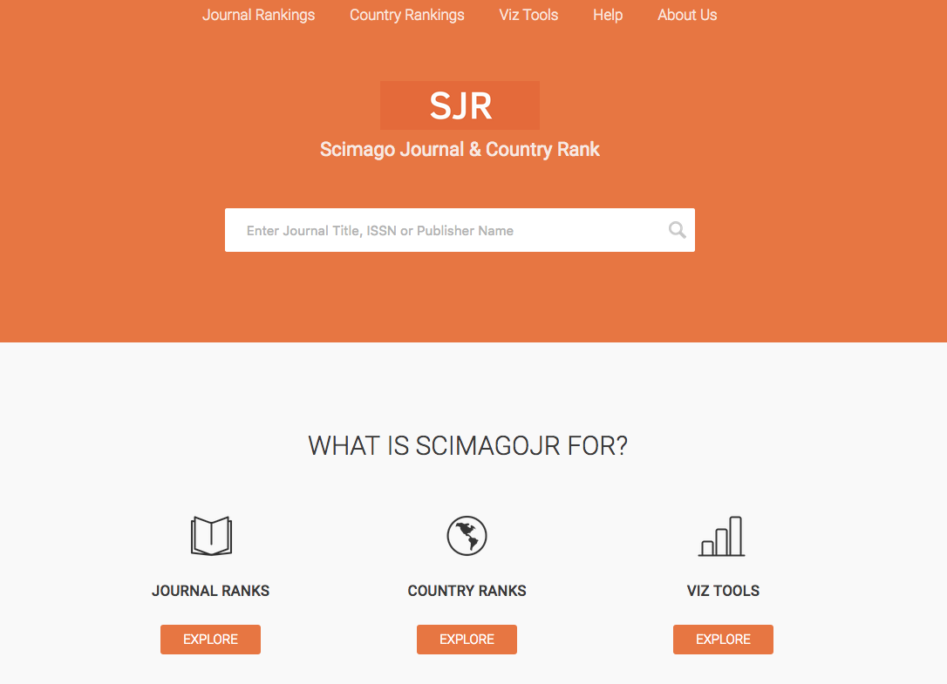

Slide 19
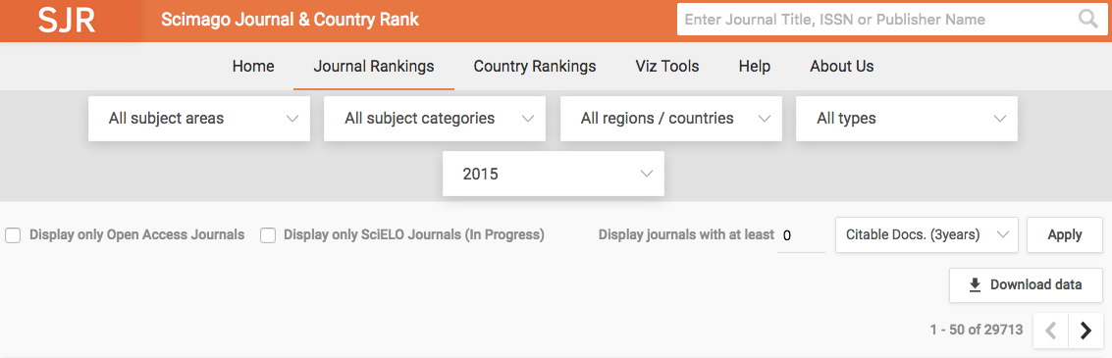

Slide 20
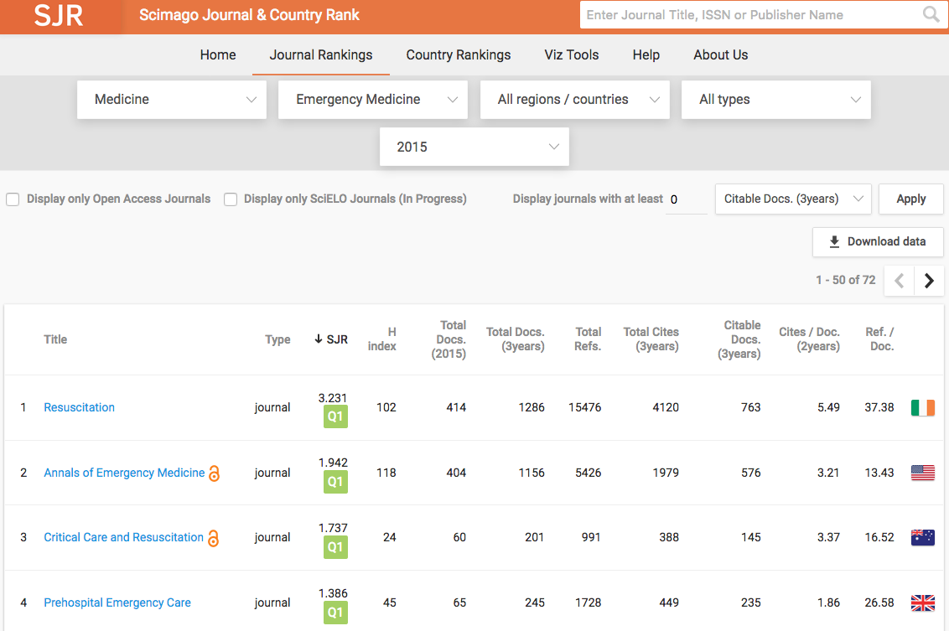

Slide 21
ACTIVITY 1: Locating Journals
Generate a list of journals using JANE
  Go to PubMed and search this article #: 26444861
  Copy & paste the abstract into JANE at jane.biosemantics.org
Find a list of journals in the OB/GYN discipline using SJR at scimagojr.com
How do the journals listed compare?

Slide 22
Assessing OA Journals

Slide 23
Spectrum of ‘Authentic’ Publishing
Authentic
Possibly Predatory
Probably Predatory
Confirmed Predatory
(Adapted from Beall 2015)

Slide 24
Defining Predatory
Predatory = publishers/journals whose sole concern is collecting $$$$$ and providing rapid publishing without peer review
Aka pseudo-journals
Predatory publishing has skyrocketed in the last decade
  Coincided with the push for open access (OA) publishing as scammers are taking advantage of the OA model
  Stigmatized serious OA journals
(Shen & Bjork 2015)

Slide 25
Why Discuss Predatory Publishers?
We all are under pressure to increase our ‘impact’ and gain recognition in our field, particularly for promotion
BUT, article acceptance rates are extremely low and it may take years to be ‘recognized’
Just to build our portfolio, we might be tempted to:
  Submit our articles to journals we’ve never heard of
  Agree to sit on editorial boards or be reviewers for those journals

Slide 26
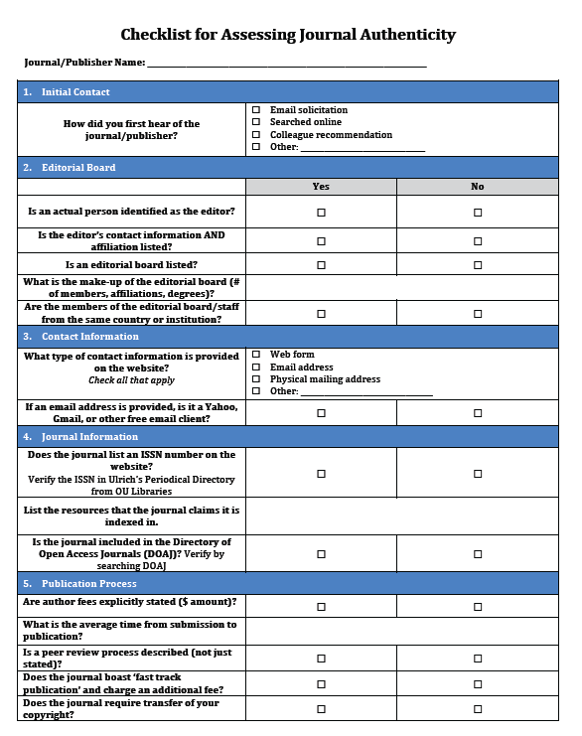

Slide 27
DOAJ Requirements for Inclusion
All content must be available for free without delay
Each published article must have its own unique URL
Journal must have an ISSN number
Journal homepage must include:
  Links to current and past/archive issues
  Search & browse capabilities
  About webpage
  Editorial Board information
  Contact Us
(Directory of Open Access Journals 2016)

Slide 28
DOAJ Requirements cont.
Editorial Board information must include:
  Current Editor (name, affiliation, email)
  Name of each editorial board member
Clearly described peer review process and links to author guidelines on journal homepage
Disclosure of publishing fees
(Directory of Open Access Journals 2016)

Slide 29
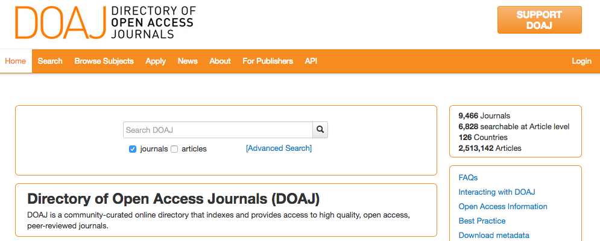

Slide 30

ACTIVITY 2: Assessing Journals
Go to the Journal of Gynecology Research website at: http://bit.ly/2sbnI2J
Complete the ‘Checklist for Assessing Journal Authenticity’
Image: Amanda Mills/CDC, Public Health Image Library
http://phil.cdc.gov (public domain)

Slide 31

OA Fund Pilot Programs
Kresge Library & OUWB Medical Library launched pilot programs last year to help fund APF for faculty publishing in OA journals or traditional journals with OA options
KL OA fund 2016-17 | Amounts
Total Amount Requested | $28,465.00
Total Amount Paid | $17,740.00
Average amount paid | $1,364.62
Minimum payment | $350
Maximum payment | $4,200
Med Lib OA fund 2015-17 | Amounts
Total Amount Requested | $9,737.77
Total Amount Paid | $9,259.77
Average amount paid | $973.78
Minimum payment | $435
Maximum payment | $1,823
Find out more on each library’s website

Slide 32
Journal Names | Publisher | OA Type
BMC Public Health | BioMed Central | Gold Open
Cogent Engineering | Cogent (T&F imprint) | Gold Open
Cogent Environmental Science | Cogent (T&F imprint) | Gold Open
Colloids and Surfaces B: Biointerfaces | Elsevier | hybrid
Communication and Critical/Cultural Studies | Taylor & Francis | hybrid
Frontiers in Physiology | Frontiers | Gold Open
International Journal of Medical Education | IJME | Gold Open
Journal of Biological Chemistry | American Society for Biochemistry and Molecular Biology | Gold Open
Journal of Cytology & Histology | OMICS International | Gold Open
Journal of Patient-Reported Outcomes | International Society for Quality of Life Research | Gold Open
Journal of Visualized Experiments (JOVE) | JOVE - video publication | hybrid
Medical Science Monitor Basic Research | International Scientific Information | Gold Open
Oncotarget | Impact Journals | Gold Open
PLOS ONE | PLoS | Gold Open
PLOS Genetics | PLoS | Gold Open
Stem Cell Research | Elsevier | Gold Open
Wiley Interdisciplinary Reviews: Computational Statistics | Wiley- WIREs | hybrid

Slide 33
OA Resources at OU Libraries
Kresge Library:
  Scholarly Communication Services: https://library.oakland.edu/services/scholarly-communication/
  Open Access Fund Pilot Program: https://library.oakland.edu/services/scholarly-communication/OAFund.html
OUWB Medical Library:
  Open Access Grant Program: https://medlib.oakland.edu/services/oa_grant.php

Slide 34
Summary
Searching OA literature has a number of benefits including expanding results, increasing transparency, & reducing redundancy
Selecting journals to publish in can be a daunting task, but there are several strategies & resources to help!
Take the time to assess journals before submitting a manuscript or agreeing to be a reviewer or editor
  Use the checklist provided today as a starting point
When in doubt, contact your librarian!

Slide 35

Photo Courtesy: Question Question Mark Request Matter Requests by geralt, Pixabay, http://pixabay.com/en/question-question-mark-request-63916/ (public domain)

Slide 36
References
Beall J. Criteria for Determining Predatory Open-Access Publishers. 3e. https://scholarlyoa.files.wordpress.com/2015/01/criteria-2015.pdf. Accessed October 6, 2016.
Directory of Open Access Journals (DOAJ). Information for Publishers. https://doaj.org/publishers. Accessed October 6, 2016.
Shen C, Bjork BC.‘Predatory’ open access: a longitudinal study of article volumes and market characteristics. BMC Medicine. 2015;13:230.

