Slide 1
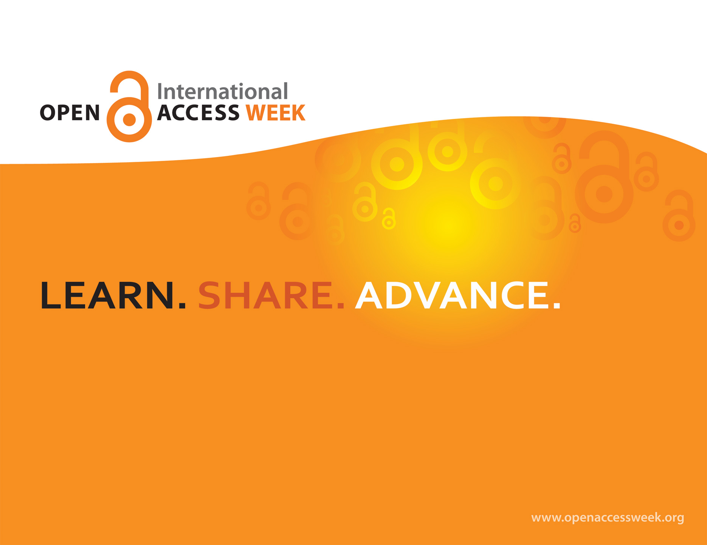

2015
Julia E. Rodriguez
Assistant Professor- Nursing, Health Sciences & Faculty Research Support Librarian, OU Libraries
juliar@Oakland.edu
This work is licensed under a Creative Commons Attribution-ShareAlike 4.0 International License.

Slide 2



ABOUT OA WEEK a global event promote the potential benefits of Open Access and to help inspire wider participation in helping to make Open Access a new norm in scholarship and research.
*Open Access (OA) is free, immediate access to scholarly information online, along with the right to use and reuse that information. (SPARC)
*OA removes price barriers (subscriptions, licensing fees, pay-per-view fees) and permission barriers (most copyright and licensing restrictions).
Peter Suber from the Budapest Open Access Initiative, 2002
JR

Slide 3


Traditional Publishing - vs - Open Access
TRADITIONAL
OA
Pay to read
Restricted access
  Library subscriptions
  Personal subscriptions
Limited peer review
NOT free to use/reuse
Delayed publishing cycle
  Long turnaround from research – submission – publication
Some publishing fees
Free to read
Widely available
Unlimited peer review/sharing/collaborating
Often free to use/reuse
Shorter publishing cycle
Some publishing fees

Slide 4
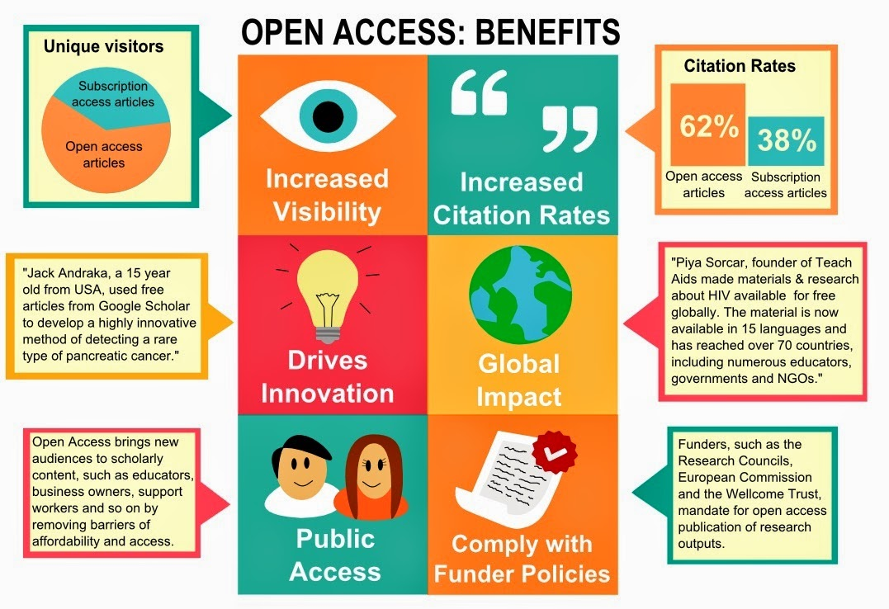
Image credit: http://www.aston.ac.uk/EasySiteWeb/GatewayLink.aspx?alId=221535 (1)

Slide 5
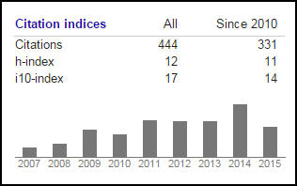
GETTING CITED:
Increase Your Impact with Open Access Repositories & Social Media
Julia E. Rodriguez
Assistant Professor- Nursing, Health Sciences &
Faculty Research Support Librarian, OU Libraries
juliar@Oakland.edu

Slide 6
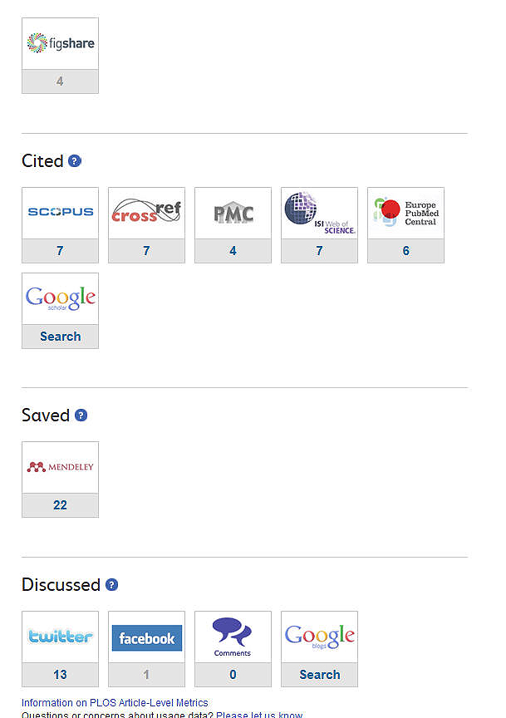
Outline
Increase Exposure
OA repositories
Academic online communities
Social media as publicity
Who has cited you?
  Finding citations
  Tools

Slide 7
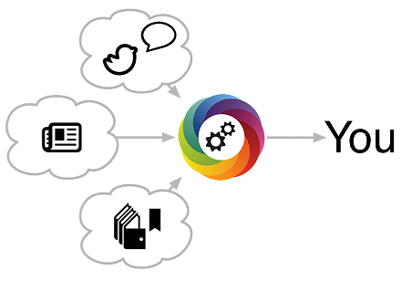
Increasing your exposure
Online repositories, profiles and communities
Open Access Institutional repositories
Online profiles
Scholarly communities
Reference managers
Social Media & publicity sites

Slide 8

Author rights and OA
  Retain rights to post a copy or preprint of article online – ALWAYS inspect publishing agreement
  Publish in OA journals that use
  Creative Commons licenses
    See Author’s rights guide on OU website guide>http://tinyurl.com/c2tsop7

Slide 9

Institutional Repositories
    Institutional Repositories are “digital collections capturing and preserving the intellectual output of a single or multi-university community”
    (SPARC 2002 Position Paper- The Case for Institutional Repositories)
1. Maximize the impact and visibility of your published research.
2. Provide a permanent space to archive and disseminate publications, presentations, data sets.
3. Archive conferences recordings, presentation slides.
4. Promote high visibility in Google and Google Scholar.
5. Enable easy distribution of your work.
Notes:
1. Maximize the impact and visibility of your published research. Open access articles are viewed and cited more frequently, thereby having the potential to increase an article’s impact.
2. Provide a permanent space to archive and disseminate publications, presentations, data sets, or any research/scholarly output with permanent, fixed URLs that won’t change or disappear.
3. Archive conferences recordings, presentation slides, and other supporting materials hosted and sponsored by Oakland University can be archived in OUR@Oakland.
4. Promote high visibility in Google and Google Scholar with an indexed and optimized system
5. Enable easy distribution of your work. OUR@Oakland doesn’t ask for your copyright, just for your permission to distribute your work freely.

Slide 10
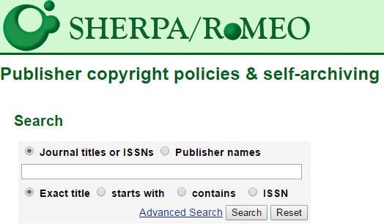
How do I submit my research?
Send us your scholarship citations and we will send you a report of eligible scholarship for archiving in OUR@Oakland.
Link available on OUR@Oakland Faculty scholarship page.

Slide 11

Disciplinary repositories
OA Directory maintains a list - http://oad.simmons.edu/oadwiki/Disciplinary_repositories
Science
arXiv.org
Physics, Mathematics, Computer Science, Quantitative Biology, Quantitative Finance and Statistics. Hosted by Cornell University Library.
PubMed Central
U.S. National Institutes of Health (NIH) All research funded by the NIH now goes into PMC, with a maximum embargo period of 12 months.
Social Science
Social Science Research Network (SSRN)
SSRN is devoted to the rapid worldwide dissemination of social science research and is composed of a number of specialized research networks in each of the social sciences.

Slide 12
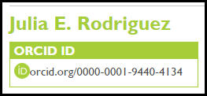

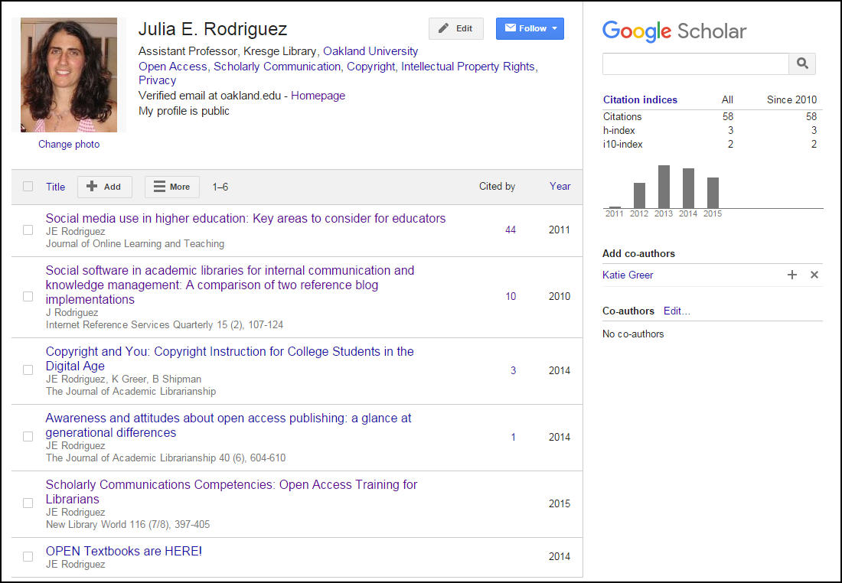
Online profiles
Establish a researcher id– persistent digital identifier for you links all your publications
ORCiD – non-profit
ResearcherID – Web of Science
Google Scholar-My Citations
Publisher website profiles

Slide 13

Online Communities
(Scholarly Networks)
Role of communities (2)
Work can be created in open forums for others to comment, note and promote (via social media).
Broadens access beyond the research community to include all potential stakeholders (funders, policymakers, potential beneficiaries).
Generates wider engagement and collaboration.
Shared knowledge can help to shorten the research cycle and the
route to potentially life-saving discoveries
Facilitate research collaboration and enhance scholarly communication.
Found to predominantly perform the passive role of an online business card.(3)
Photo source:http://www.nmspacecenter.com/2013/06

Slide 14

Online Communities
(Scholarly Networks)
Academia – multi-disciplinary community
ResearchGate – heavily science based –collaboration
Labroots - scientific -producer of educational virtual events and webinars
Reference manager and more
Mendeley, Zotero
Tools for researchers blog
Photo source:http://www.nmspacecenter.com/2013/06
Notes:
Mendeley -A platform comprising a social network, reference manager, article visualization tools
Find discipline specific community:

Slide 15

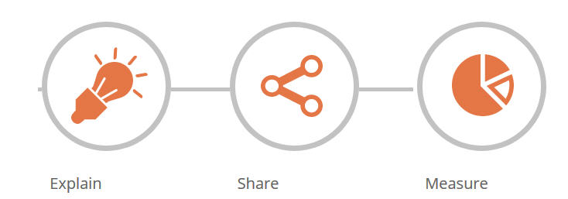

Social Media
Transform journal articles into an easy-to-understand Scinopsis (scientific synopsis) for everyone to learn and enjoy.
Kudos is a web-based service that helps researchers and their institutions and funders to maximize the visibility and impact of their published articles.
Twitter – social networking and quick new releases, self promotion tool

Slide 16
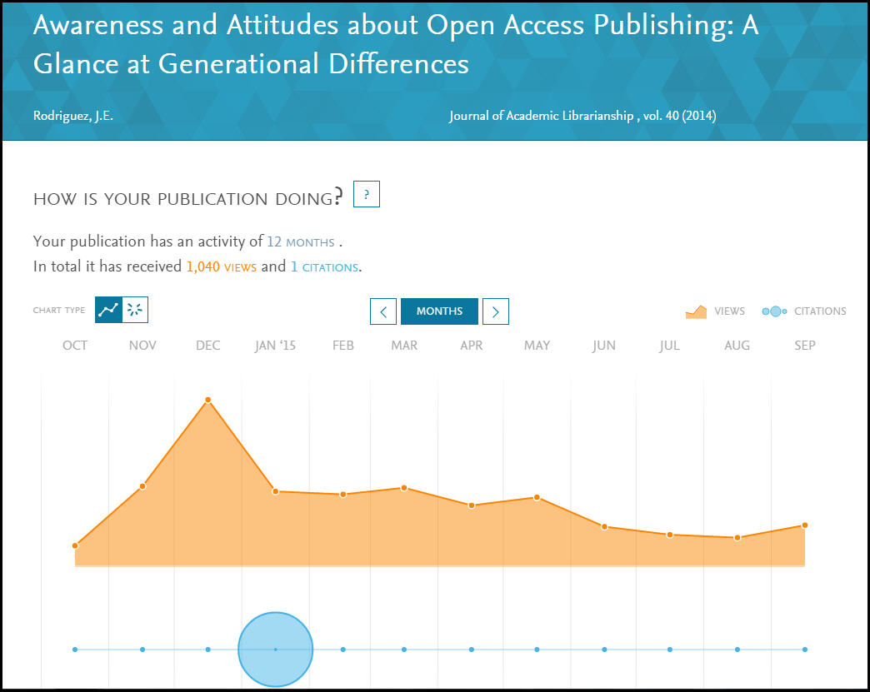
Whose cited you?
Cited reference searching- Finding citations
  Scopus (OU database)
  Web of Science – JCR (OU database)
  Google Scholar
  Other discipline databases
  Publisher Author’s dashboards

Slide 17
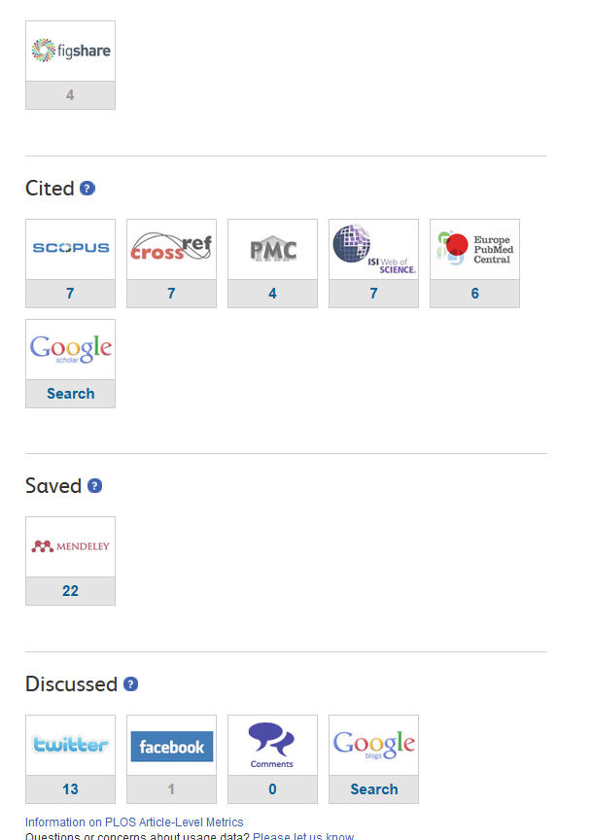
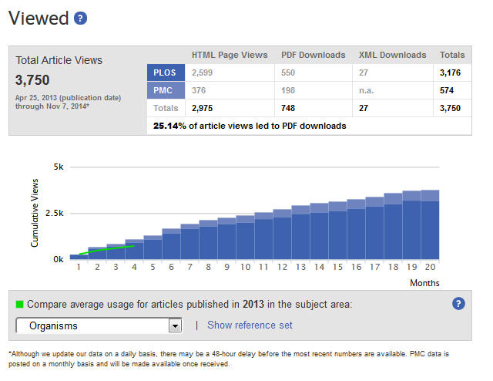
PLOS ONE
Article level metrics

Slide 18
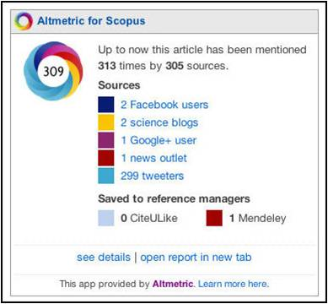
Altmetrics
Quantifiable data
usage
social bookmarking and dissemination activity
citations
media and blog coverage
discussion activity and ratings
    Mendeley
    Zotero
    Facebook
    Twitter…
Notes:
Example : Beyond alcohol and drug addiction. Does the negative trait of low distress tolerance have an association with overeating
http://www.plumanalytics.com/metrics.html

Slide 19
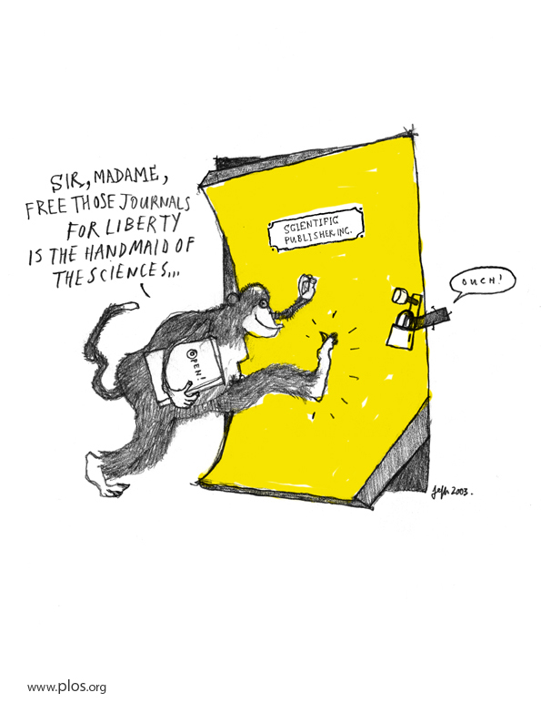

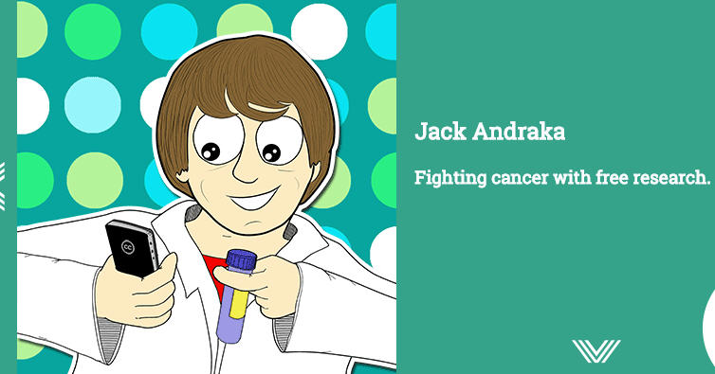

http://teamopen.cc/all/#science
Smartphone become a microscope

Slide 20

Photo Courtesy: Question Question Mark Request Matter Requests by geralt, Pixabay, http://pixabay.com/en/question-question-mark-request-63916/ (public domain)
Notes:
Academia.edu is a website where researchers can post their articles and discover andread articles posted by others. It combines the archival role of repositories like ArXiv,SSRN, or PubMed with social networking features, such as proﬁles, news feeds, recom-mendations,andtheabilitytofollowindividualsandtopics. Thesitelaunchedin2008and as of April 2015 has approximately 20 million registered users who have uploadedapproximately ﬁve million articles. Registration on the site is free and users can freelydownloadallpaperspostedtothesite

Slide 21
References
1. Benefits of OA. Australian Open Access Support Group. Retrieved from:
http://aoasg.org.au/resources/benefits-of-open-access/
2. Taylor, M. (14 Feb. 2013) How virtual science communities are transforming academic research. Retrieved from:
https://www.elsevier.com/connect/how-virtual-science-communities-are-transforming-academic-research
3. Jordan, K. (2014) Academics and their online networks: Exploring the role of academic social networking sites
First Monday, Vo. 19, No. 11. doi: http://dx.doi.org/10.5210/fm.v19i11.4937
http://firstmonday.org/ojs/index.php/fm/article/view/4937/4159
Additional Reading:
PLOS - List of Tools & Services http://article-level-metrics.plos.org/alt-metrics/
Swan, A. (2010) The Open Access citation advantage: Studies and results to date. Technical Report , School of Electronics & Computer Science, University of Southampton. Retrieved from http://eprints.ecs.soton.ac.uk/18516/2/Citation_advantage_paper.pdf
Hitchcock, S. (2011) The effect of open access and downloads ('hits') on citation impact: a bibliography of studies. The Open Citation Project - Reference Linking and Citation Analysis for Open Archives. retrieved from http://opcit.eprints.org/oacitation-biblio.html

