Slide 1
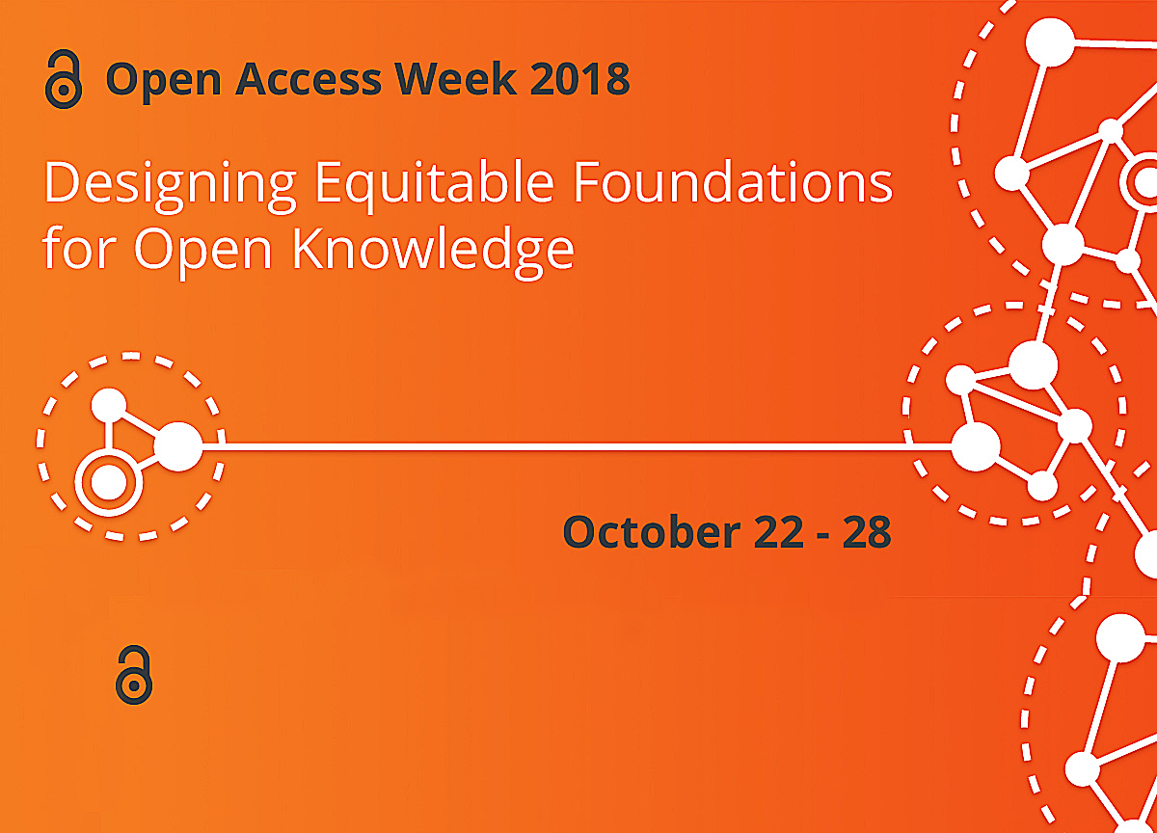

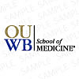
SPONSORED by Oakland University Libraries and OUWB School of Medicine

Slide 2
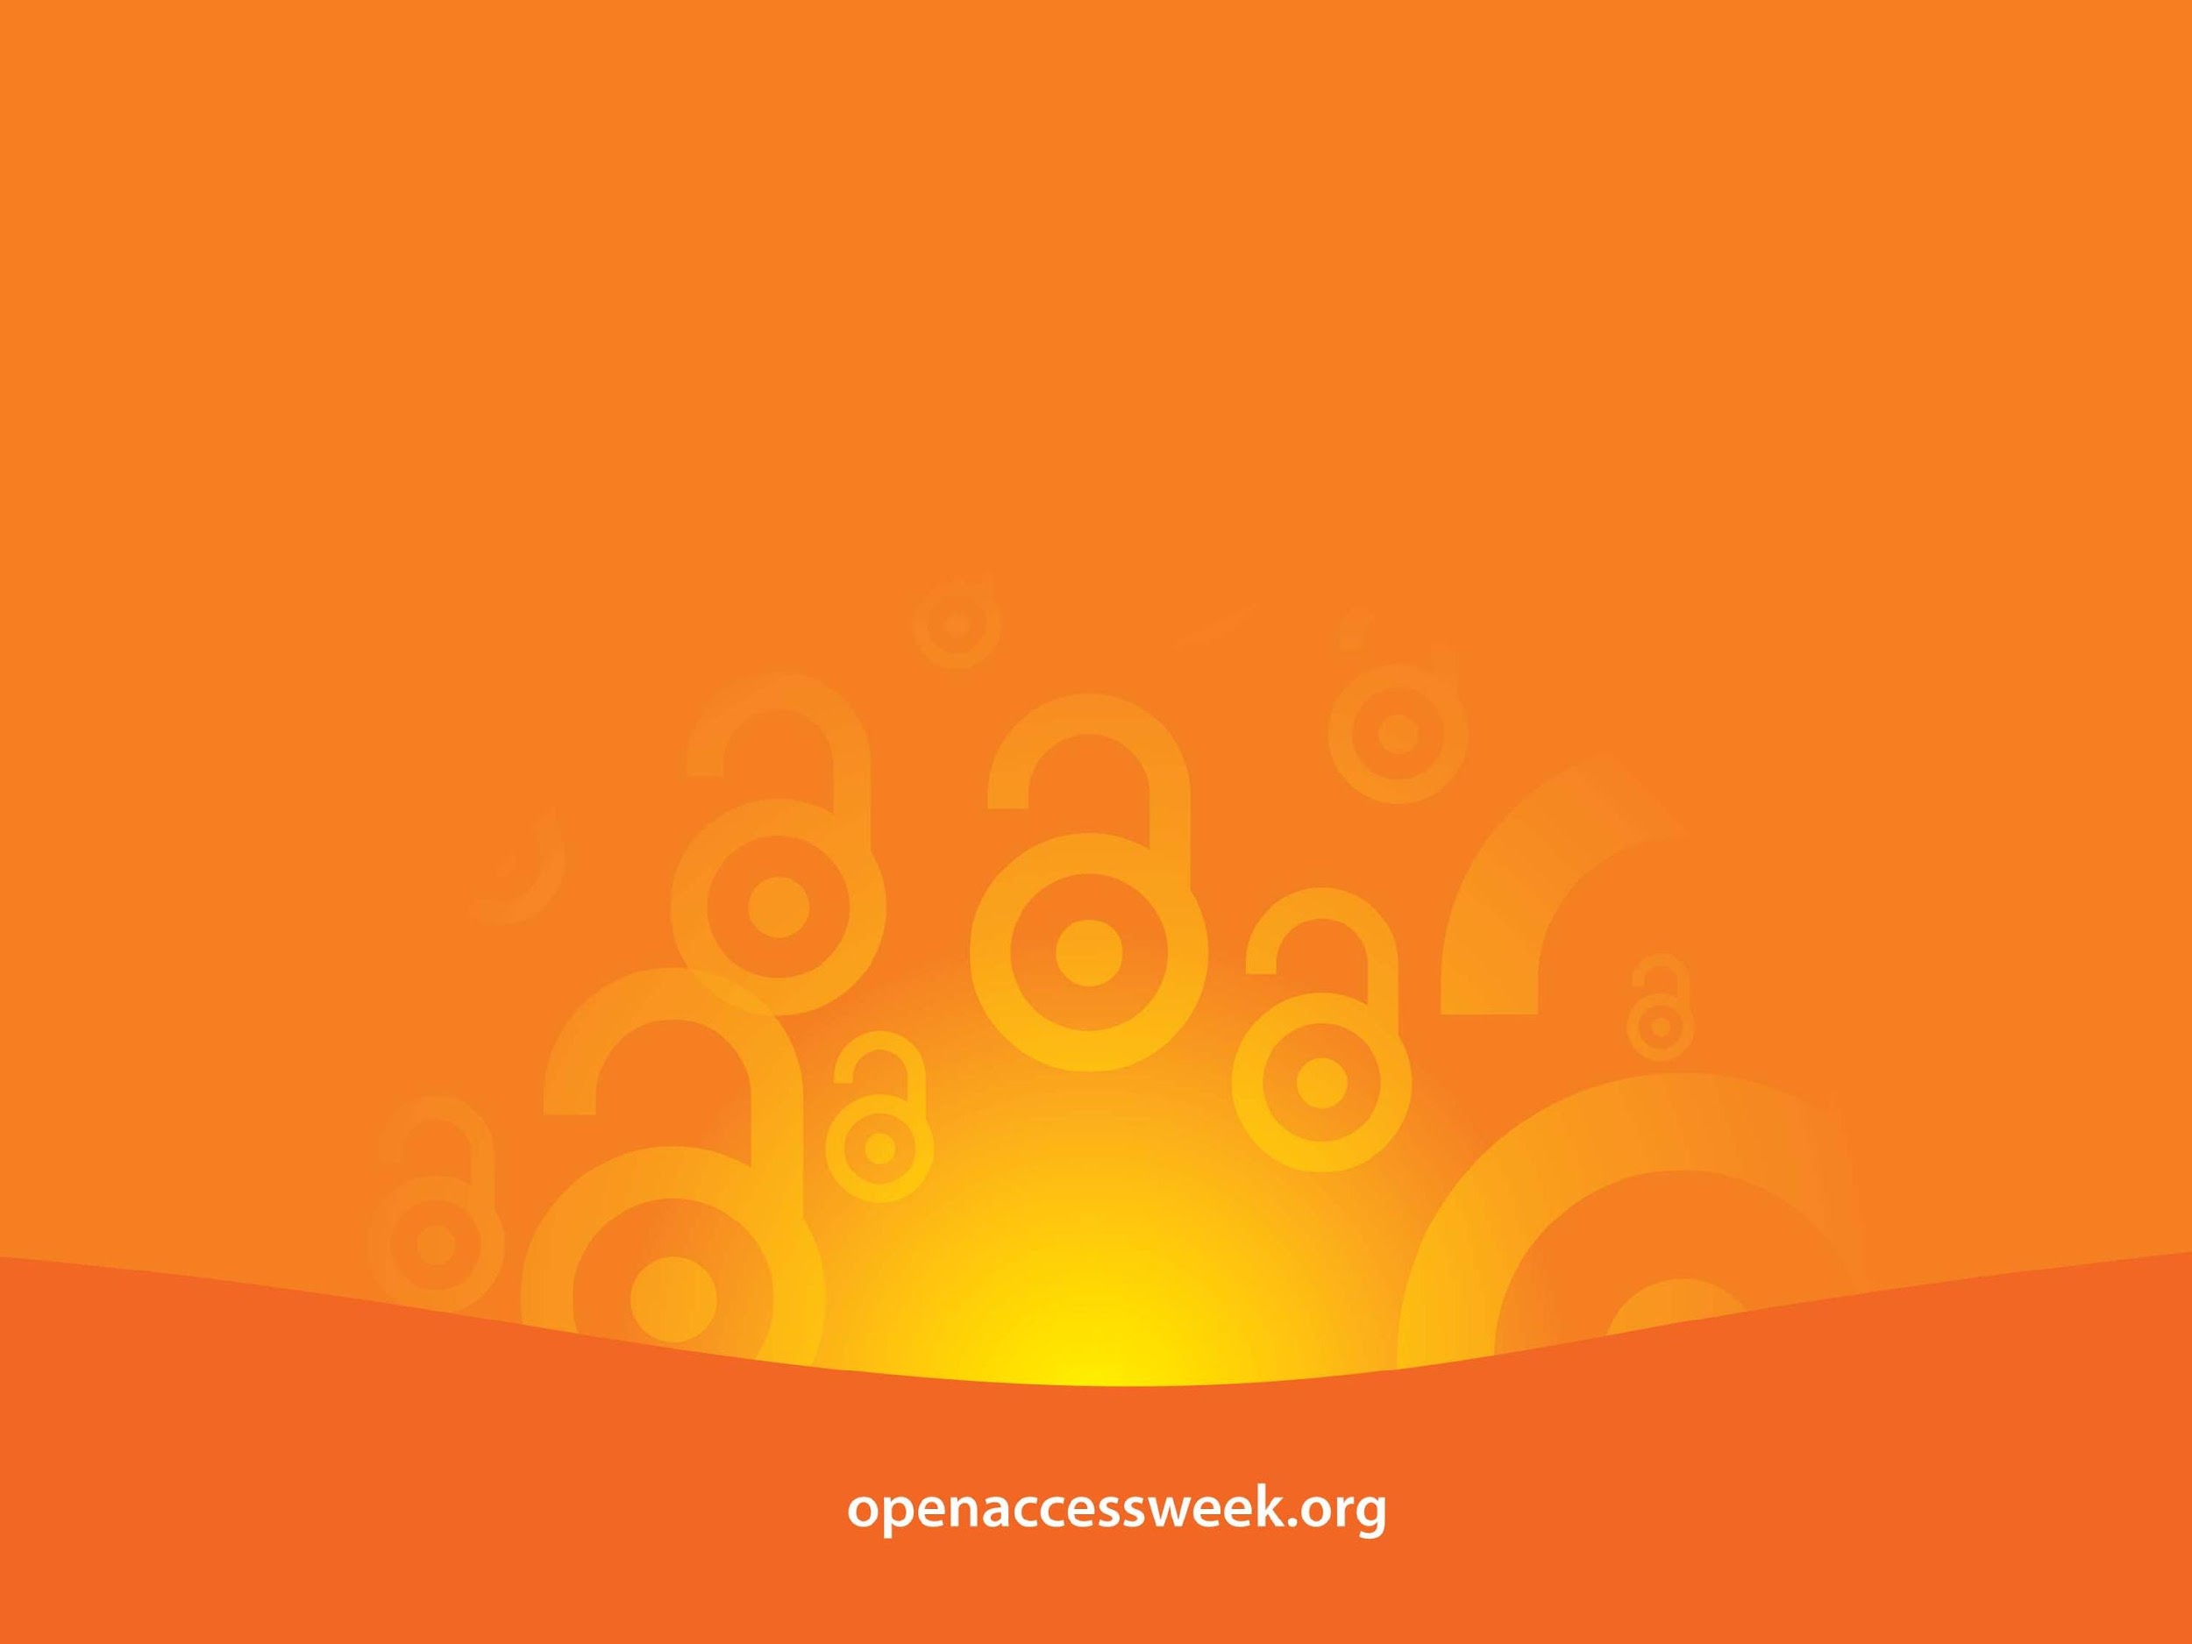
*Open Access (OA) is free, immediate access to scholarly information online, along with the right to use and reuse that information. (SPARC)
OA WEEK is a global event to promote the potential benefits of Open Access and to help inspire wider participation in helping to make Open Access a new norm in scholarship and research.

Slide 3

OPEN =
Free to read
Widely available
Unlimited peer-review/ sharing/ collaborating
Free to use/reuse
Shorter publishing cycle
Great Discoverability

Slide 4

Documentary Screening Party for Paywall: The Business of Scholarship
Film by Jason Schmitt, documentary filmmaker and producer and associate professor of Communication and Media at Clarkson University in Potsdam, N.Y.
“paywalls hinder innovation by creating barriers to accessing knowledge”

Slide 5

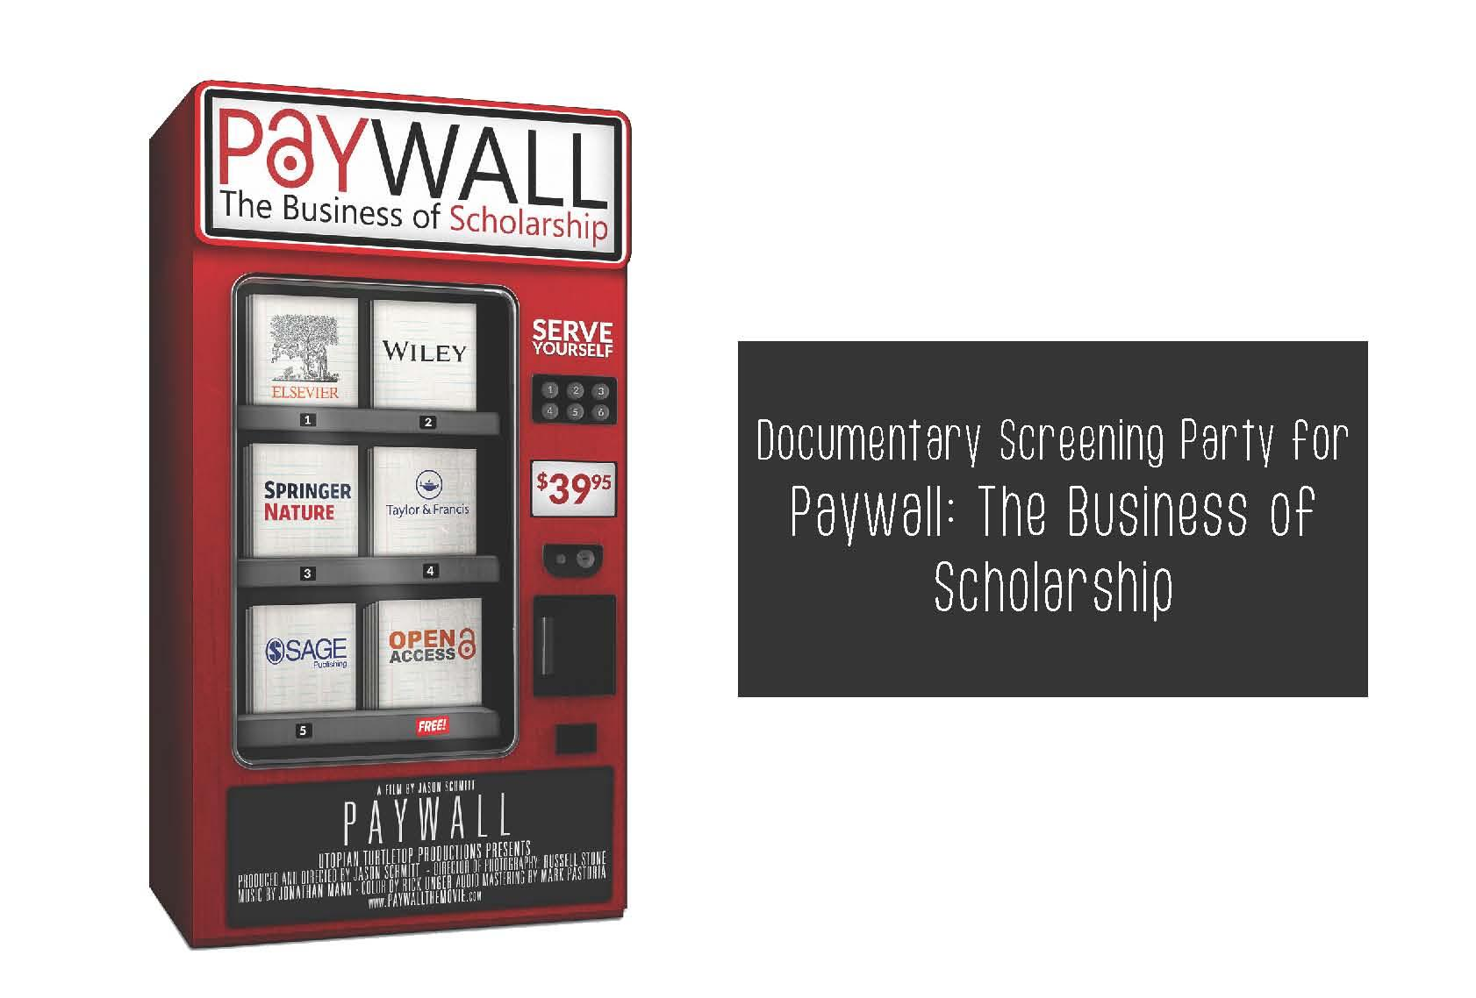
https://paywallthemovie.com/

