Slide 1
“The mail never stops. It just keeps coming and coming and coming...”
Providing Research Support and Instruction to High-enrollment Programs
Presenters: Julia E Rodriguez, Nursing, Health Sciences & Scholarly Communications Librarian, Oakland University
Elizabeth R. Bucciarelli, Health Sciences Librarian & Liaison Librarian Team Leader, Eastern Michigan University
Michigan Academic Library Association Annual Conference - East Lansing, MI - May 17, 2018

Slide 2
Origins of the Partnership
Health science and nursing librarians are often ‘lone wolves’ on campus
OU-EMU Instructional Exchange
  Faculty status with non-scheduled summers
  Similar challenges regarding meeting faculty & student research needs
Benefits of the partnership

Slide 3
Outline of Discussion
The Problem - too many students and programs, not enough time
Strategies - Myriad solutions applied
Results - Less repetition, greater sanity, extended access
Sustainability - Questionable but doable
Notes:
‘Extended access’ - Is this for the students, i.e., the support resources that we provide can be used )for the most part) 24/7 ; Or does this pertain to us, that we, as teachers, are able to extend our access via these methods? Both?

Slide 4

The Problem - Overview
Positive job outlook for healthcare professionals- 18% 2016-2018 (https://www.bls.gov/ooh/healthcare/home.htm)
  Number of masters & PhD programs is expanding as the health professions move towards graduate degrees as terminal degrees, e.g., physician assistants, physical therapy, doctor of nursing practice
Undergraduate and graduate students
  Providing research support for year-round enrollment
Notes:
Year round enrollment in PA, DNP, RN-BSN- various forms of this program ; information literacy
Reduced librarian staffing during the Summer semester
Online RN-BSN program with year-round revolving enrollment

Slide 5
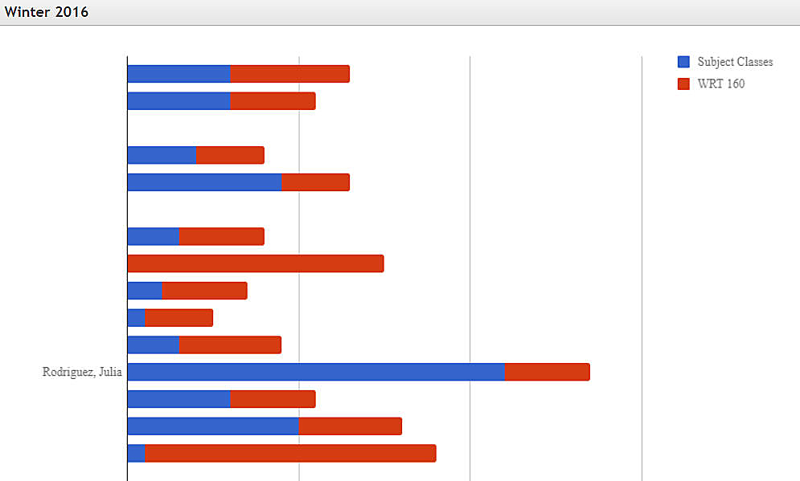
The Problem - Quantity
Provide support for 4,000+ students per semester
Multiple course sections requires a multifaceted approach
Variety of program formats
  Traditional two year
  Accelerated 1.5 year
  Hybrid
  Fully-online
Notes:
EMU Fall 2017 headcount - undergrads=3,800 + grads=601 (not Social Work) =4,400

Slide 6
The Problem - Learning
How to meet the learning styles and needs of large numbers of students
  High number of returning students, non-traditional, full-time employed, part-time, parents, veterans
  Limited exposure to
    Research terminology
    Research skills
    Project formats- posters, slide presentations, papers

Slide 7
The Problem - Graduate Student Needs
Graduate student research questions require more librarian time
  Developing the multi-part research question
  Locating higher-level resources
  Locating a variety of resources
  Accessing resources
  Evaluating higher-level resources
Notes:
Advising re: developing research questions (PICOT)
Some students are not local & we are instructing via Skype or phone ; interpreting the research level skills of the student
Librarians have to rearrange their schedules for those students who want to meet in-person, e.g., evening consultation hours

Slide 8
Strategies
Research Instruction
Technology
Pedagogical Approaches
Individualized Research Support
Technology
Face-to-Face

Slide 9
Strategies - Research Instruction
TECHNOLOGY
Self-enrollable general content short courses with badges
  Universal topics; plagiarism, Introduction to library research, Data Literacy
Open tutorials with or without badges
  General topics, how to select a database
Subject and course targeted research tools
  Course guides, Nursing Toolkit
Notes:
myriad of strategies used to provide both in-person and online research instruction for undergraduate and graduate students, including: short videos for FAQs and class assignments; train-the-trainer instruction; course-targeted research tools; and self-enrollable short courses and learning modules integrated into the campus learning management system.

Slide 10

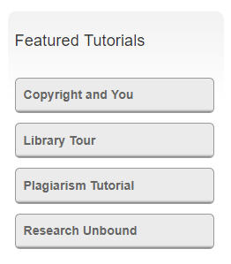
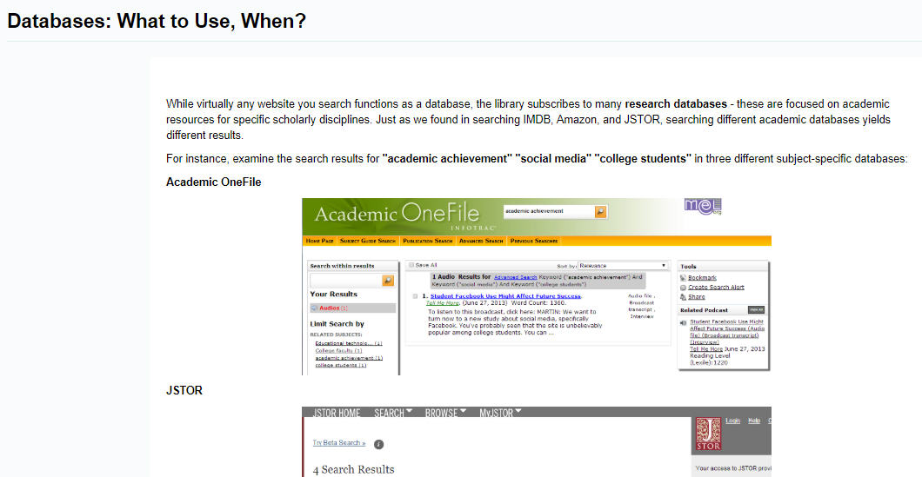
Self-enrollable Short Courses with Badges - Example

Slide 11

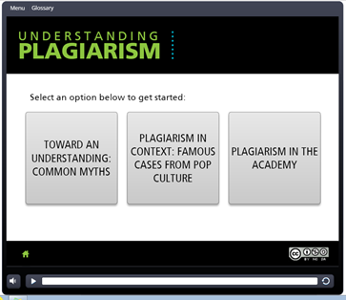
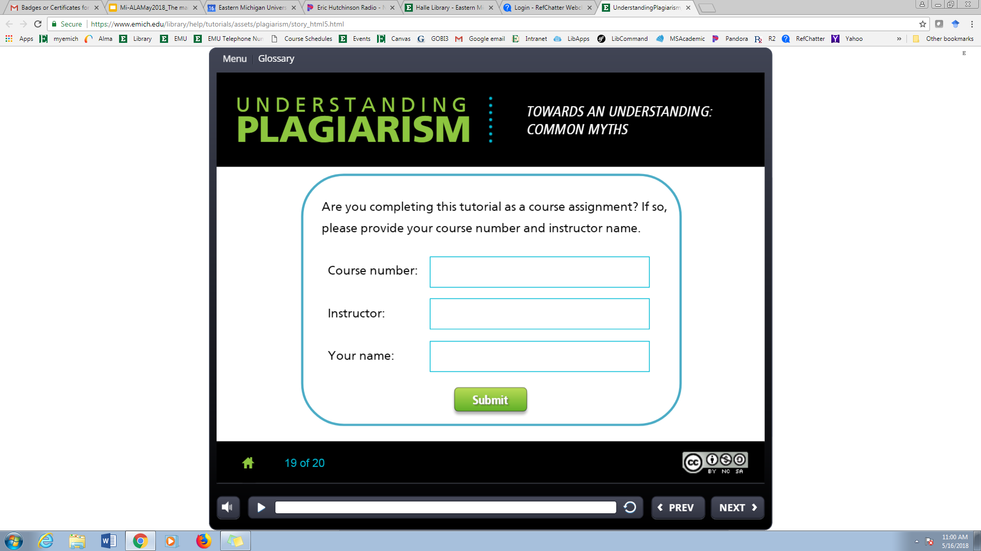
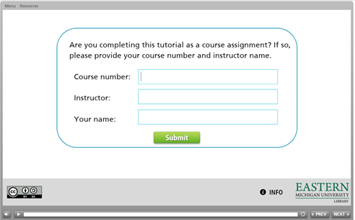
Data Literacy & Plagiarism Tutorials-Optional Badges

Slide 12
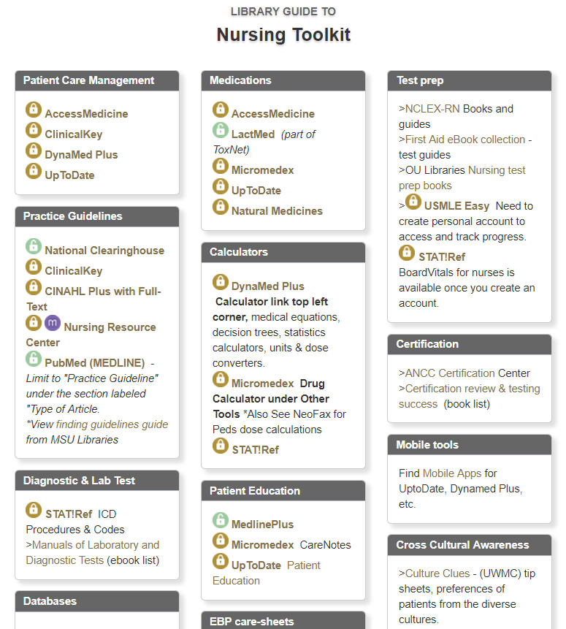
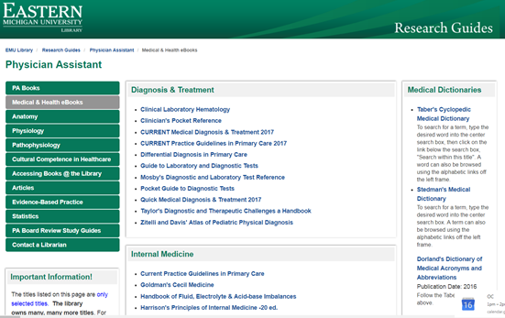
Discipline & Course Targeted Research Tools - Examples
Notes:
Subject guides auto feed into courses. If a course guide is available that appears. OU has to put guides in on request.

Slide 13
Strategies: Research Instruction
Technology
Short videos for FAQs and class assignments
Learning modules integrated into the campus learning management system
Notes:
myriad of strategies used to provide both in-person and online research instruction for undergraduate and graduate students, including: short videos for FAQs and class assignments; train-the-trainer instruction; course-targeted research tools; and self-enrollable short courses and learning modules integrated into the campus learning management system.

Slide 14
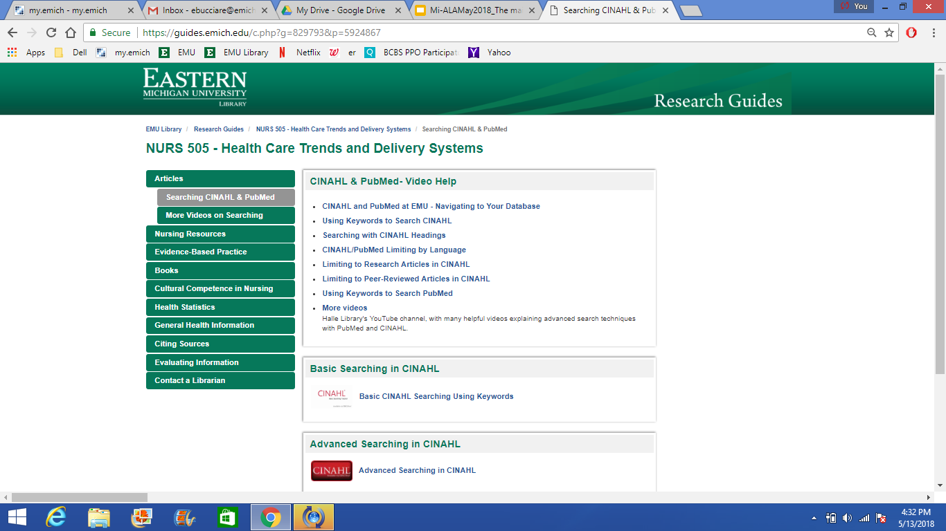
Short Videos for FAQs - Example

Slide 15
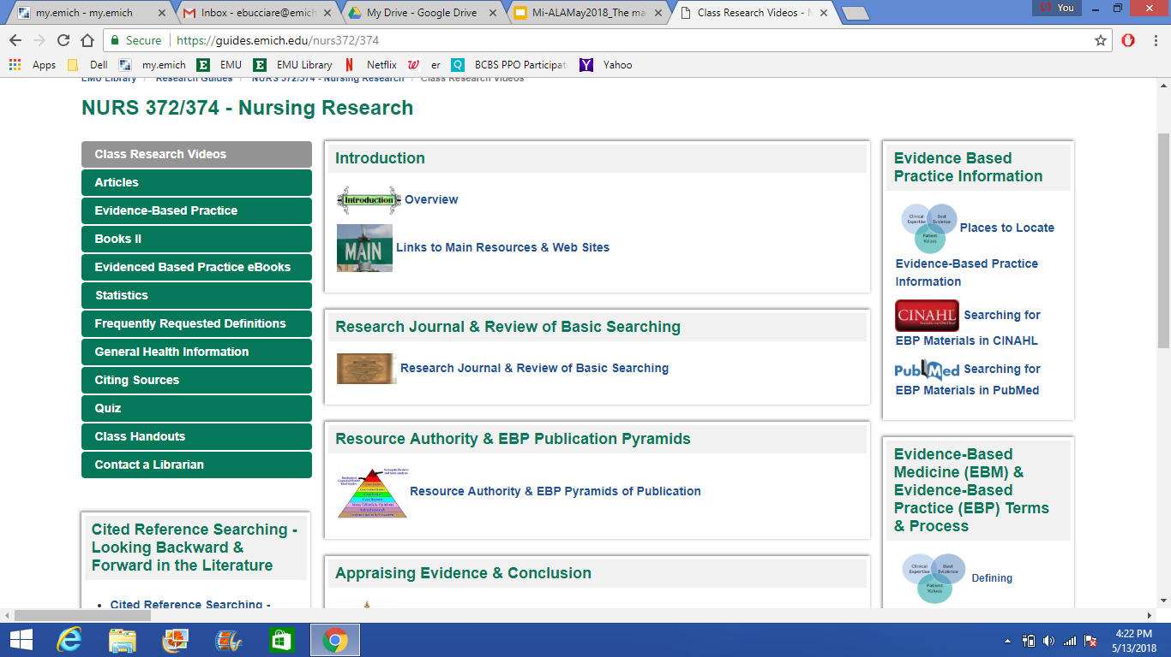
Short Videos for Class Assignments - Example
Notes:
Panopto videos separated into small segments
Users can watch shorter clips
I can record new segments as the assignment changes without recording a whole new three hour piece

Slide 16
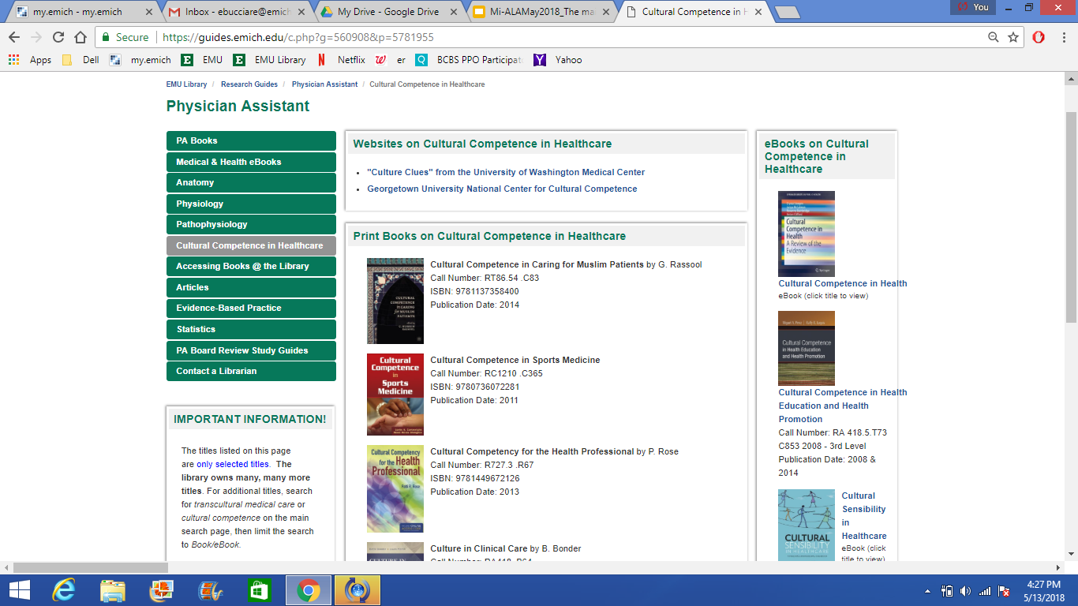
Research Guide for FAQs - Example

Slide 17
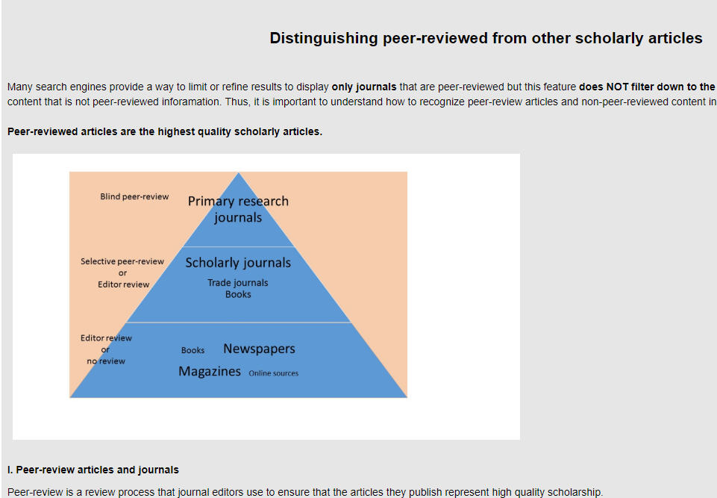
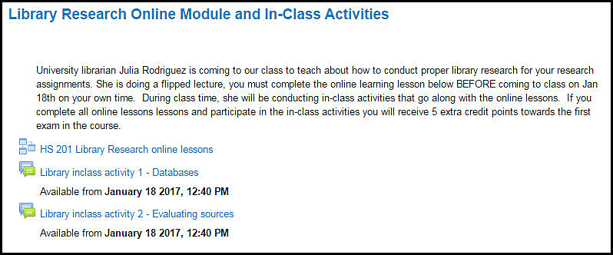
Learning Modules Integrated into the Learning Management System - Example

Slide 18
Strategies: Research Instruction
Pedagogical Approaches
Addressing different learning styles
Techniques:
Flipped classroom model - online modules completed before class
Required scheduled librarian consultation hours in program-based building for group assignments
Required librarian consultation hours scheduled in the classroom for a group assignment; co-teaching structure
Notes:
myriad of strategies used to provide both in-person and online research instruction for undergraduate and graduate students, including: short videos for FAQs and class assignments; train-the-trainer instruction; course-targeted research tools; and self-enrollable short courses and learning modules integrated into the campus learning management system.
Flipped classroom model - HLAD 315- pre-assignment that is handed in for a grade; we meet and discuss specific searches in-class - took class more seriously; increase in student learning
Scheduled librarian consultation hours -
PAS 670 - ‘office hours’ in their building with a print sign-up sheet, 2-hour block to allow for students from other programs to schedule appointments
OCTH 540 - 3 hours and most questions are answered ; now NURS 640

Slide 19
Occupational Therapy Research Course
Session #1 - Meet with the two combined classes in the very early weeks of the semester
Database exploration exploration with in-class sharing
In-class small group exercise = research question database selection
Session #2 - Meet with each class separately, but located in adjacent classrooms; three hours total
Both the teaching faculty member and I meet with each small group at least once
Faculty member working with each group
Session #3 - Optional small group appointments using my electronic calendar

Slide 20
Physician Assistant Research Course
Assignment
Small groups of 3-4 students assigned to a pro or con stance on a controversial medical topic
Each small group required to meet with the librarian in-person at least once
Problem - Overwhelmed my appointment calendar to such a degree that students from other the health sciences programs were unable to make appointments for three weeks
Solution
Hold office hours for two hours immediately following the time slot for the PA research course in their building
Disseminate a sign-up sheet to the professor so student the groups can sign up for a single time slot until all groups have had an opportunity to meet with me at least once
Optional small group appointments using my electronic calendar

Slide 21
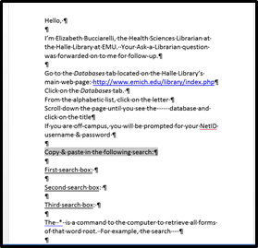
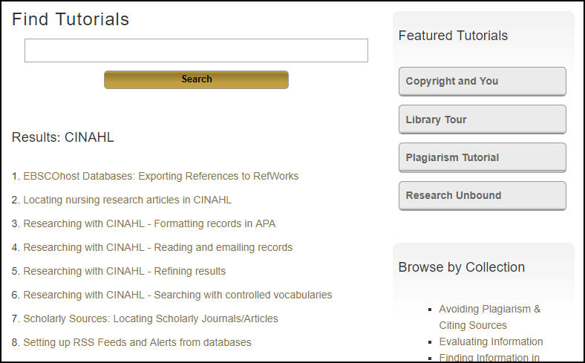
Strategies - Individualized Research Support
Technology
Template emails for FAQs
Electronic appointment scheduling with shorter appointment durations, e.g., 30 minutes instead of 60 minutes
Small group consultations
Telephone consultations
Online meetings
Searchable tutorials database
Notes:
providing personalized research support to the large numbers of students from both on and off campus, in multiple class sections and in hybrid/online only programs.
managing a high volume of students seeking assistance, and share strategies, including: template emails for FAQs; electronic appointment scheduling; group consultations; telephone consultations; online meetings and regularly scheduled workshops

Slide 22
Strategies - Individualized Research Support
Face-to-Face
Train-the-trainer instruction for FAQs:
  Librarians and reference desk staff
    Librarian meetings
  Program faculty
Regularly scheduled drop-in workshops
Partnership - Writing Center
Notes:
providing personalized research support to the large numbers of students from both on and off campus, in multiple class sections and in online only programs.
managing a high volume of students seeking assistance, and share strategies, including: template emails for FAQs; electronic appointment scheduling; group consultations; telephone consultations; online meetings and regularly scheduled workshops
Nurse patient ratio and safety, medication errors, patient falls

Slide 23
Strategies - Other Remedies
Ask (plead) for help
  Redistribute introductory undergraduate course research instruction to other librarians
Trained library student assistants and staff how to make referrals
Encourage the student to use the Academic Projects Center and virtual reference
Notes:
Learning to ask for help. It’s about the students.
Intro nursing course to Paula; intro health admin course to Bob
Referrals - email, business cards (decreases interuptions)

Slide 24
Sustainability - Technology
Guide maintenance
  Part-time lecture(s) trained to update guides
Videos need updating regularly
  Match changes of website/databases
  ADA - W3C compliance
Online modules
  Less internal links needing updating
  Need to adjust lessons to changing syllabi
  Problems with ‘giving away’ content - move to local system with badges?

Slide 25
Sustainability - Face-to-Face
Electronic appointment scheduling w/ shorter appointment durations
Small group consultations
Telephone / WebEx consultations
Regularly scheduled drop-in workshops
Train-the-trainer instruction
Partnership - Writing Center

Slide 26
Sustainability - Questionable but ….
Reaching out
Letting go...
Need many of these structures in place
Schools of Nursing require their own librarian subject specialist

Slide 27
Questions? Best Practices?
Julia E Rodriguez, Nursing, Health Sciences & Scholarly Communications Librarian, Oakland University ~ juliar@oakland.edu
Elizabeth R. Bucciarelli, Health Sciences Librarian & Liaison Team Leader, Eastern Michigan University ~ ebucciare@emich.edu

