Slide 1



SPONSORED by Oakland University Libraries and OUWB School of Medicine Library
Notes:
5 minutes - Welcome - Julia
15 minutes - Textbooks & Monographs - Julia
15 minutes - Open Data - Joanna
15 minutes - Open Research/Journals & Images - Stephanie

Slide 2

Open Access (OA) is free, immediate access to scholarly information online, along with the right to use and reuse that information (SPARC)
OA WEEK is a global event to promote the potential benefits of Open Access and to help inspire wider participation in helping to make Open Access a new norm in scholarship and research.

Slide 3

OPEN =
Free to read
Widely available
Unlimited peer-review/ sharing/ collaborating
Free to use/reuse
Shorter publishing cycle
Great Discoverability

Slide 4
Avoiding Unethical Publishers & Determining Journal Quality
Stephanie Swanberg, MSI, AHIP
Associate Professor, Information Literacy & eLearning Librarian
OUWB School of Medicine Library
swanberg@oakland.edu
Notes:
5 minutes - Welcome - Julia
15 minutes - Textbooks & Monographs - Julia
15 minutes - Open Data - Joanna
15 minutes - Open Journals & Images - Stephanie

Slide 5
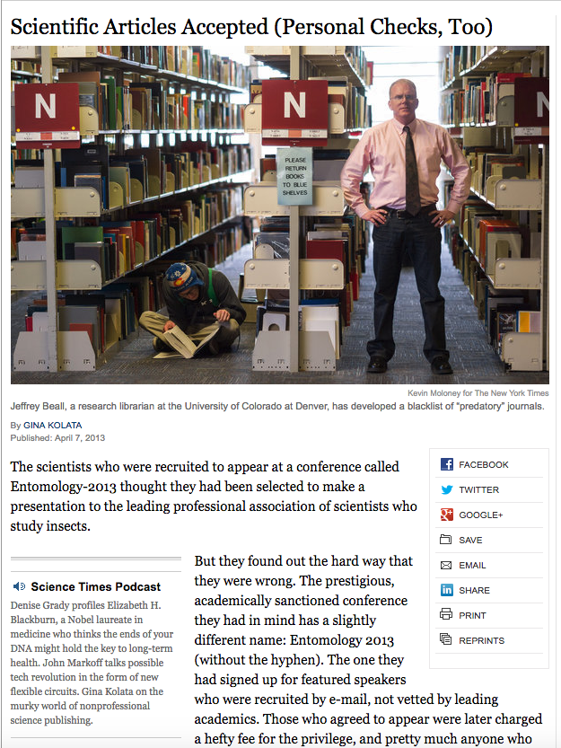
2013
The
New York
Times
Notes:
Kolata G. Scientific articles accepted (personal checks, too). The New York Times. 2013. https://archive.nytimes.com/www.nytimes.com/2013/04/08/health/for-scientists-an-exploding-world-of-pseudo-academia.html Accessed October 24, 2018.

Slide 6
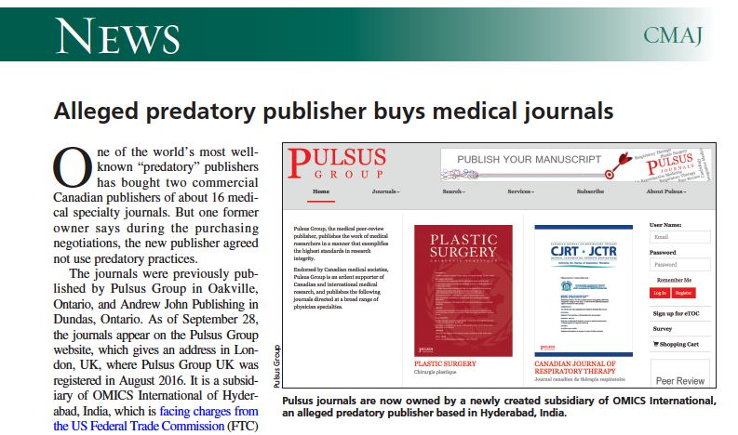
2016 Canadian Medical Association Journal
Notes:
Brown C. Alleged predatory publisher buys medical journals. CMAJ. 2016;188(16):E398.

Slide 7
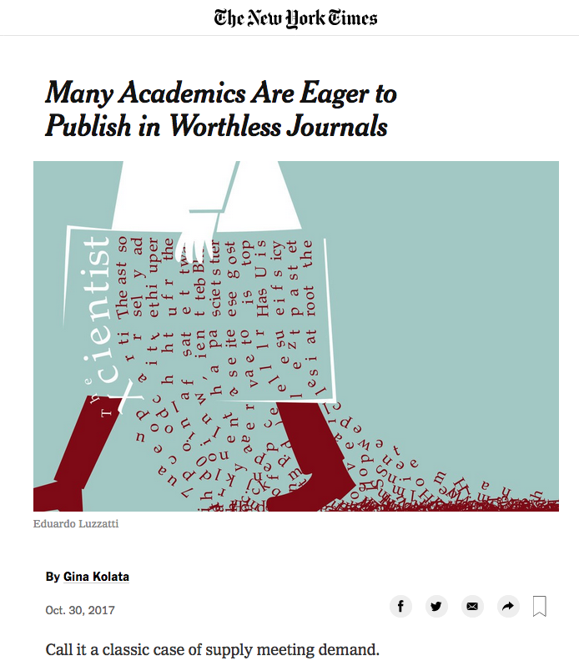
2017
The
New York
Times
Notes:
Kolata G. Many academic are eager to publish in worthless journals. The New York Times. 2017. https://www.nytimes.com/2017/10/30/science/predatory-journals-academics.html Accessed October 24, 2018.

Slide 8
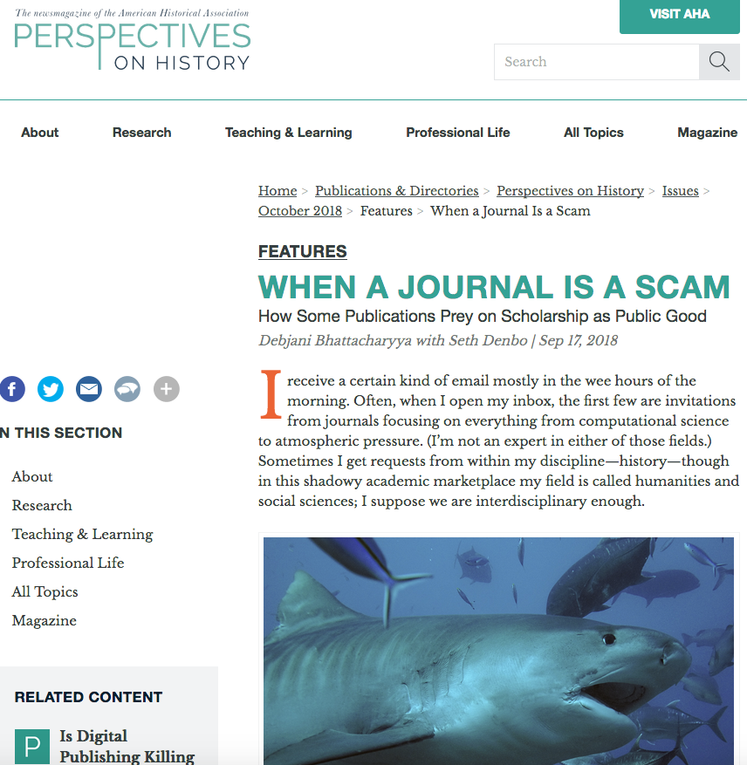
2018
Perspectives on History
News Magazine of the American Historical Association
Notes:
Bhattacharyya D. When a journal is a scam: how some publications prey on scholarship as public good. Perspectives on History. https://www.historians.org/publications-and-directories/perspectives-on-history/october-2018/when-a-journal-is-a-scam-how-some-publications-prey-on-scholarship-as-public-good Accessed October 24, 2018.

Slide 9

Objectives
Define predatory journals and predatory conferences and their impact on academia
Identify appropriate resources for assessing the quality of journals and conferences

Slide 10
Spectrum of ‘Authentic’ Publishing
Authentic
Possibly Predatory
Probably Predatory
Confirmed Predatory
(Adapted from Beall 2015)

Slide 11
Defining Predatory
Predatory = unethical journals whose sole concern is collecting $$$$$
  Unsolicited emails
  Promise of rapid acceptance
  No or little peer review
  No indexing
Predatory publishing has skyrocketed in the last decade
  Coincided with the push for open access (OA) publishing as scammers are taking advantage of the OA model
  Stigmatized serious OA journals
(Shen & Bjork 2015)

Slide 12
Why Discuss Predatory Publishers?
Immense pressure (“publish or perish”)
  increase ‘impact’
  gain recognition in our field
  promotion & tenure
Yet, article acceptance rates are extremely low and it may take years to be ‘recognized’
Temptations to publish in predatory OA journals:
  Lack of awareness
  Lack of experience in selecting journals
  Pressure to publish

Slide 13
Checklist for Assessing
Journal Quality

Slide 14

Think. Check. Submit.
https://thinkchecksubmit.org/
Video: https://vimeo.com/151882443
Journal Checker provides a list of questions to help you assess quality: https://thinkchecksubmit.org/check/

Slide 15
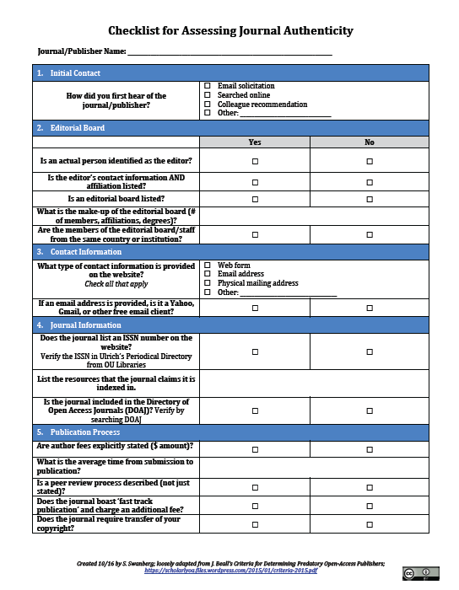
OU Libraries’ Checklist for Journal Authenticity

Slide 16
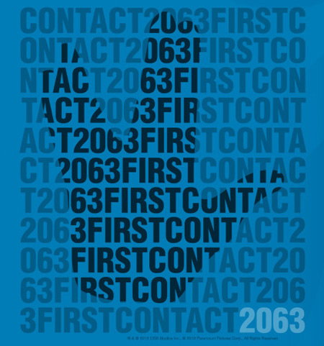
Checklist: First Contact
How did you first hear of the journal/publisher?
  Did you get an email solicitation?
  Did a colleague recommend it?
  Did you search online?
Image: Copyright of Paramount Pictures
(Beall 2015; Berger & Cirasella 2015)

Slide 17
Checklist: Editorial Board
Editorial Board
Is an actual person identified as the editor?
  Is their contact information and affiliation listed?
Is an editorial board listed?
  If so, what is the make-up of the editorial board?
    How many members?
    Are affiliations & degrees included?
What is the geographic diversity of the editorial board/staff?
  Are they all from the same country or institution?
(Beall 2015; Berger & Cirasella 2015)

Slide 18
Checklist: Contact Info
Contact Information
What type of contact information is provided?
  Is it just a web form or email address?
  Is the email address ‘official’?
    or is it a Yahoo, Gmail, or other?
Is a physical mailing address or location included?
(Beall 2015; Berger & Cirasella 2015)

Slide 19
Checklist: Publication Process
Publication Process
Are author fees explicitly stated?
  Hint: Look for specific $ amount
What is the average time from submission to publication?
  Is the peer review process described?
  Does the journal boast ‘fast track publication’ and charge an additional fee?
Does the journal require transfer of your copyright?
(Beall 2015; Berger & Cirasella 2015)

Slide 20
Checklist: Journal Info
Journal Information
Does the journal list an ISSN number?
  Verify at: http://journal-index.org/ISSN-validator
What, if any, resources index the journal?
Is the journal included in:
  Ulrich’s Periodical Directory (subscribed to by OU Libraries)?
  Directory of Open Access Journals (DOAJ) - https://doaj.org/?
(Beall 2015; Berger & Cirasella 2015)

Slide 21
DOAJ Requirements for Inclusion
All content must be available for free without delay
Each published article must have its own unique URL
Journal must have an ISSN number
Journal homepage must include:
  Links to current and past/archive issues
  Search & browse capabilities
  About webpage
  Editorial Board information
  Contact Us
(Directory of Open Access Journals 2016)

Slide 22
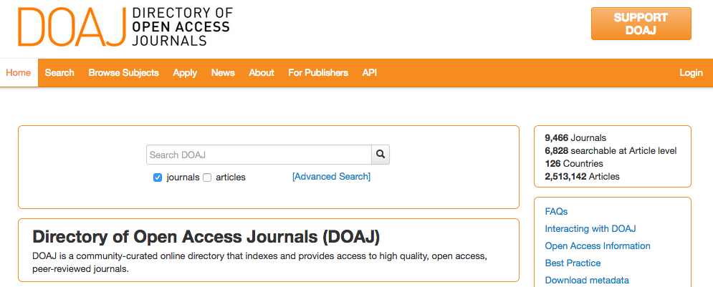

Slide 23
Group Activity: Assessing a Sample Journal
Visit the website of: Journal of Literature and Art Studies
  http://www.davidpublisher.org/Home/Journal/JLAS
Using the checklist, what stands out to you?
  What elements favor it as a legitimate journal?
  What elements favor it as a predatory journal?

Slide 24
It’s just not journals…

Slide 25
Predatory Conferences
"These are not conferences organized by scholarly societies. Instead, they are conferences organized by revenue-seeking companies that want to exploit researchers' need to build their vitas with conference presentations and papers in the published proceedings or affiliated journals"
-Pai & Franco, 2016

Slide 26
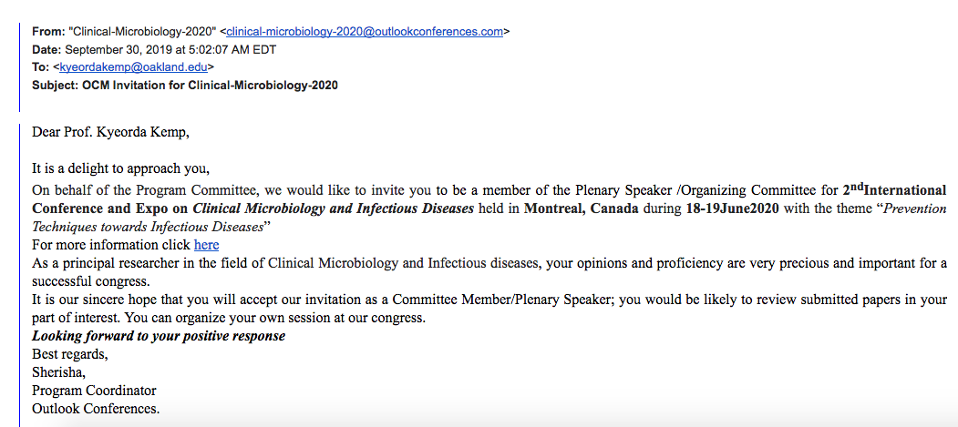
Signs of Predatory Conferences
unsolicited emails to present or be a “keynote” at a conference you have never heard of

Slide 27

Signs of Predatory Conferences
conference location is usually international, often in India, China, or Japan
bundled registration packages that include conference registration, lodging, meals, transportation, and sightseeing
Image: Pixabay under Pixabay Open License

Slide 28

Signs of Predatory Conferences
conference focus includes many, unrelated disciplines
pay to submit your abstract
promise of rapid abstract acceptance
no stated peer review
Image by mohammed_hassan. Pixabay under Pixabay Open License

Slide 29

Think. Check. Attend.
https://thinkcheckattend.org/
Same producers as Think. Check. Submit.
Conference Checker Tool: https://www.surveymonkey.com/r/GWDXFGM

Slide 30
Group Activity:
Assessing a Conference Website
Visit the website of the 5th Annual International Conference on Education & Teaching at:
  http://www.conference123.net/eduinnov2020
Using the questions from Think. Check. Attend, what stands out to you?
  What elements favor it as a legitimate conference?
  What elements favor it as a predatory conference?

Slide 31
Selecting Journals

Slide 32
Best Practices for Selecting Journals
Make a Journal List:
  Check your manuscript reference list
  Re-do your literature search to find similar articles & where they are published
  Ask colleagues for advice

Slide 33
Best Practices in Selecting Journals
Do Your Homework:
  Review journal website for aims and scope
  Read sample published articles from target journal

Slide 34
Best Practices in Selecting Journals
Do Your Homework:
  Verify journal indexing using:
    Ulrich’s Periodical Directory
    DOAJ
  Review journal website for professionalism and key indicators of quality

Slide 35
How OU Libraries Can Help

Slide 36

Contact your Liaison Librarian
If you are unsure about a journal’s quality, verify it with a librarian!
  Send us an email
  Schedule a one-on-one consultation
Our on-site experts are also available to train your department!
Image: Copyright of Pinterest

Slide 37
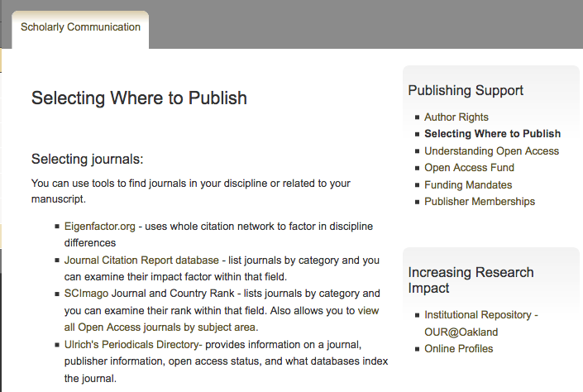
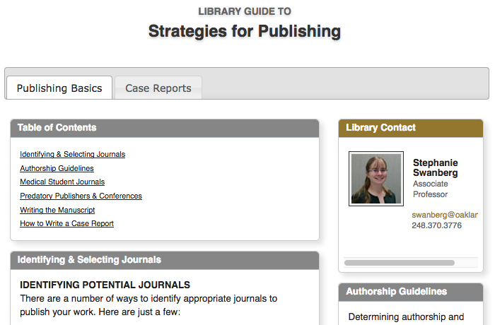
Visit the Libraries’ Websites
  OU Libraries’ Scholarly Communications Webpages
Medical Library’s Scholarly Publishing Online Guide
https://library.oakland.edu/services/scholarly-communication/Select_Journals.html
https://research.library.oakland.edu/sp/subjects/guide.php?subject=publishing

Slide 38
Summary
Predatory publishers & conferences are a genuine concern for scholars and you can take steps to protect yourself
Take the time to assess conferences and journals before submitting an abstract or manuscript or agreeing to be a reviewer or editor
  Use the checklists provided today as a starting point
When in doubt, contact your librarian!

Slide 39

Photo Courtesy: Question Question Mark Request Matter Requests by geralt, Pixabay, http://pixabay.com/en/question-question-mark-request-63916/ (public domain)

Slide 40
References
Beall J. Criteria for Determining Predatory Open-Access Publishers. 3e. https://scholarlyoa.files.wordpress.com/2015/01/criteria-2015.pdf. Accessed October 6, 2016.
Berger M, Cirasella J. Beyond Beall’s List: Better Understanding Predatory Publishers. College & Research Libraries News. 2015;76(3):132-135.
Directory of Open Access Journals (DOAJ). Information for Publishers. https://doaj.org/publishers. Accessed October 6, 2016.
Pai M, Franco E. Predatory Conferences undermine science and scam academics. The Huffington Post. 2016. Accessed September 27, 2018.
Shen C, Bjork BC.‘Predatory’ open access: a longitudinal study of article volumes and market characteristics. BMC Medicine. 2015;13:230.

