Slide 1

No Textbook Required:
Converting courses to no-cost course materials to support student success
Julia E. Rodriguez
Scholarly Communication and Open Knowledge Librarian

Slide 2
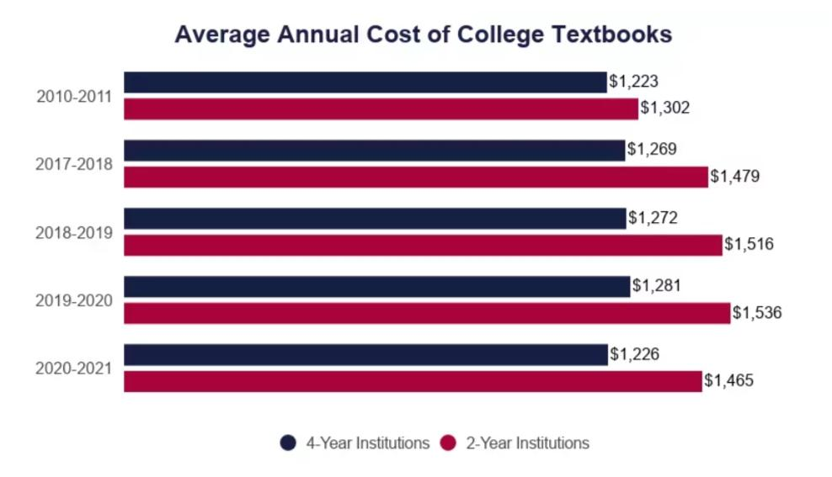
Cost of Textbooks
Hanson
The average full-time, in-state undergraduate student at a four-year public university pays $1,226 for books and supplies in one academic year.
Notes:
First, I am going to briefly discuss textbooks and the impact of their high cost on student success. Textbooks aren’t cheap. The average full-time, in-state undergraduate student at a four-year public university pays $1,226 for books and supplies in one academic year. Depending on one's circumstance this added expense can have a large impact on degree completion.
The data shows that American students are paying $1.5 billion per semester, or $3.15 billion per year in financial aid on textbooks. Why are federal funds going to subsidize the textbook industry?

Slide 3
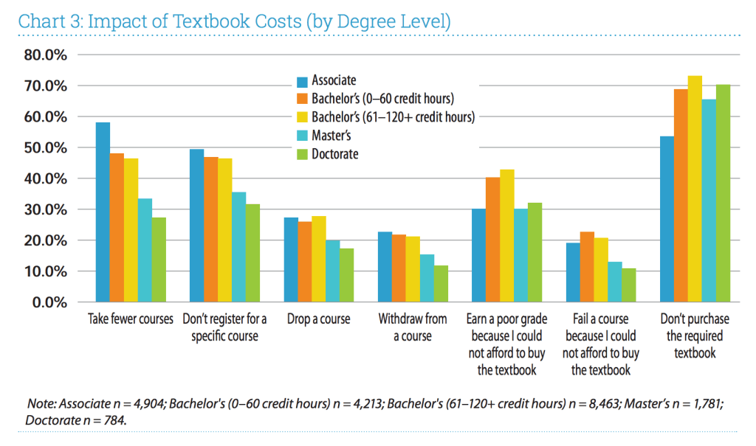
Impact of high textbooks cost
64% of students decide not to purchase a textbook because of cost despite knowing that not purchasing will impact their grade
Student take fewer classes
Don’t register for a specific course
Withdraw from a course
Fail course because they don’t have the book
Florida Virtual Campus
Notes:
The American Association of Colleges and Universities issue a report 2023 detailing the impact textbook prices are having across degree paths.
64% of students decide not to purchase a textbook because of cost despite knowing that not purchasing will impact their grade.
Students also take fewer classes, drop or withdraw from course and feel they fail because they couldn’t afford the book.
They have reported working more hours and skipping meals to afford their textbooks.

Slide 4
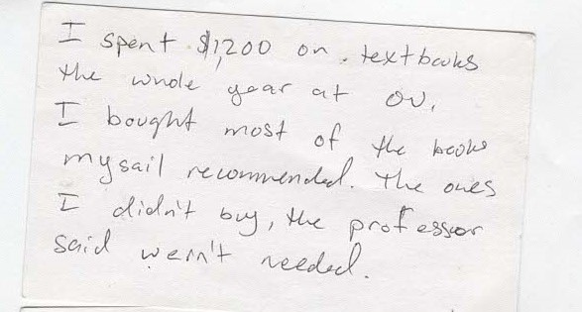

Student Story
Supporting the family
“..having to pay the incredibly high cost of classes along with all of the bills I am paying for my mom...the incredibly high price of textbooks has been breaking for me. The sad part is I know I am not the only student that has been experiencing a situation”
Notes:
We asked student to tell us about their struggled with affording textbooks.
The postcards on the left were submitted by OU students at a library event in 2019. These two students report spending $1,000 or more on textbooks.
We know some degrees have higher textbook prices and I’ve heard on more than one occasion of students not pursuing their desired major because of the textbook price.
The OU Student Conrgess conducted a survey of students about textbook prices ain 2021. The quote on the right is from that survey. This student wrote about being the oldest of three siblings and helping to support the family after their father passed away. Pause for audience to read quote.

Slide 5
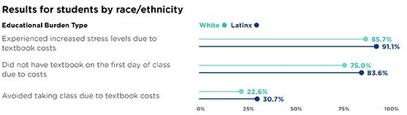
Impact of textbook cost on various student groups
AACU report
Nearly all students said that the cost of the book was a factor in deciding whether to take the class.
Notes:
The AACU report data shows that under-represented minorities, first gen and Pell grants students are disproportionately impacted by textbook costs.
These students experience
higher levels of stress
more often don’t have the book on the first day of class
or are avoiding taking a class because of the textbook cost.
First-generation students report taking fewer classes, not registering for classes, and dropping or withdrawing from classes at higher rates.
A point to note is that nearly all students said the cost of the textbooks was impacting their decisions to take a course.

Slide 6
Open Educational Practices (OEP)
OEP - moving beyond a content-centred approach, shifting the focus from resources to practices. (Cronin, 2017)
“OEP are collaborative practices that include the creation, use, and reuse of OER, as well as pedagogical practices employing participatory technologies and social networks for interaction, peer-learning, knowledge creation, and empowerment of learners.” (Cronin, 2017) (Ehlers, 2011)
Notes:
Ok so I have framed the problem. Now I am going to switch to talking how we get to the no textbook required part.
The overarching principles I will be discussing are part of what is called Open Educational practices or OEP.
Designing courses and assignment with OEP in mind moves beyond a content centric approach and shift the focus from the resources to practices.
~Read quote

Slide 7
Open Education Resources defined
OER are teaching and learning resources that are free of cost, and include built in permission to retain, reuse, revise, remix, and redistribute the material.
*Hewlett Foundation gives nearly $8 million each year to develop OER.
*US Dept of Education has allocated $47 million over last six years for the Open Textbook Pilot grant program.
Notes:
Open educational resources are what make OEP possible.
OER are textbooks, lesson plans, worksheets, lab manuals and ancillary materials that are free of cost but also have built in permission that allow anyone to retain, reuse, revise, remix and redistribute the material.
*Hewlett Foundation gives nearly $8 million each year to develop Open Educational Resources. They support the development of high quality textbooks and resources that can be used by students for free because they believe that education and knowledge is a human right. They have supported flipping the business model by paying scholars and experts to create textbooks and giving them away to students for free rather than university subsiding faculty to give their intellectual property away to publishers for free and charging student huge sums every semester.
*US Dept of Education has allocated $47 million over last six years for the Open Textbook Pilot grant program.

Slide 8


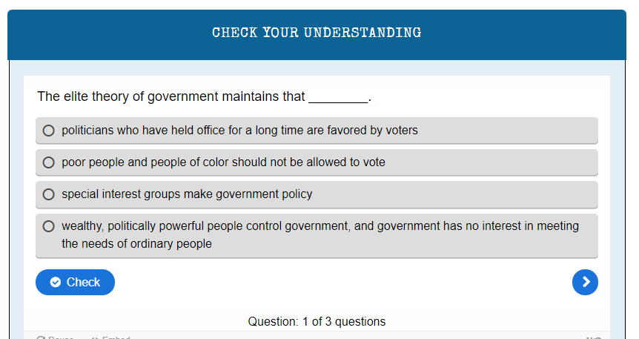
University of Georgia system
Buy a hard copy or download an editable version
153 interactive activities
Add the digital and changeable attributes
Allows for dynamic, interactive, up-to-date, accessible, DEI
University System of Georgia
Notes:
Open textbooks are one type of OER. They are openly licensed peer-review free textbooks, available to read online or download in multiple formats.
Electronic technology allows open textbooks the possibility of being more dynamic, interactive and update and accessible.
These can be adapted to include case studies and images that reflect the region and or students that will be utilizing the materials Such as, an OU Criminal Justice faculty member who uses an open textbook and embeds local Detroit data set and case studies for students to use.

Slide 9
Why OER is not just FREE stuff
OER are considered to meet the “5Rs Framework,” meaning that users are free to:
Retain: Users have the right to make, archive, and "own" copies of the content;
Reuse: Content can be reused in its unaltered form;
Revise: Content can be adapted, adjusted, modified or altered;
Remix: The original or revised content can be combined with other content to create something new;
Redistribute: Copies of the content can be shared with others in its original, revised or remixed form.
Notes:
OER at not just free resources. To be considered an OER it must be licensed in a way that permits what is call the 5 R’s
Users can retain a copy, reuse it, alter it in any form they want, revise, adapt and modify.
This is all achieve while still respecting copyright because OER resources use Creative Commons licenses, which is an open license the copyright holder attaches to their resource to communicate to those wanting to use the resource what they can do with it.
Creative commons license include an option that restricts commercial uses. ~ point to slide

Slide 10
Why Should I Use OER?
For students
Remove price barriers
Saves students money
Everyone has own copy from the first day of class
Keep and use forever
For Instructors
Freedom to use as much or as little as you want of textbook
Augment, enhance, update content to be relevant for your students
Correlation between use- lower DFW rates, greater credit accumulation, same of better grade obtainment.*
Notes:
Why should we use OER.
For students, having a free textbook removes the price barrier that might stop them from purchasing a textbook for a class.
Every student will be able to have their own copy of the first day of class, no waiting for shipping, financial aid, pay checks etc.
They get to keep a copy indefinitely. For some majors this could come in handy when they want to refer back in another semester. They can’t do this when they rent the book or have an access code to something they never own.
For instructors, not using an assigned textbook provides the freedom to use as little or as much of the content and, in any order you wish.
I’ve had faculty tell me that they felt obligated to have students use the whole book even though the faculty really wasn’t interested in teaching some of the chapters because they had students spend a $100 on the book.
Instructors have the ability to augment, enhance and update the content
Quite a bit of research that shows a correlation between OER use and lower DFW rates, greater credit accumulation, same of better grade obtainment.

Slide 11
OER-enabled pedagogy - Open Pedagogy
Openness supports enhanced pedagogical methods - utilizing open pedagogy, students as creators, critical pedagogy, decolonization of knowledge.
Flexibility in what is being taught
inclusion of greater variety of topics & voices, new perspectives, new images and representations
Student driven topics
Notes:
OER supports enhanced pedagogical methods such as utilizing open pedagogy, having students be creators of course content not just passive recipients, the use of critical pedagogies.
.
Using enhance pedagogical methods allows space for the inclusion of missing stories, the deconstruction of the knowledge that is being presented and offers greater capacity for representation.
Again and again faculty told me that the flexibility allowed them to reconsidered what they taught. Now they can incorporate other topics, perspectives, themes, missing and overlooked groups and even alter this based on current students’ interest. Every faculty member I’ve worked with who has converted their course has said that it has re-energized their teaching even for a course they have been teaching for years.

Slide 12
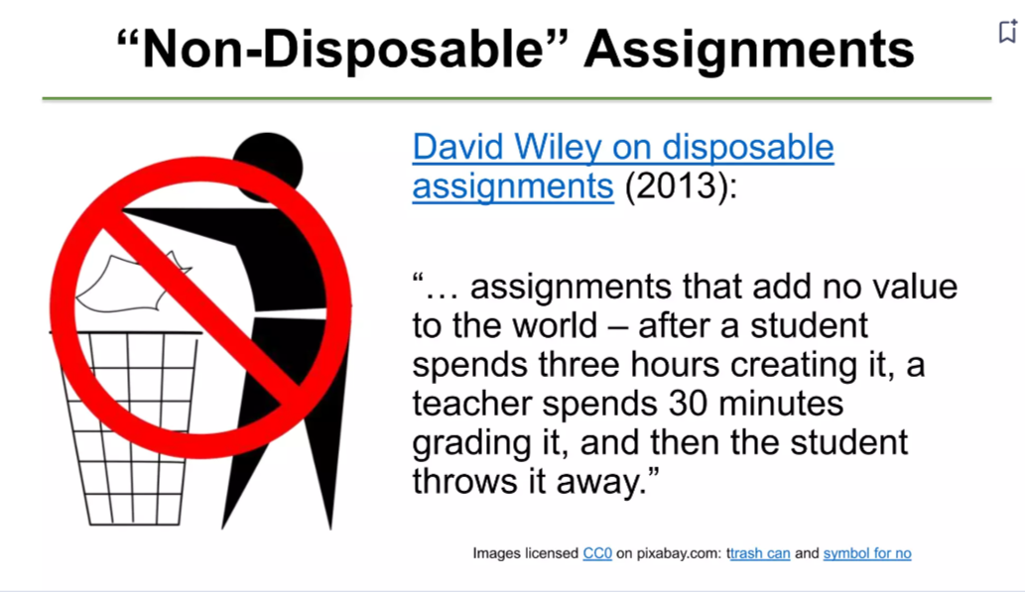
Renewable assignments
Assignments which students create for the purpose of sharing and releasing as OER.
Collaborative, focused on knowledge creation, peer-learning, respecting and empowering learner as co-producers.
borrowed from Christina Hendricks What’s Open About Open Pedagogy?
Notes:
One element of OER enable pedagogy are renewable assignments.
These are assignments that add value to the world within or beyond the class even after the course is over. In other words, what the students produce through their coursework is useful and usable by others beyond the instructor. (Christina Hendricks-)
These may serve to encourage students to learn and apply information, practice skills, engage in problem solving and they can show instructors the level of mastery students have reached.
“Disposable assignments” don’t provide any further value to the world after they’re completed and are typically tossed out by the student.
Faculty who use renewable assignments have shared that students say they invest significantly more time and effort in these assignments and enjoy doing them more. It makes sense that if students are doing work for a wider audience than just their instructor, and if they feel that this work is valuable to others, they may be more invested in it than in disposable assignments. (Wiley)

Slide 13
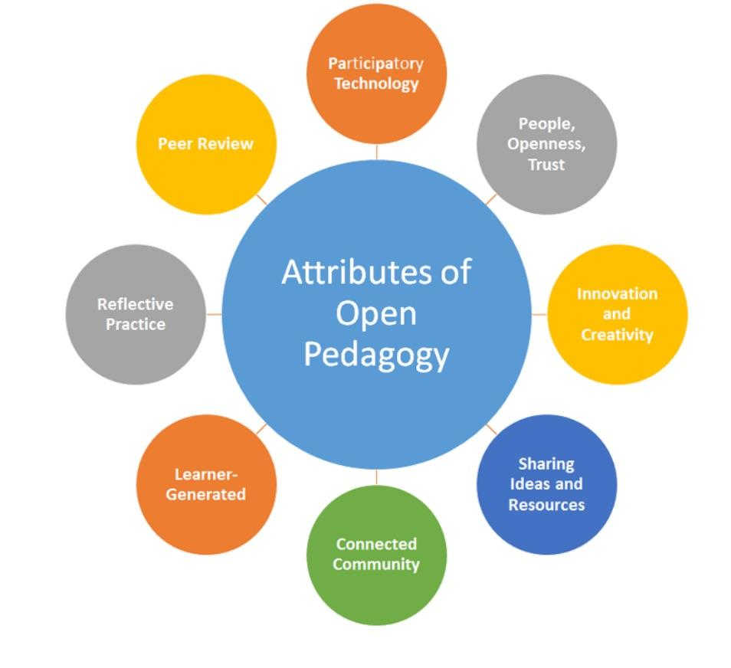
OP Elements
Knowledge is created and revised
Democratize your syllabus
Inclusive/collaborative projects
Students as teachers
Notes:
What does this look like .. open pedagogy is a variety of practices and methods that come together.
Rather than thinking of knowledge as something that is download or transmitted we think about knowledge as something that is created and revised and the students take part in this as activity participants.
DeRosa and Robison (2017) https://pressbooks.pub/teachinginadigitalagev3m/chapter/11-4-open-pedagogy/
You can Start your class with openness in mind by asking students to participate in the creation of definitions in the syllabus. This might include:
Class code of conduct
Options and choices for topics/delivery methods for various assignments
Opportunities for students to lead class sessions
Give input on marking schemes, etc. such as a degrading scenario
https://tlc.ontariotechu.ca/teaching/open-educational-practices/open-pedagogy.php

Slide 14
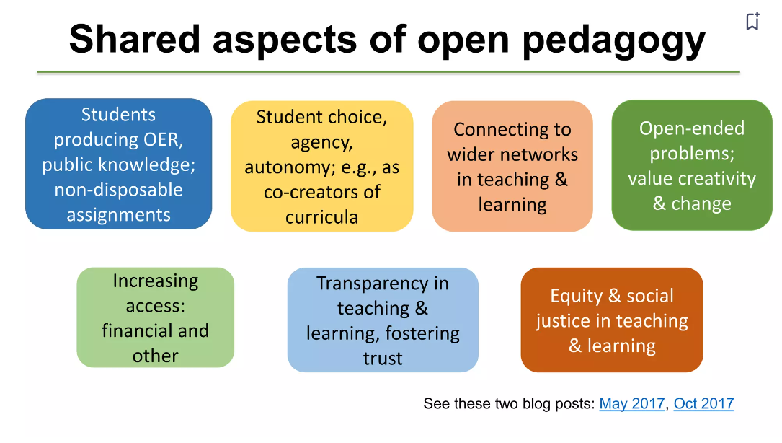
borrowed from Christina Hendricks What’s Open About Open Pedagogy?
Notes:
The shared aspect of open pedagogy put students first, gives them agency in their learning , re-enforces that they have something valuable to bring to the course and the subject, which builds relationships and trust which enhances the their learning.
All of these elements are things I students are telling us they want in their classrooms, more engagement. Student choice, equity & social justice in teaching.

Slide 15
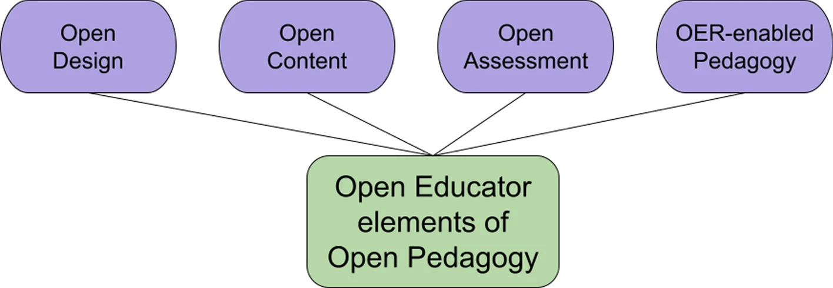
Site for OEP Examples
Open Pedagogy Approaches
Open Pedagogy Notebook
Notes:
That was a whirlwind introduction to the topics. Now I am going to point you to some resources you can explore further on your own.
I’ve listed just two OP sites on this slide Open Pedagogy Approaches & Open Pedagogy Notebook. There are many sites you can visit to see more examples or you can simply google open educational practices or open pedagogy and find loads of resources. OEP is one element consider part of being an open educator.

Slide 16
OER Discovery Tools
Textbooks:
BCOpen Campus - publisher and creator of open textbooks, guides and best practices
OpenStax – Leading OER peer-reviewed textbooks
Open Textbook Library - University of Minnesota premiere resource for peer-reviewed academic textbooks, member organization with textbook library.
Pressbooks Directory - Index of openly published books using Pressbooks network - includes a filter for H5P activities
Search databases to try first:
DOAB - Directory of Open Access Books - all titles are open access with varying reuse licenses.
OER Commons- largest public library of OER content. Filter by type and education level.
OASIS - search tool that includes public domain content, includes full courses.
FULL LIST ON OER Library GUIDE
Notes:
Listed on this slide are some of the top OER discovery tools. If you are strictly looking textbooks you should start by searching the top bulleted sites.
The Open Textbook Library is a very thorough site which includes reviews from faculty who have used the book or done a peer review of the title.
OpenStax is the largest open textbook publisher and now one of the top textbook publishers in general. There titles frequently come with instructor resources such as slides and activities.
The bottom section is what we call directories. These search across lots of different kinds of content, textbooks but also lesson plans, full courses and activities.
Some, like the OASIS search engine, pull in public domain content. This is just a shortlist of those top ones that I go to.
A more exhaustive list can be found on the OER guide linked here and from the OU library’s webpages.

Slide 17
Other types of free (not OER)
Lectures - Videos, PP, TedX, TedEd, YouTube, Google (open license setting)
Videos - OU Kresge video databases - check you institution
Images - OER guide finding CC content
Articles and ebooks Library licensed databases - Databases by format, A-Z, subject - check you institution
Openly accessible sources - Library of Congress, archives, museums etc.
Notes:
Finally I want to mention that there are lots of free resources that can be used to supplement materials. These are not OER but they are free to students. OU Libraries has access to video and full monographs as ebooks, as do most academic libraries. Many GLAM organizations make their collections available online and include great primary source materials.

Slide 18

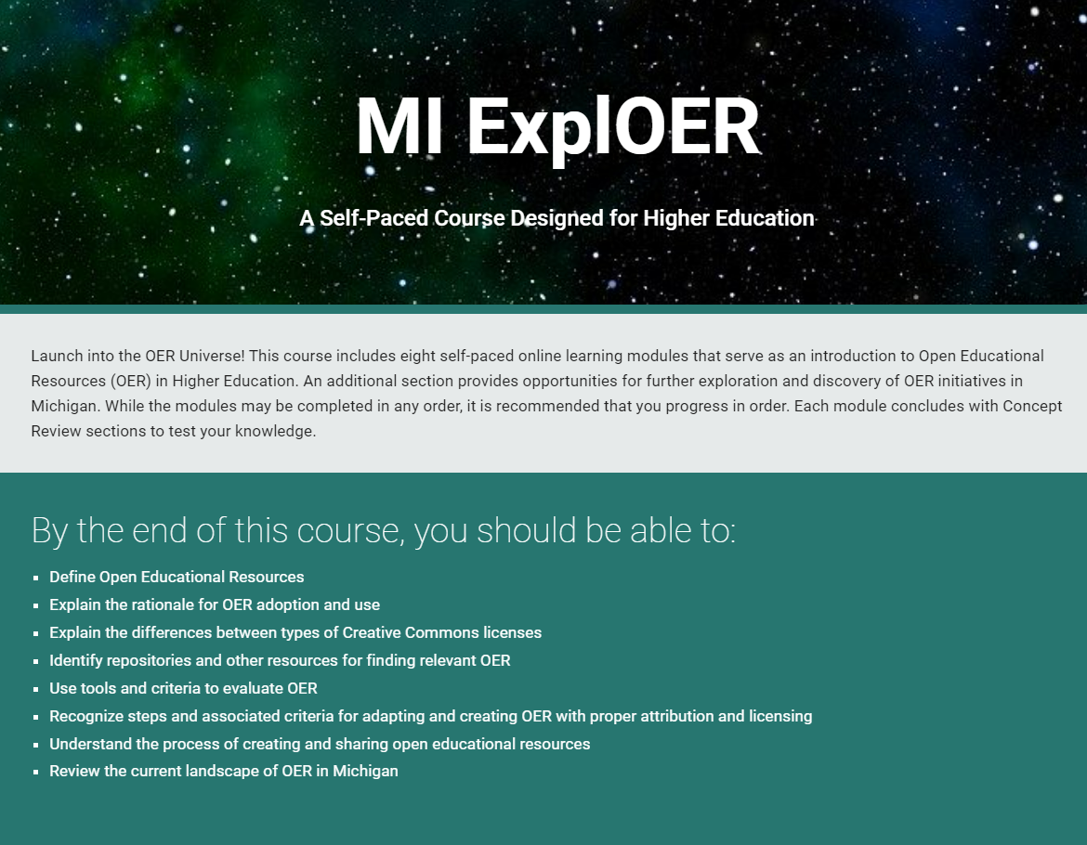

Professional Development & Funding Opportunities
MI-OER Network
https://certificate.mioer.org/
OU faculty earn $100 for completion
Friday, November 7th at Washtenaw Community College
https://www.mioer.org/
https://oakland.libguides.com/ACMI
Course conversion stipends
Notes:
If you are interested in learning more about OER, there is a free online self paced course you can complete. OU faculty receive a $100 stipend for completion. I also list many PD opportunities on my ACMI website such the MI OER Network conference which will take place Nov. 7 this year and OU faculty can grants to attend.

Slide 19

Thank you!
Julia Rodriguez ~ juliar@oakland.edu
SLIDES https://tinyurl.com/y49ye9vn

Slide 20
References
Cronin, C. (2017). Openness and praxis: Exploring the use of open educational practices in higher education. The International Review of Research in Open and Distributed Learning, 18(5).
Hanson, M. “Average Cost of College Textbooks” EducationData.org, October 12, 2024. https://educationdata.org/average-cost-of-college-textbooks
Hendricks, Christina (October 29th, 2015) blog post Renewable assignments: Student work adding value to the world. Flexible Learning.
Florida Virtual Campus. (2016). 2016 Florida Student Textbook & Course Materials Survey. Tallahassee, FL. Retrieved from https://www.flvc.org/documents/96858/931951/2016+Student+Textbook+Survey.pdf/591cf5b0-bbe8-406d-acd8-b23d89b8577f
Ehlers, U. D. (2011). Extending the territory: From open educational resources to open educational practices. Journal of Open, Flexible and Distance Learning, 15(2). Retrieved from http://www.editlib.org/p/147891/
Elder, A. (2019) The OER Starter Kit. Iowa State University Digital Press. Retrieved from: https://iastate.pressbooks.pub/oerstarterkit/
Wiley, D. (2017) OER-Enabled Pedagogy. Iterating toward openness. pragmatism before zeal. Retrieved from https://opencontent.org/blog/archives/5009
Watson, C. E., & Rush-Marlowe, R. (2023). Making the case for open educational resources. American Association of Colleges and Universities (AAC&U).

Slide 21
Further Reading
Bliss, TJ (2015, Ja, 6.) Z as in zero: Increasing college access and success through zero-textbook-cost degrees. William & Flora Hewlett Foundation. Retrieved from https://hewlett.org/z-as-in-zero-increasing-college-access-and-success-through-zero-textbook-cost-degrees/
Cochrane, M., & Cheng, D. The Institute for College Access & Success. Student Debt and the Class of 2016, Twelfth annual report. Published September 2017. Retrieved from https://ticas.org/sites/default/files/pub_files/classof2016.pdf
Colvard, N. B., Watson, C. E., & Park, H. (2018). The impact of open educational resources on various student success metrics. International Journal of Teaching and Learning in Higher Education, 30(2), 262-276.
Fischer, L., Hilton, J., Robinson, T.J. et al. A multi-institutional study of the impact of open textbook adoption on the learning outcomes of post-secondary students. J Comput High Educ 27, 159–172 (2015). https://doi.org/10.1007/s12528-015-9101-x
Griffiths, R., Gardner, S., Lundh, P., Shear, L., Ball, A., Mislevy, J., Wang, S., Desrochers, D., Staisloff, R. (2018). Participant Experiences and Financial Impacts: Findings from Year 2 of Achieving the Dream’s OER Degree Initiative. Menlo Park, CA: SRI International. https://www.achievingthedream.org/sites/default/files/resources/participant_experiences_and_financial_impacts_oer_2018.pdf
Hickman, H., & Porfilio, B. J. (Eds.). (2012). The new politics of the textbook: Problematizing the portrayal of marginalized groups in textbooks (Vol. 1). Springer Science & Business Media.
Hilton, J. (2019) Open educational resources, student efficacy, and user perceptions: a synthesis of research published between 2015 and 2018. Education Tech Research Dev.. https://doi.org/10.1007/s11423-019-09700-4
Senack, E., & Donoghue, R. (2016). Covering the cost: Why we can no longer afford to ignore high textbook prices. Student PIRGs Center for Public Interest Research, Inc. Published 2016. Retrieved from https://studentpirgs.org/2016/02/03/covering-cost/

Slide 22
Thank you.
Julia Rodriguez ~juliar@oakland.edu
Credits and Attributions
This text presentation is licensed under a Creative Commons Attribution-NonCommercial 4.0 International License.
All images are protected by copyright and are used in accordance with fair use.

