Slide 1
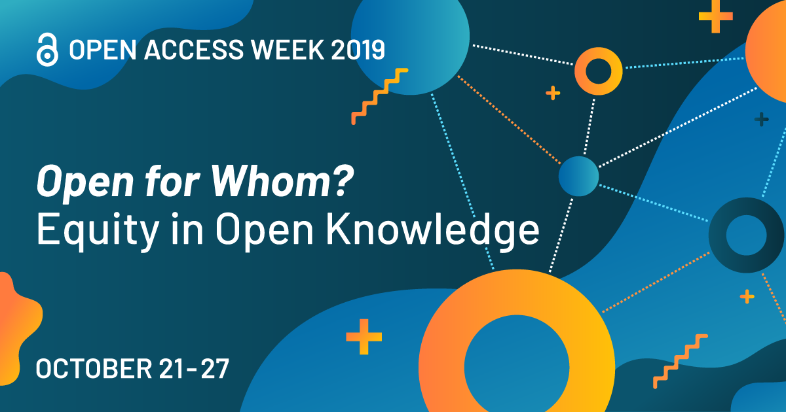


SPONSORED by Oakland University Libraries and OUWB School of Medicine

Slide 2
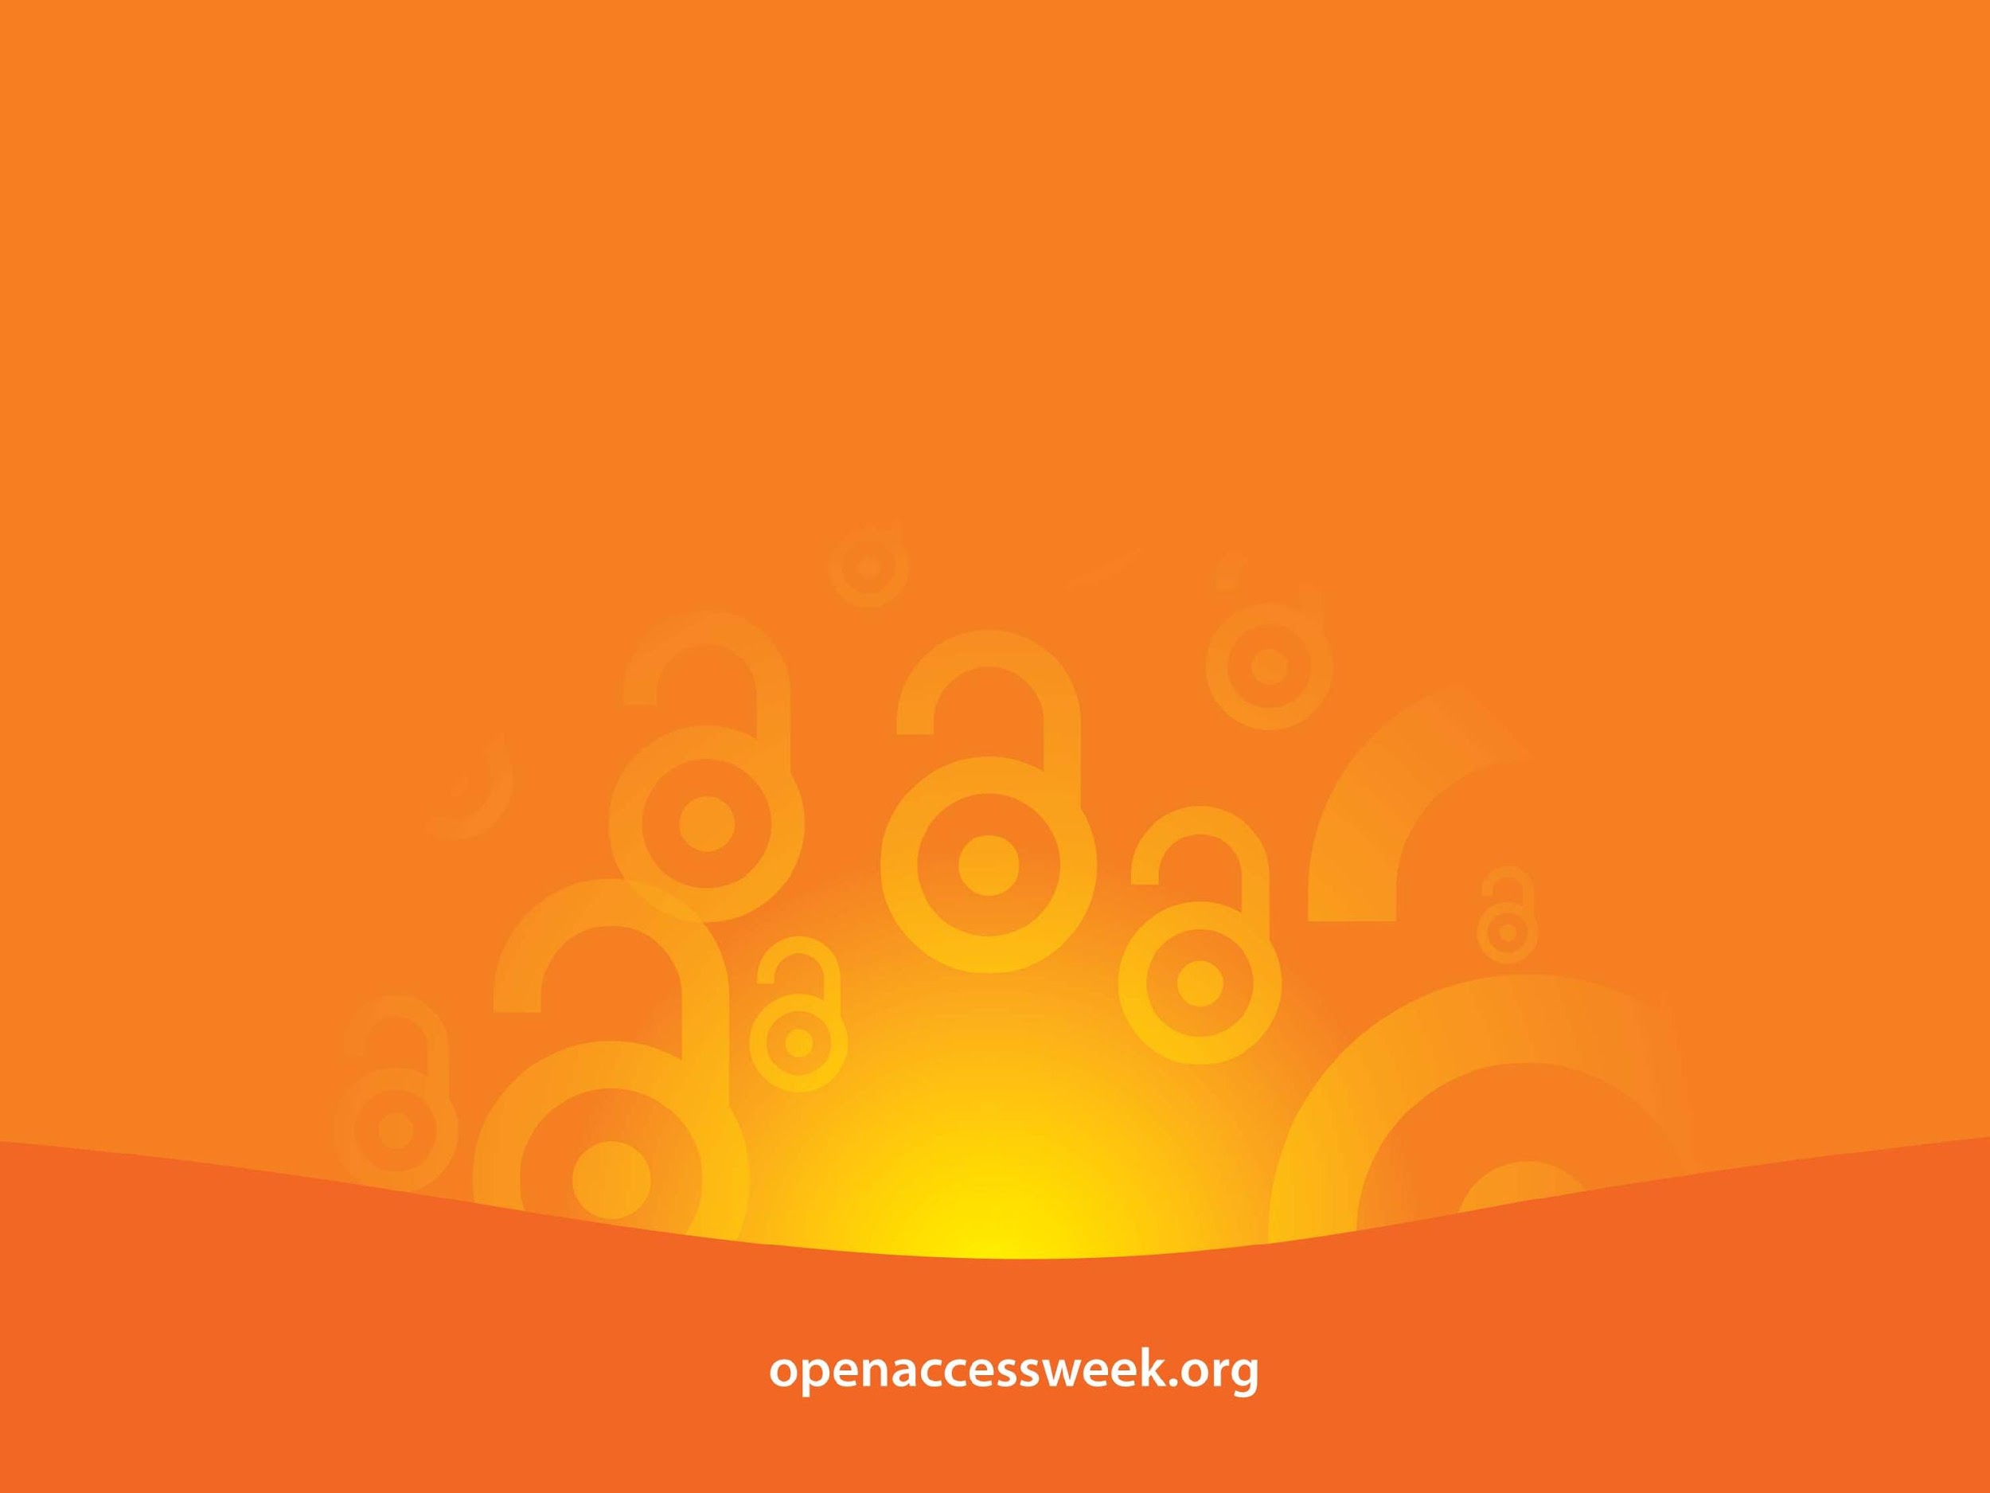
*Open Access (OA) is free, immediate access to scholarly information online, along with the right to use and reuse that information. (SPARC)
OA WEEK is a global event to promote the potential benefits of Open Access and to help inspire wider participation in helping to make Open Access a new norm in scholarship and research.

Slide 3

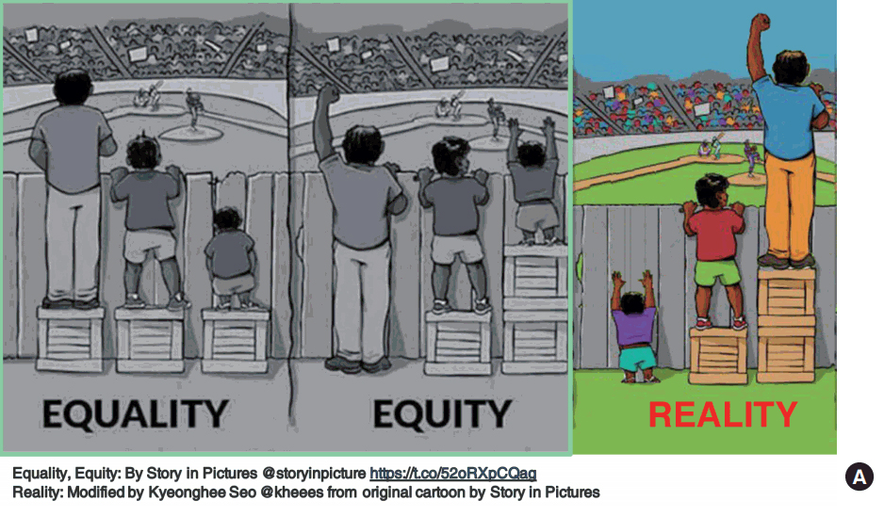
OPEN =
Free to read
Widely available
Unlimited peer-review/ sharing/ collaborating
Free to use/reuse
Shorter publishing cycle
Greater discoverability
Equality vs Equity
Open access ensure equal access.
Equality and equity are not equivalent.
Equality is about sameness – everyone gets to read the paper.
Equity is about fairness – each person has the ability to find, and also understand the paper.
Open access journal does little to increase the scope of dissemination to the members in our global community who may most benefit from the information
Michelle EH Fournet

Slide 4
Increase Your Research Visibility
Getting Your Work Noticed, Cited and Read
Julia Rodriguez, Associate Professor, Scholarly Communications Librarian
Oakland University Libraries

Slide 5
Steps for increasing visibility, use and impact
1. Get a Researcher ID – connect your publications
2. Build a deliberate online persona
3. Share your publications with different audiences
  Check copyright of publications
  Post online using appropriate tools
4. Engage with others (academic, public, media)
5. Track use and impact - metrics

Slide 6
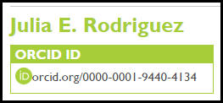
Get
Establish a researcher ID
persistent digital identifier for you links all your publications
  ORCiD http://orcid.org/
  ResearcherID http://www.researcherid.com

Slide 7
Build
Online profiles
Open scholarship collection in IR
Google Scholar profile
Author profiles - publisher sites
Faculty website - link publications
ORCID-ID

Slide 8
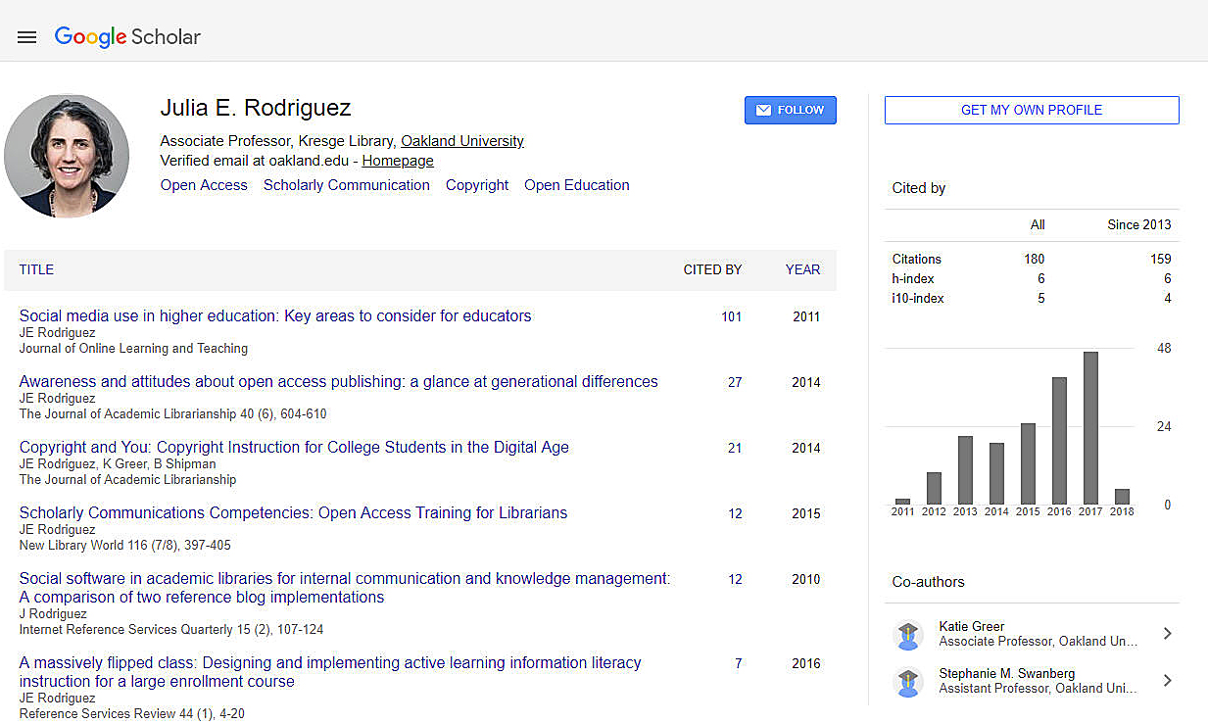
Google Scholar

Slide 9
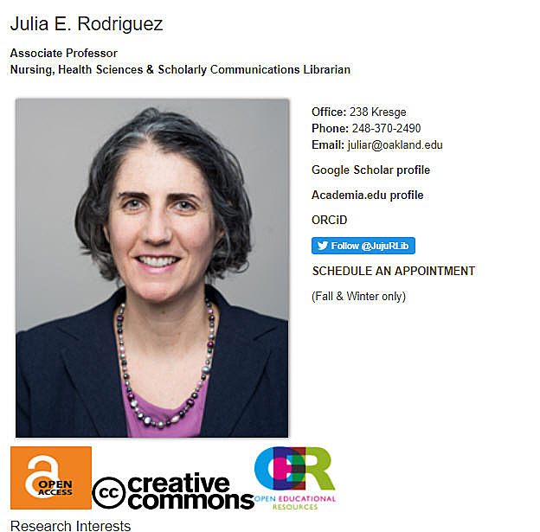
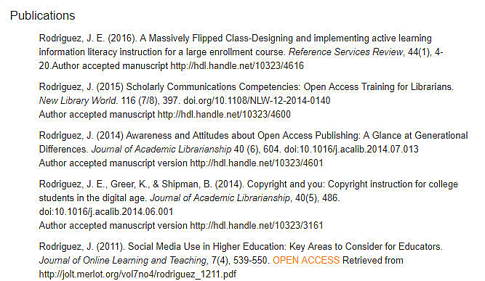

Slide 10


Know Before You GO
Author rights
  Retain rights to post a copy or preprint of article online – ALWAYS inspect publishing agreement
  Publish in OA journals that use
  Creative Commons licenses

Slide 11

Making full-text available
https://our.oakland.edu/
1. Maximize the impact and visibility of your published research.
2. Provide a permanent space to archive and disseminate publications, presentations, data sets.
3. Archive conferences recordings, presentation slides.
4. Promote high visibility in Google and Google Scholar.
5. Enable easy distribution of your work.
Science
arXiv.org
Physics, Mathematics, Computer Science, Quantitative Biology, Quantitative Finance and Statistics.
PubMed Central
U.S. National Institutes of Health (NIH) All research funded by the NIH now goes into PMC, with a maximum embargo period of 12 months.
Social Science
Social Science Research Network (SSRN)

Slide 12

Share & Engage
Scholarly communities - Connect, collaborate, share
Reference managers - Persona based on scholarly reading, share bibliographies
Social media - Connects you - your research to different communities within & beyond academia to all relevant stakeholders, media, public

Slide 13
Some online communities
Academia – multi-disciplinary community, track usage and discover
ResearchGate – heavily science based –collaboration ask questions, follow others
Labroots - scientific -producer of educational virtual community conversations
Reference managers and more…
Mendeley, Zotero
Tools for researchers blog
Photo source:http://www.nmspacecenter.com/2013/06
Notes:
Research gate - kresgeLIBRARY!
mendley
rodrigu3@oakland.edu
kresge

Slide 14
Why Use Social Media
YOUR RESEARCH
Connects you - your research to different communities within & beyond academia
Facilitating knowledge translation post-publication
Invites varying perspectives and uses
Broader uses and access increases impact of research
YOU AS A RESEARCHER
Meet people whom probably wouldn't have met
Keep up to date on what’s happening in field
Gives a voice to traditionally underrepresented groups
Build network of colleagues for collaboration and support

Slide 15

Social Media Strategy
Determine Goals – what are you looking to get out of activity
Align goals with proper tool
Be deliberate in the creation of your digital identity
Separate professional and private accounts
To measure impact > need to first clearly articulate aims and means
Seven Questions:
What do you want to achieve?
Who are you trying to reach
What content are you working with and how can you repurpose this?
Who can you work with to make your social media use more efficient and effective?
How can you make your content actionable, shareable and rewarding?
How will you monitor and evaluate your plan?
How does your social media plan contribute to your wider research impact plan?
Mollett, A., Brumley, C., Gilson, C., Williams, S. (2017) Communicating your research with social media. SAGE. Los Angeles, CA., p. 250. Adapted from Reed, 2016, Research Impact Handbook

Slide 16


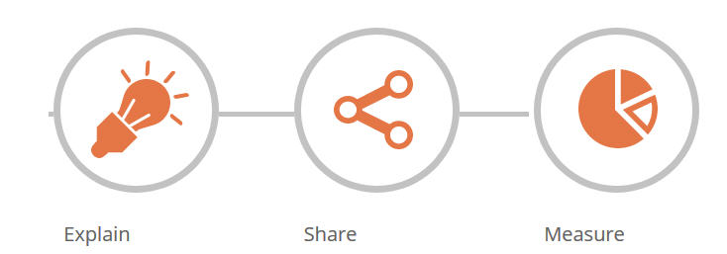

Social Media
WeShareScience is a place to share, search, and discuss today's research.
YouTube – share videos or create educational channel
Kudos is a web-based service that helps researchers and their institutions and funders to maximize the visibility and impact of their published articles.
Twitter – new PR releases, self promotion tool, follow and connect with other academic or public

Slide 17
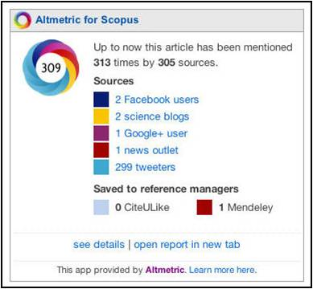
Altmetrics
“Metrics can help to capture patterns of influence and broaden our understanding of how content is being used, communicated and acted upon.”
Capturing quantifiable data
  usage
  social bookmarking
  dissemination activity
  citations
  media and blog coverage
  discussion activity and ratings
Notes:
Example : Beyond alcohol and drug addiction. Does the negative trait of low distress tolerance have an association with overeating
http://www.plumanalytics.com/metrics.html

Slide 18

Photo Courtesy: Question Question Mark Request Matter Requests by geralt, Pixabay, http://pixabay.com/en/question-question-mark-request-63916/ (public domain)

