Slide 1



2016
“OPEN IN ACTION”

Slide 2
Protecting against predatory publishers
Stephanie Swanberg, MSI, AHIP
Assistant Professor, Information Literacy & eLearning Librarian
swanberg@oakland.edu, October 26, 2016

Slide 3
Objectives
Define predatory publishing and the implications on academia
Identify appropriate resources for assessing the quality of publishers and journals
Review and assess a sample journal against a journal authenticity checklist

Slide 4
What Constitutes Predatory?

Slide 5
Defining Predatory
Predatory = publishers/journals whose sole concern is collecting $$$$$ and providing rapid publishing without peer review
Aka pseudo-journals
Predatory publishing has skyrocketed in the last decade
  Coincided with the push for open access (OA) publishing as scammers are taking advantage of the OA model
  Stigmatized serious OA journals
(Shen & Bjork 2015)

Slide 6
Spectrum of ‘Authentic’ Publishing
Authentic
Possibly Predatory
Probably Predatory
Confirmed Predatory
(Adapted from Beall 2015)

Slide 7
Predatory in Perspective
Shen & Bjork’s 2015 study examined the growth of predatory publishing since 2010
  Sampled 613 journals from Beall’s List (discuss later)
Major findings included:
  # of active predatory journals has rapidly increased
  Fairly linear growth in the # of articles published by these journals
  Geographic location of publisher and publishing authors seem to favor Asia and Africa, particularly India
Positive finding --- legitimate OA journals have experienced similar growth!
(Shen & Bjork 2015)
Notes:
# of active predatory journals has rapidly increased
1,800 in 2010 to 8,000 in 2014!
Fairly linear growth in the # of articles published by these journals
53,000 in 2010 to 420,000 in 2014!
Geographic location of publisher and publishing authors seem to favor Asia and Africa, particularly India
Positive is that legitimate OA journals have experienced similar growth
with ~10,000 OA journals (June 2015) and ~500,000 published articles from those journals

Slide 8
Why Discuss Predatory Publishers?
We all are under pressure to increase our ‘impact’ and gain recognition in our field, particularly for promotion & tenure
BUT, article acceptance rates are extremely low and it may take years to be ‘recognized’
Just to build our portfolio, we might be tempted to:
  Submit our articles to journals we’ve never heard of
  Agree to sit on editorial boards or be reviewers for those journals

Slide 9
Checklist for Assessing Authenticity

Slide 10
Video
https://www.youtube.com/watch?v=7mTP8E_J7Ac

Slide 11
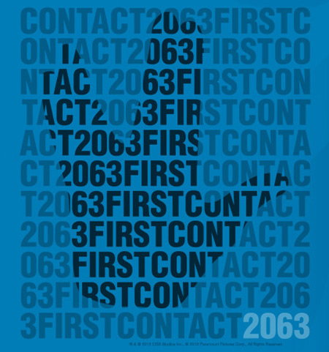
Checklist: First Contact
How did you first hear of the journal/publisher?
  Did you get an email solicitation?
    (Or several?)
  Did you search online?
  Did a colleague recommend it?
Image: Copyright, Paramount Pictures
(Beall 2015; Berger & Cirasella 2015)

Slide 12
Checklist: Editorial Board
Editorial Board
Is an actual person identified as the editor?
  Is their contact information and affiliation listed?
Is an editorial board listed?
  If so, what is the make-up of the editorial board?
    How many members?
    Are affiliations & degrees included?
What is the geographic diversity of the editorial board/staff?
  Are they all from the same country or institution?
(Beall 2015; Berger & Cirasella 2015)

Slide 13
Checklist: Contact Info
Contact Information
What type of contact information is provided?
  Is it just an web form or email address?
    Is the email address ‘official’ or is it a Yahoo, Gmail, or other?
Is a physical mailing address or location included?
(Beall 2015; Berger & Cirasella 2015)

Slide 14
Checklist: Journal Info
Journal Information
Does the journal list an ISSN number?
  Verify the journal in Ulrich’s Periodical Directory from OU Libraries
(Beall 2015; Berger & Cirasella 2015)

Slide 15

Demo & Activity 1: Using Ulrich’s
Go the website for: American Journal of Engineering Research (ajer.org)
Verify the journal by searching Ulrich’s Periodical Directory through OU Libraries
Image: Amanda Mills/CDC, Public Health Image Library
http://phil.cdc.gov (public domain)

Slide 16
Checklist: Journal Info cont.
Journal Information
What, if any, resources index the journal?
  Easy to cross check and verify the information posted on the journal website
Is the journal included in the Directory of Open Access Journals (DOAJ)?
(Beall 2015; Berger & Cirasella 2015)

Slide 17
DOAJ Requirements for Inclusion
All content must be available for free without delay
Each published article must have its own unique URL
Journal must have an ISSN number
Journal homepage must include:
  Links to current and past/archive issues
  Search & browse capabilities
  About webpage
  Editorial Board information
  Contact Us
(Directory of Open Access Journals 2016)

Slide 18
DOAJ Requirements cont.
Editorial Board information must include:
  Current Editor (name, affiliation, email)
  Name of each editorial board member
Clearly described peer review process and links to author guidelines on journal homepage
Disclosure of publishing fees
(Directory of Open Access Journals 2016)

Slide 19
Activity 2: Using DOAJ
Look up the American Journal of Engineering Research again, this time in the Directory of Open Access Journals (doaj.org)
Image: Amanda Mills/CDC, Public Health Image Library
http://phil.cdc.gov (public domain)

Slide 20
Checklist: Publication Process
Publication Process
Are author fees explicitly stated?
  Hint: Look for specific $ amount
What is the average time from submission to publication?
  Is a peer review process described?
  Does the journal boast ‘fast track publication’ and charge an additional fee?
Does the journal require transfer of your copyright?
(Beall 2015; Berger & Cirasella 2015)

Slide 21
Beall’s List of Predatory Publishers
https://scholarlyoa.com/publishers/
A ‘list’ of publishers and journals that may be predatory
  Produced by Jeff Beall, an academic librarian at the University of Colorado
Developed his own criteria for assessing journal authenticity
His list should NOT be used as the sole indicator of a journal’s authenticity
(Beall 2015)

Slide 22
Activity 3: Pulling It All Together
Complete the ‘Checklist for Assessing Journal Authenticity’ on the sample communication you just received
We’ll be discussing what you found as a group!

Slide 23
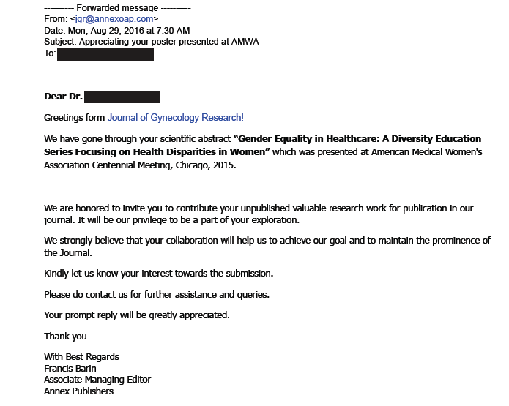

Slide 24
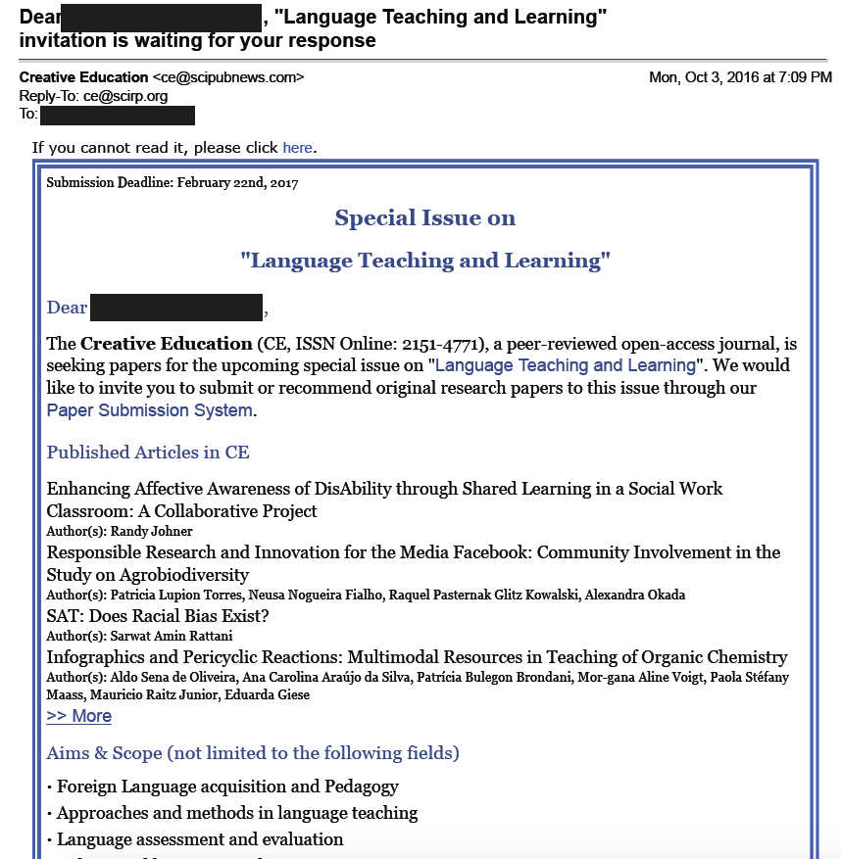

Slide 25
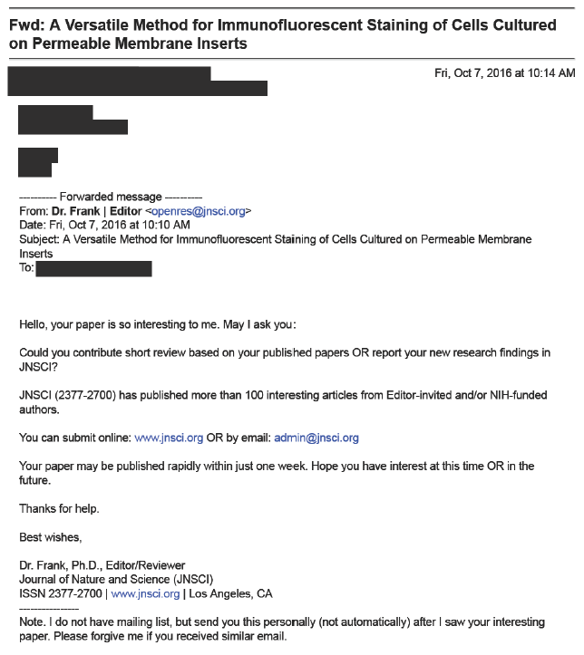

Slide 26
Summary
Predatory publishing is a genuine concern for scholars and you can take steps to protect yourself
Take the time to assess journals before submitting a manuscript or agreeing to be a reviewer or editor
  Use the checklist provided today as a starting point
When in doubt, contact your librarian!

Slide 27

Photo Courtesy: Question Question Mark Request Matter Requests by geralt, Pixabay, http://pixabay.com/en/question-question-mark-request-63916/ (public domain)

Slide 28
References
Beall J. Beall’s List of Publishers. https://scholarlyoa.com/publishers/. Updated October 5, 2016; Accessed October 6, 2016.
Beall J. Criteria for Determining Predatory Open-Access Publishers. 3e. https://scholarlyoa.files.wordpress.com/2015/01/criteria-2015.pdf. Accessed October 6, 2016.
Berger M, Cirasella J. Beyond Beall’s List: Better Understanding Predatory Publishers. College & Research Libraries News. 2015;76(3):132-135.
Directory of Open Access Journals (DOAJ). Information for Publishers. https://doaj.org/publishers. Accessed October 6, 2016.
Shen C, Bjork BC. ‘Predatory’ open access: a longitudinal study of article volumes and market characteristics. BMC Medicine. 2015;13:230.

