Slide 1
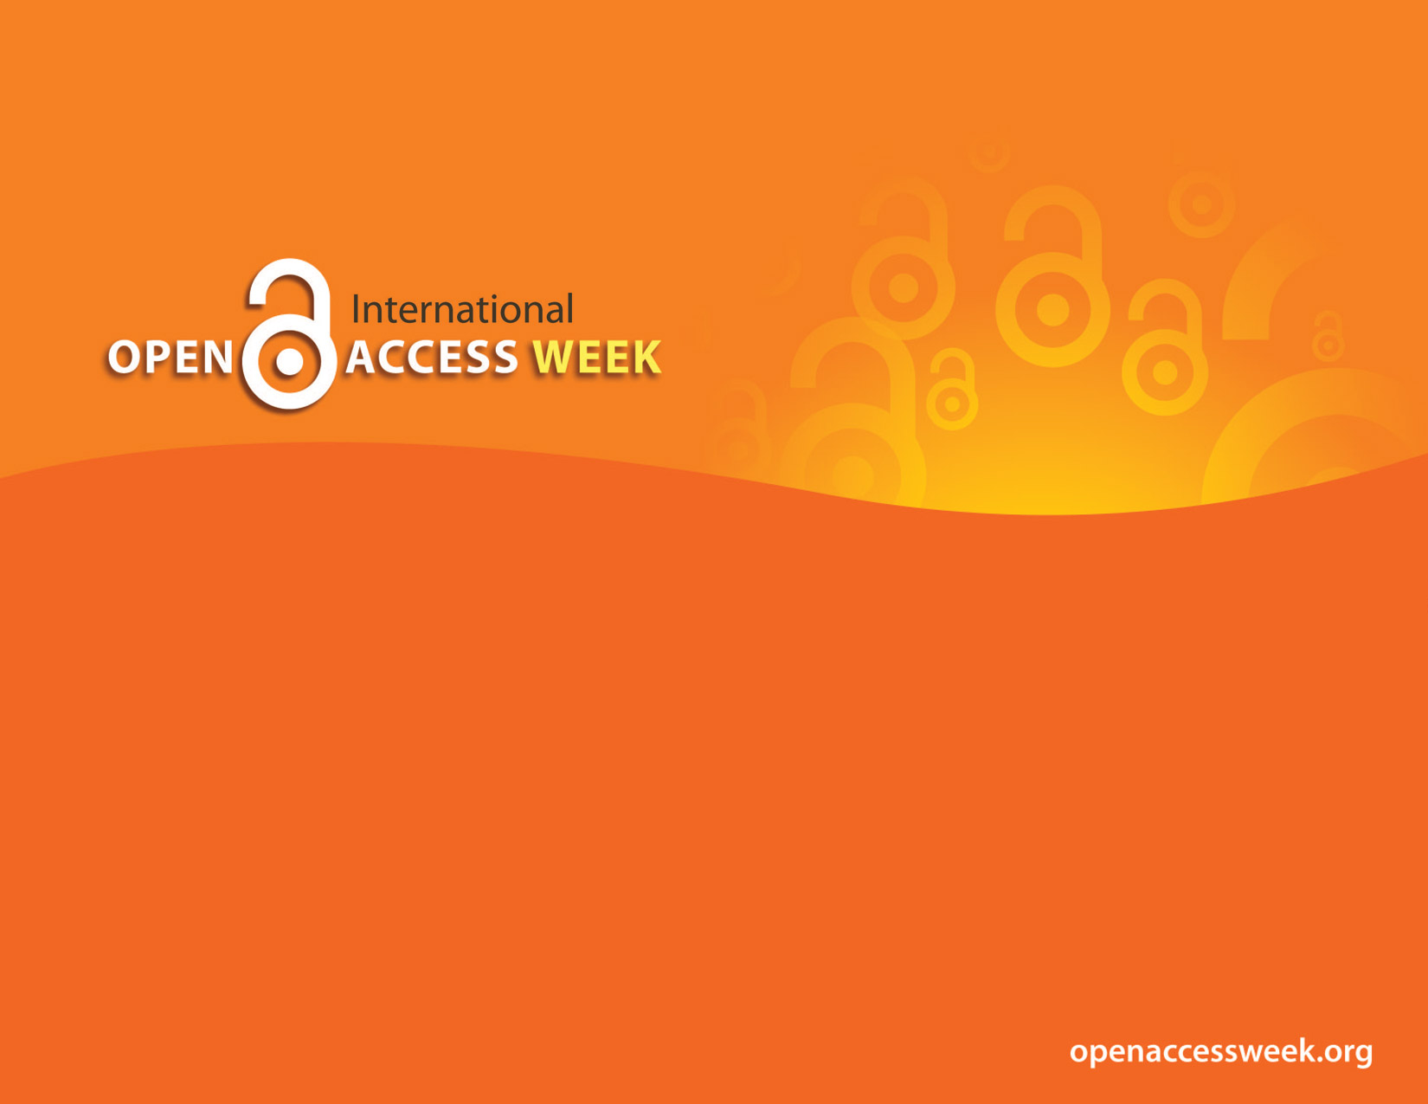
2017
OPEN IN ORDER TO:
Enable Global Participation in Research
Raise Research Visibility
Enable Public Health
Collaborate

Slide 2

Open Access (OA)
is free, immediate access to scholarly information online, along with the right to use and reuse that information (SPARC)
OA Week
is a global event to promote the potential benefits of Open Access and to help inspire wider participation in helping to make Open Access a new norm in scholarship and research

Slide 3

OPEN =
Free to read
Widely available
Unlimited peer-review/ sharing/ collaborating
Usually free to use/reuse
Shorter publishing cycle
Non-traditional publishing models

Slide 4



OPEN ACCESS CAFÉ:
WHY OPEN ACCESS MATTERS
Panel discussion with:
Valerie Palmer-Mehta, Professor of Communication
G. Rasul Chaudhry, Professor of Molecular Biology
October 26, 2017

Slide 5
FLAVORS OF OA
Fully open access journal: All journal content is available publically to read, print, download, distribute, or link to without fees. Uses a CC-by license
Hybrid journal: Some content is open access, typically via publication or author fees. May use use a CC-by license
Embargoed open access: Delayed open access. Subscription model that provides open access to content after an embargo period expires. For example, the most current content may only be available to subscribers, while the archived issues are open access.

Slide 6
THREE ROUTES TO OA
GREEN | GOLD OA Journals | GOLD OA Articles
Deposit of author’s accepted manuscript version in a repository. Individual self-archiving policies by publisher/journal. Embargo periods may apply. | Fully OA journals and subscription-based journals. OA content is freely available for anyone at anytime sometimes there’s a publication charge. Gold OA removes permission barriers (most copyright and license restrictions). | Hybrid OA option for subscription-based journals. Only OA articles in the subscription journal are freely available for anyone at anytime Require a publication charge.
Example: upload post-print to OUR@Oakland repository managed by OU Libraries | Examples: BMC Public Health BioMed Central Transgender Health Mary Ann Liebert, Inc. Publishers | Examples: Clinical Rehabilitation - Sage Communication and Critical/Cultural Studies - Taylor & Francis
Notes:
Communication and Critical/Cultural Studies - Taylor & Francis

Slide 7
Why OA

Slide 8
IMPACT ↑
Research Impact
OA work has potential for greater international impact, more citations, earlier citations
  Research locked behind paywalls can only be read by those with $ to access
  Limit on research exposure and reuse, limits public impact and use
Increased recognition and prestige
Impact of faculty research affects their ability to get grants
Research collections are strategic marketing tools for institutions
More public exposure bring more prestige
Losing copyright to own work with traditional publishing models
Giving away intellectual property and licensing back content
Restrictions on use of own work, no derivatives, no sharing, no distribution, no reuse limits future uses

Slide 9
IMPACT ↑
Compliance
Major US gov. agencies (19) and research funders require open access for publications and data
Accelerating pace of science, discoveries and scholarly knowledge
If other researchers can’t access and utilize the research then they aren’t able to build upon that knowledge
Public good argument
Public institutions - Give back to the community we serve.
Large scale adoption> EU Horizon 2020 mandate UK-OA mandates
Example of pulbic impact: Research being done in Pontiac, non-OU people can’t obtain results with no access to the prestigious, expensive journals

Slide 10
SUCCESS ↑
Student success
Access to broadest resources - students in all disciplines need access to the latest research to have a complete education in their field of study.
Faculty expertise - If professors can’t read it, they can’t teach it: when professors can’t access the most recent research, they are deprived of the opportunity to bring that material into the classroom.
Wasting limited research dollars
Avoid duplication of research - if you can’t access something you don’t know it exist. Limited access limits researchers ability to communicate with each other and collaborate.
Library’s inability to continue to pay high prices for journals - faculty giving away scholarship, library buying back. Not able to subscribe to all the journals faculty publish in or increased number of important journals.

Slide 11
SUCCESS ↑
OA policies at other universities – staying in-step with peers
  COMPACT 20 major signatories
  33 universities with OA funds
  74 universities faculty voted for OA policies
    Example: Indiana University-Purdue University Indianapolis (IUPUI), to reward OA scholarship in the P&T process
THE COMPACT FOR OPEN ACCESS
PUBLISHING EQUITY
Each of the undersigned universities commits to the timely establishment of durable mechanisms for underwriting reasonable publication charges for articles written by its faculty and published in fee-based open-access journals and for which other institutions would not be expected to provide funds
Notes:
THE COMPACT FOR OPEN-ACCESS PUBLISHING EQUITY each of the undersigned universities commits to the timely establishment of durable mechanisms for underwriting reasonable publication charges for articles written by its faculty and published in fee-based open-access journals and for which other institutions would not be expected to provide funds.

Slide 12
OA Authors at OU

Slide 13
G. Rasul Chaudhry
Professor of Molecular Biology
studies a wide-range of basic and applied biomedical research problems, stem cells, tissue engineering, regulation of gene expression, biotechnology and toxicology
Valerie Palmer-Mehta
Professor of Communication
Communication Program Director
Scholarship sits at the intersection of rhetorical studies and gender/sexuality studies with a specialization is feminist rhetorical studies
Advances and challenges in stem cell culture Colloids and Surfaces B: Biointerfaces
Isolation and comparative analysis of potential stem/progenitor cells from different regions of human umbilical cord Stem Cell Research
Isolation and characterization of mesenchymal stromal cells from human umbilical cord and fetal placenta Journal of Visualized Experiments (JOVE)
2,044 VIEWS since published 4/03/2017
A “suitably dead” woman: Grieving Andrea Dworkin Communication and Critical/Cultural Studies
587 VIEWS since publication in 2016
Notes:
http://www.tandfonline.com/doi/full/10.1080/14791420.2015.1119291

Slide 14
Discussion Points
What do you think are the major benefits of publishing open access?
What advice would you give to a colleague who is currently seeking to publish a research study (related to open access)?
How would you compare your experience with publishing in an open access versus a traditional journal?
How do you currently assess the quality of journals when investigating where to publish your work?
What do you see as the role of libraries/librarians in aiding researchers/faculty/authors with open access publishing?

Slide 15
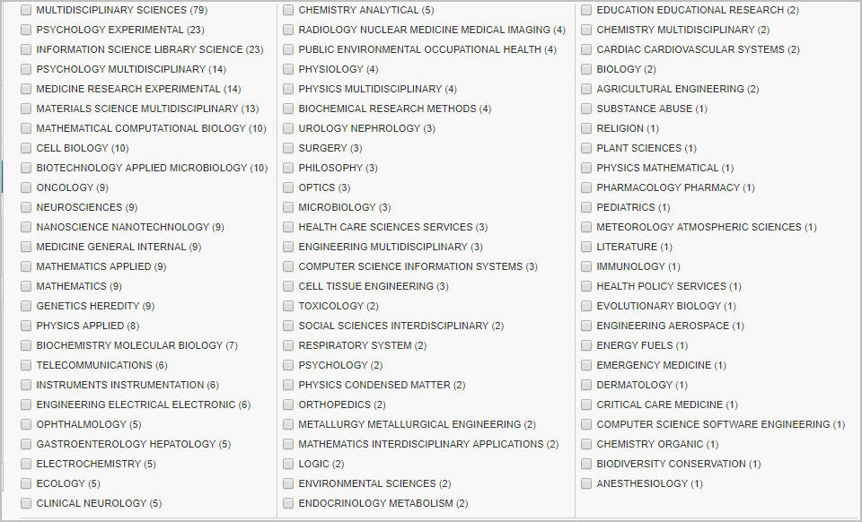
OA Articles by OU Faculty in Web of Science

Slide 16
OA at OU Libraries

Slide 17

OA Fund Pilot Programs
Kresge Library & OUWB Medical Library launched pilot programs last year to help fund APF for faculty publishing in OA journals or traditional journals with OA options
KL OA fund 2016-17 | Amounts
Total Amount Requested | $28,465.00
Total Amount Paid | $17,740.00
Average amount paid | $1,364.62
Minimum payment | $350
Maximum payment | $4,200
Med Lib OA fund 2015-17 | Amounts
Total Amount Requested | $9,737.77
Total Amount Paid | $9,259.77
Average amount paid | $973.78
Minimum payment | $435
Maximum payment | $1,823
Find out more on each library’s website

Slide 18
Journal Names | Publisher | OA Type
BMC Public Health | BioMed Central | Gold Open
Cogent Engineering | Cogent (T&F imprint) | Gold Open
Cogent Environmental Science | Cogent (T&F imprint) | Gold Open
Colloids and Surfaces B: Biointerfaces | Elsevier | hybrid
Communication and Critical/Cultural Studies | Taylor & Francis | hybrid
Frontiers in Physiology | Frontiers | Gold Open
International Journal of Medical Education | IJME | Gold Open
Journal of Biological Chemistry | American Society for Biochemistry and Molecular Biology | Gold Open
Journal of Cytology & Histology | OMICS International | Gold Open
Journal of Patient-Reported Outcomes | International Society for Quality of Life Research | Gold Open
Journal of Visualized Experiments (JOVE) | JOVE - video publication | hybrid
Medical Science Monitor Basic Research | International Scientific Information | Gold Open
Oncotarget | Impact Journals | Gold Open
PLOS ONE | PLoS | Gold Open
PLOS Genetics | PLoS | Gold Open
Stem Cell Research | Elsevier | Gold Open
Wiley Interdisciplinary Reviews: Computational Statistics | Wiley- WIREs | hybrid

Slide 19

Open Access Pledge
Kresge Library
OUWB Medical Library
Make our own research freely available whenever possible by seeking publishers that have either adopted open access policies, publish content online without restriction, and/or allow authors to self-archive their publications on the web;
Link to and/or self-archive our publications to make them freely available;
Give equal consideration to peer-reviewed articles published in open access journals during the tenure and promotion process and encourage this practice throughout the university.
Adopted by unanimous vote Nov. 2016

Slide 20

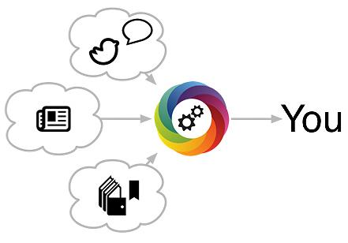



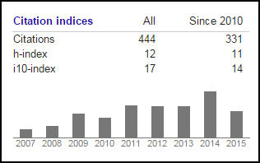
Service to Support OA Publishing
Data Librarian - Joanna Thielen
Scholarly Communications Librarian - Julia Rodriguez
Increasing Impact of research
Author Rights support
OU Institutional Repository
OU Libraries is now a member in BioMed Central, which means OU authors get a 15% discount off author publication fees
Tracking Citations

Slide 21

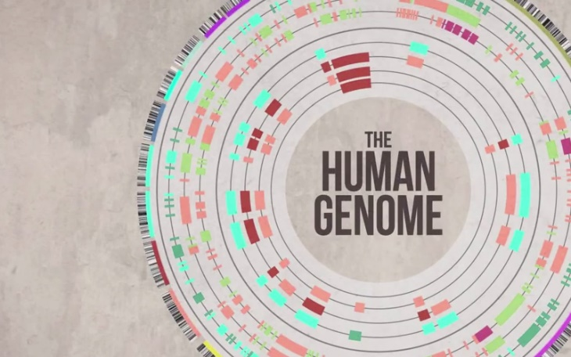
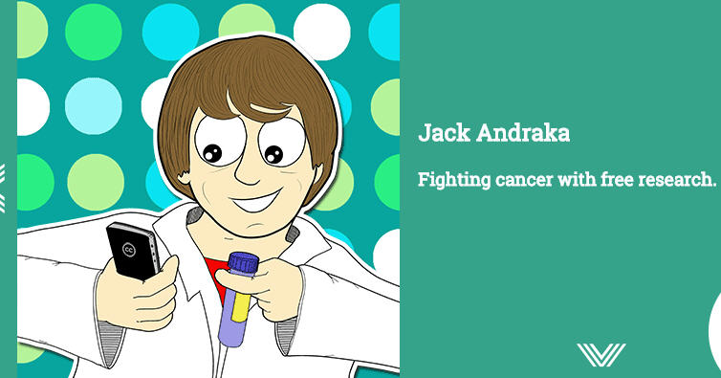
Open in order to - Impact stories
Harness the Human Genome - Researchers with the Human Genome Project agreed that all new information they produced should be made freely available online within 24 hours of discovery. First time, the public had unrestricted access to the findings and data as it was being discovered and shared.
The Human Genome Project was completed, presenting the world with the human genetic blueprint in April 2003.
Read about impact…
Smartphone become a microscope Using an open access article by global health researchers who’d invented the original cell phone microscope for use in remote clinical settings a middle school teacher developed a student-ready cell phone microscope.
At 15 years old Jack Andraka developed an innovative method for detecting a rare type of pancreatic cancer using open access research.

Slide 22
OA Resources
Kresge Library:
  Scholarly communication webpages
  Open Access guide
  Open Access Glossary
  Research Data Management guide
  OA Fund Pilot Program
OUWB Medical Library Open Access Grant Program
COPE - Compact for Open-Access Publishing Equity
Creative Commons licenses - choose a the appropriate use license for your work
Increasing Access to the Results of Federally Funded Scientific Research (OSTP Public Access memo -2013)
ROARMAP - Check mandates and deposit requirements from funders
Right to Research Coalition - Students organizing for open access
Sherpa/Romeo - Database to check publisher copyright agreements

