Slide 1
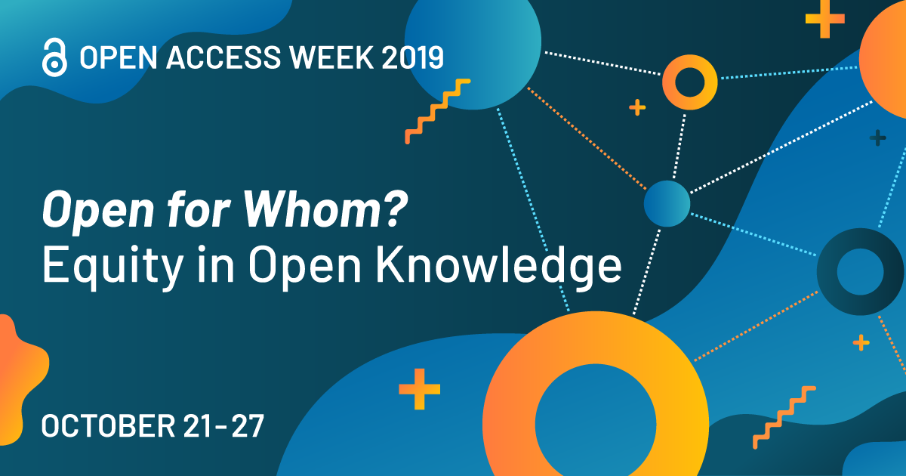


SPONSORED by Oakland University Libraries and OUWB School of Medicine Library
Notes:
5 minutes - Welcome - Julia
15 minutes - Textbooks & Monographs - Julia
15 minutes - Open Data - Joanna
15 minutes - Open Research/Journals & Images - Stephanie

Slide 2
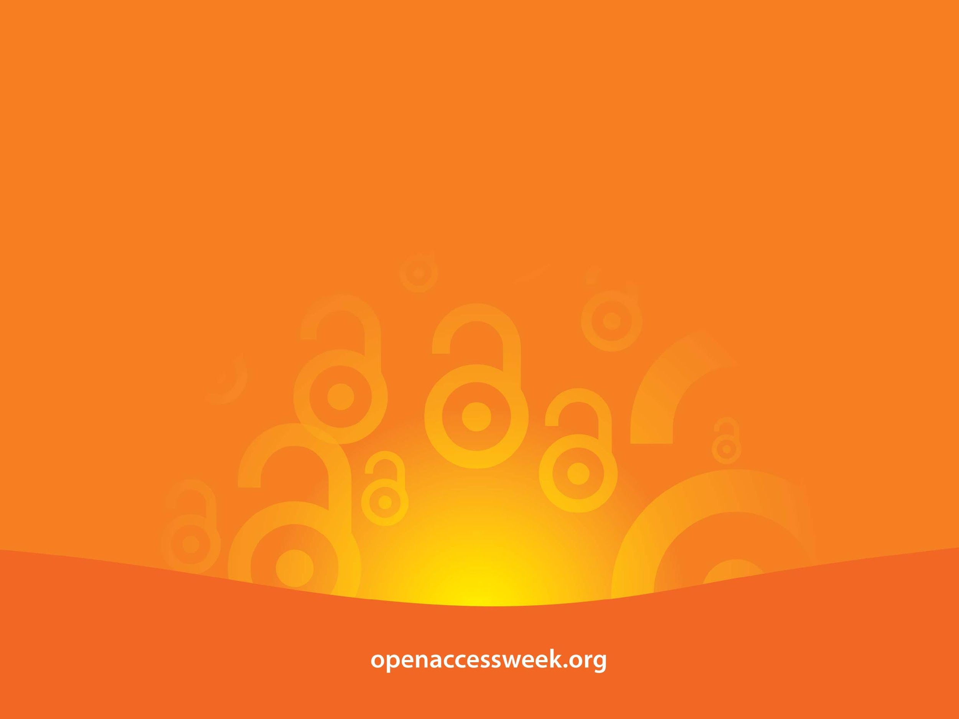
Open Access (OA) is free, immediate access to scholarly information online, along with the right to use and reuse that information. (SPARC)
OA WEEK is a global event to promote the potential benefits of Open Access and to help inspire wider participation in helping to make Open Access a new norm in scholarship and research.

Slide 3

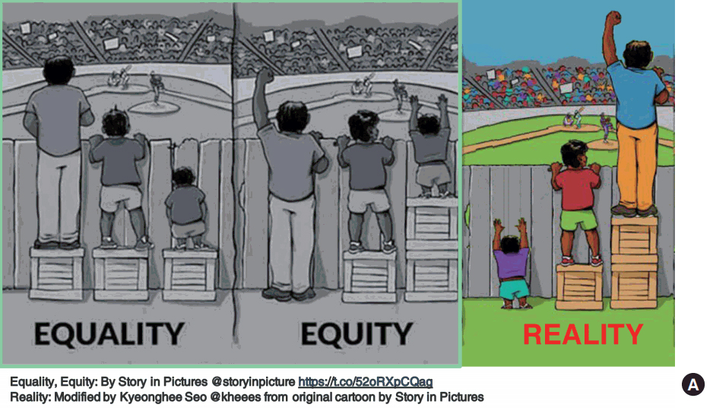
OPEN =
Free to read
Widely available
Unlimited peer-review/ sharing/ collaborating
Free to use/reuse
Shorter publishing cycle
Greater discoverability
Equality vs Equity
Open access ensure equal access.
Equality and equity are not equivalent.
Equality is about sameness – everyone gets to read the paper.
Equity is about fairness – each person has the ability to find, and also understand the paper.
Open access journal does little to increase the scope of dissemination to the members in our global community who may most benefit from the information Michelle EH Fournet

Slide 4
I Didn't Know That Was Open!
Locating and Using
Cool Free Quality Content
Julia Rodriguez, Associate Professor, Scholarly Communications Librarian
Stephanie Swanberg, Associate Professor, Information Literacy & eLearning Librarian
Joanna Thielen, Assistant Professor, Research Data Librarian
Notes:
5 minutes - Welcome - Julia
15 minutes - Textbooks & Monographs - Julia
15 minutes - Open Data - Joanna
15 minutes - Open Journals & Images - Stephanie

Slide 5

Open Books
Image by Tina Franklin via Flickr - Creative Commons Attribution-ShareAlike 2.0 Generic (CC BY-SA 2.0)

Slide 6
Open Access Monographs
Open Access Directory - Monographs Wiki hosted by the School of Library and Information Science (SLIS) at Simmons College
Aggregators
Directory of Open Access Books - (DOAB) includes 21,352 Academic peer-reviewed books and chapters from 321 publishers
Haithi Trust Digital Library “global partnership of major research institutions and libraries working to ensure that the cultural record is preserved and accessible long into the future”
Project Muse Open Access Collection - thousands of digitized books from the NEH open book grants from multiple institutions
OAPEN Library (EU) Contains freely accessible academic books, mainly in the area of humanities and social sciences
JSTOR Open - More than 5,800 Open Access ebooks from 75+ publishers
Notes:
Open Monograph publishing models

Slide 7
Open Book Publishers: Open Collections
Government
National Academies Press - Sciences, Engineering and Medicine
Academic Publishers
MIT Press Open leader in open access book publishing for two decades
U of California Press Luminosoa.org - The author will be asked to secure $7,500
Lever Press - consortium of liberal arts institutions - “paid-in-the-middle” model for open access scholarship
University College London Press - UK’s first fully open access university press - stats https://www.uclpress.co.uk/pages/statistics
For-profit publishers
Palgrave Open - McMillan imprint
Emerald Insight - open access books/journals
Notes:
Open Monograph publishing models

Slide 8
Open Educational Resources
OER are: “...teaching, learning, and research resources in any medium that reside in the public domain or are released under an intellectual property license that permits their free use and repurposing by others” (UNESCO/Hewlett Foundation). OER are free of cost, and include built in permission to retain, reuse, revise, remix, and redistribute the material.
Textbooks - Published peer-reviewed open textbooks, rated and non-reviewed non-rated textbooks
Lessons - Full course and circulumns to individual lessons - MOOCs
Lectures - Video captured lectures or narrated powerpoint presentations
Videos - Videos recorded on a specific topic or video of experts
Images - Images openly licensed
Library licensed resources - scholarly articles, books, videos
Data - Openly licensed, public domain and library licensed

Slide 9
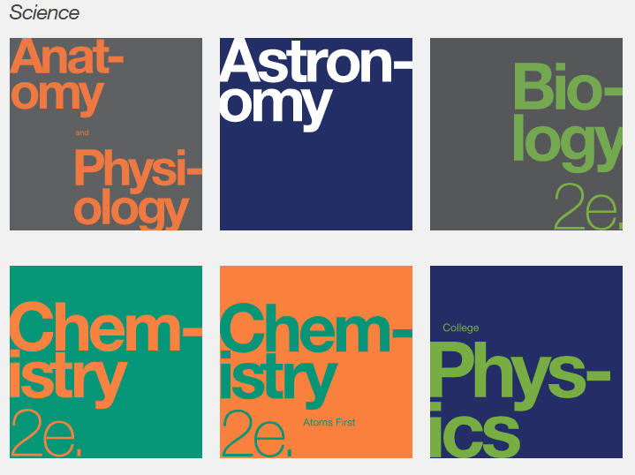
Open Textbooks
Published textbooks and ancillary materials that are free, adaptable, openly licensed peer-reviewed quality textbooks and supplemental materials.
Major Textbook publishers
OpenStaxCollege – Nonprofit organization based at Rice University
Provides free, high quality, openly licensed peer-reviewed textbooks to nearly 1.5 million college students per year.
Meet the W3C-WAI Web Content Accessibility Guidelines (WCAG) 2.0 at Level AA and Section 508 of the Rehabilitation Act.
Open Textbook Network - University of Minnesota premiere resource for peer-reviewed academic textbooks, member organization with textbook library.
BCOpen Campus - publisher and creator of open textbooks, guides and best practices

Slide 10
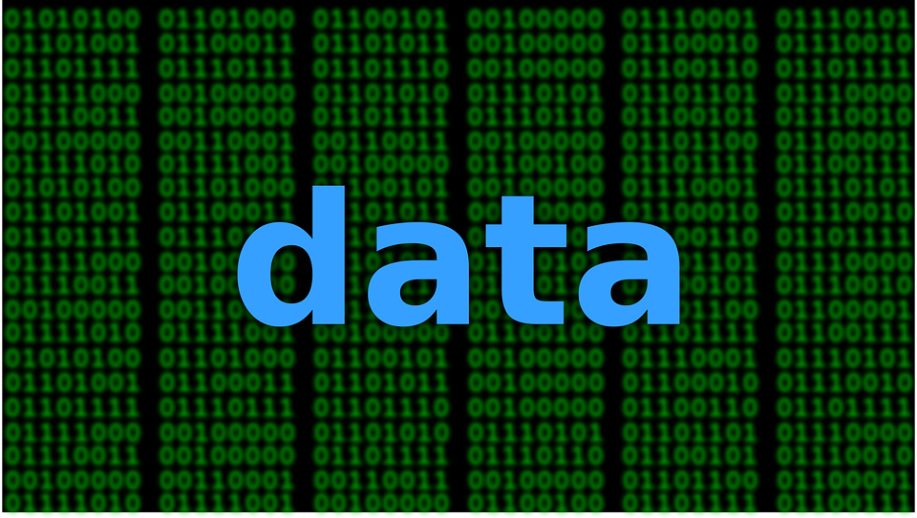
Open Data
Image by ranjithsiji via Pixabay - Pixabay Open License

Slide 11
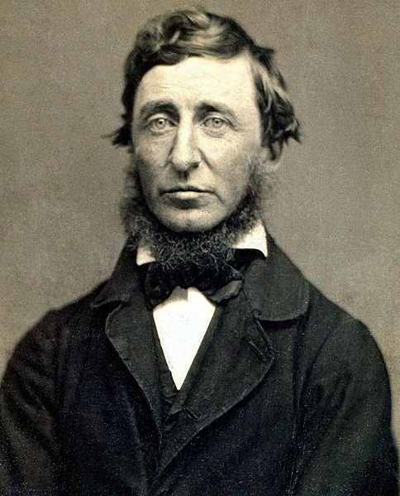
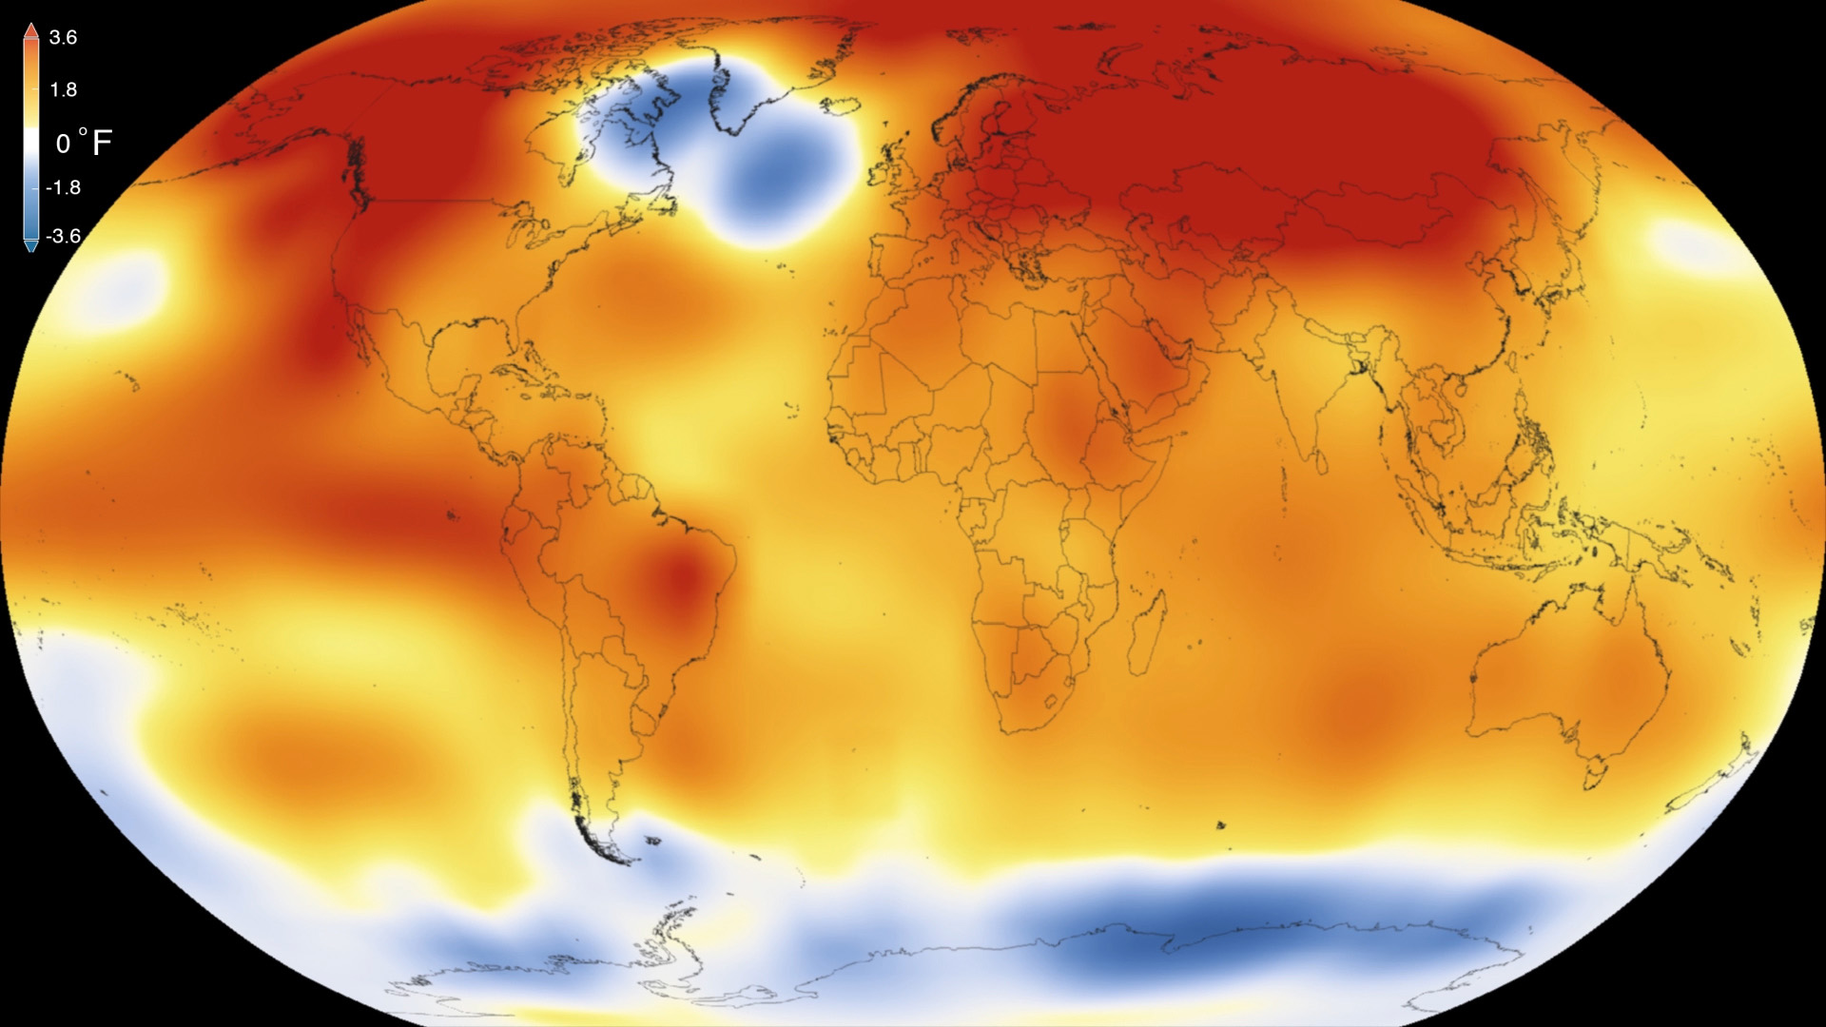
How has Thoreau contributed to climate change research?
Climate change
Henry David Thoreau
Essayist, Poet, Philosopher
1817-1862
Notes:
Joanna

Slide 12
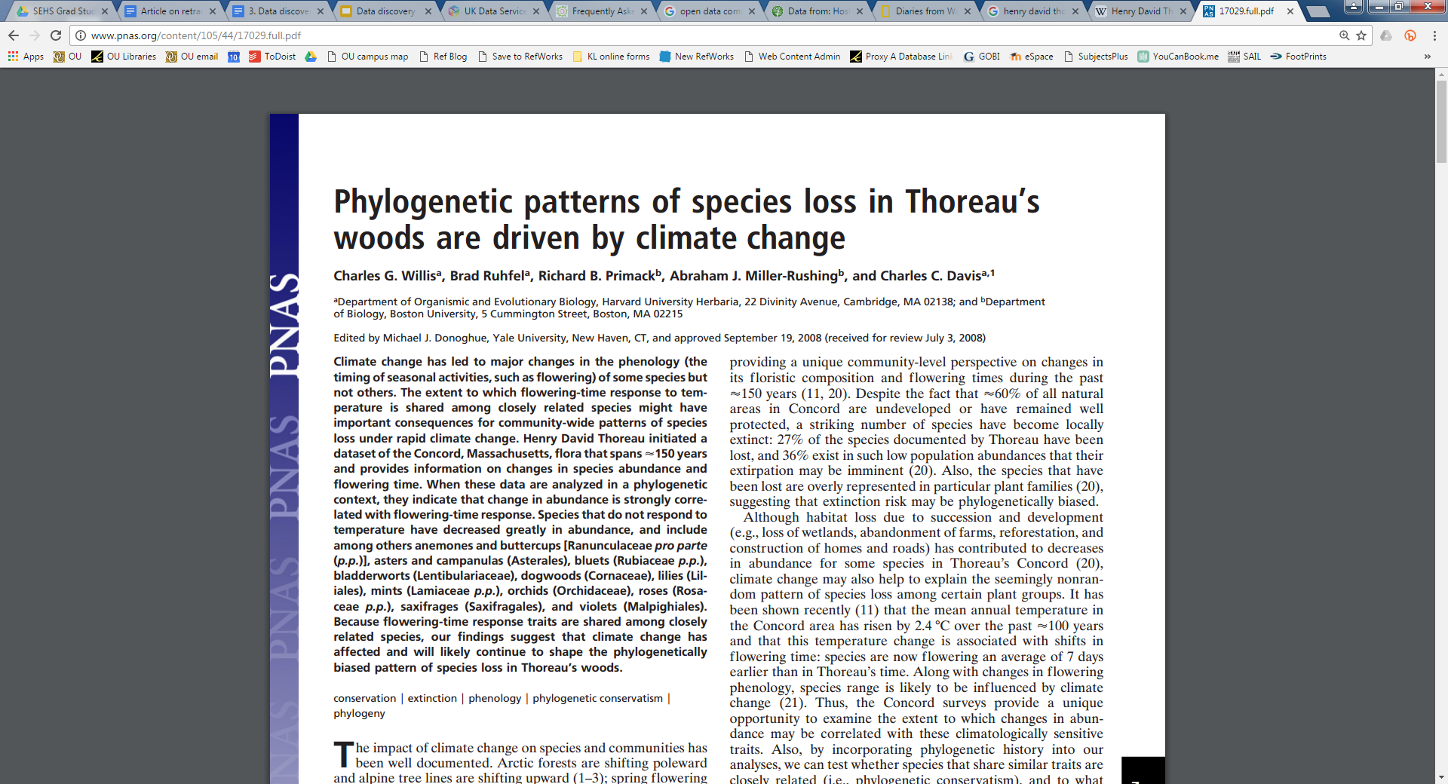
Thoreau’s diary is helping scientists document climate change
National Geographic article (July 2016)
“The detailed notes that Henry David Thoreau kept about weather, plants, and seasons are helping scientists measure the effects of global warming.”
Willis et al. (2008) Proceedings of the National Academy of Sciences of the United States of America, 105(44), 17029-17033

Slide 13
Definition of Open Data
“Open data is data that can be freely used, re-used and redistributed by anyone - subject only, at most, to the requirement to attribute and share alike.”
Open Data Handbook
Open Knowledge 2015

Slide 14
Why is Open Data Important?
ENCOURAGES
Reuse of datasets and discourages duplication of effort
Proper management of data
Transparency and reproducibility of research
IMPROVES
Discoverability/visibility of datasets
Attribution to original data producers and curators
University of California Office of Scholarly Communication. (2014). Data Publication. Retrieved from: http://osc.universityofcalifornia.edu/scholarly-publishing/data-publication/
Notes:
Most importantly: helps to recognize data as a valuable scholarly output; data is the new currency in academia

Slide 15
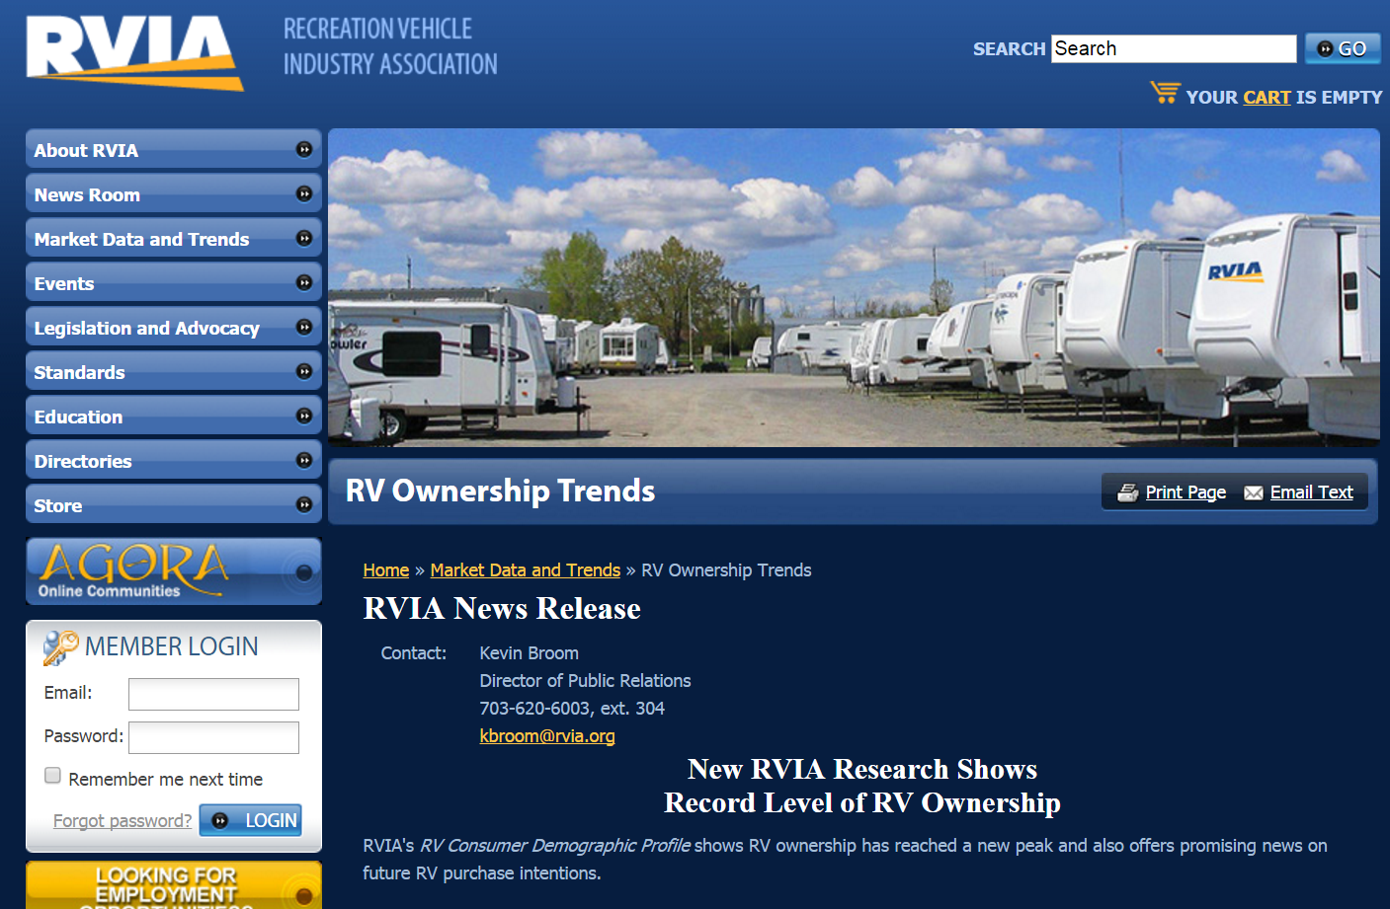
Locating open data - Who cares about this data?
Governmental agency?
For-profit company or association?
Non-profit organization?
Who would care about the demographics of RV owners?
Dataset: RVIA’s RV Consumer Demographic Profile
Notes:
RVIA: Recreation Vehicle Industry Association

Slide 16
Common Government Data Sources
American FactFinder - Demographic data from US censuses and other surveys
Data.gov - “Home of US government’s open data”
Data.michigan.gov - State of Michigan’s Open Data Portal
Access Oakland - Oakland County’s Open Data Portal

Slide 17
Common Data Sources
ICPSR - Inter-University Consortium for Political and Social Research; data: 1960s to present
  Firearm Safety Among Children and Teens
  National Archive of Computerized Data on Aging
  National Archive of Criminal Justice Data
  National Archive of Data on Arts & Culture
Pew Research Center - “nonpartisan fact tank that informs the public about the issues, attitudes and trends shaping the world.”

Slide 18
Common Data Sources
Qualitative Data Repository - qualitative and mixed methods research in the social sciences; alphanumeric, video, audio, and photographic data
Association of Religion Data Archives
EU Open Data Portal - from EU institutions and bodies
General data repositories: Zenodo, FigShare, Dryad
Registry of Research Data Repositories (Re3) - discover domain-specific repositories

Slide 19
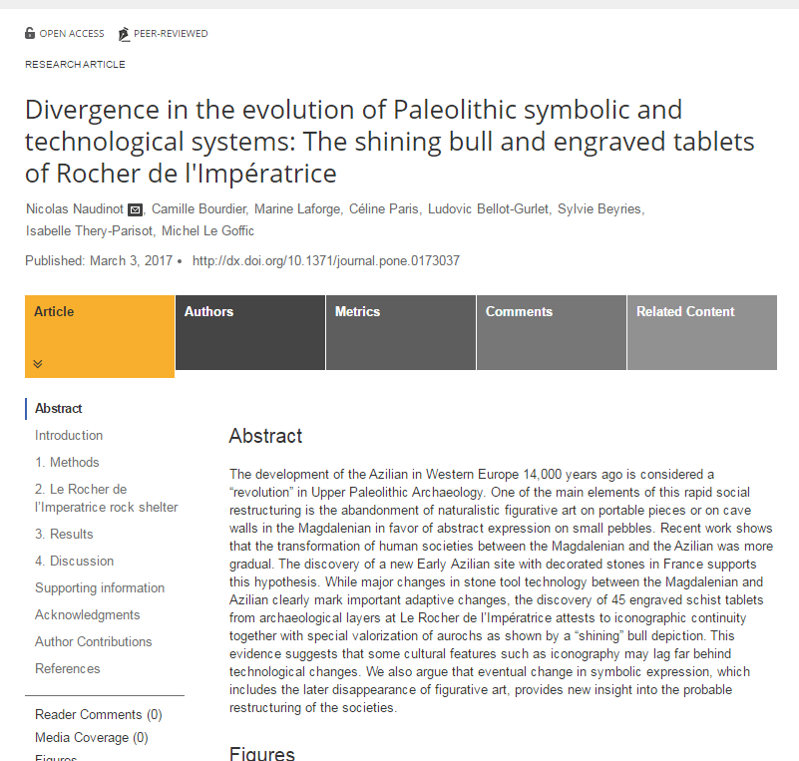
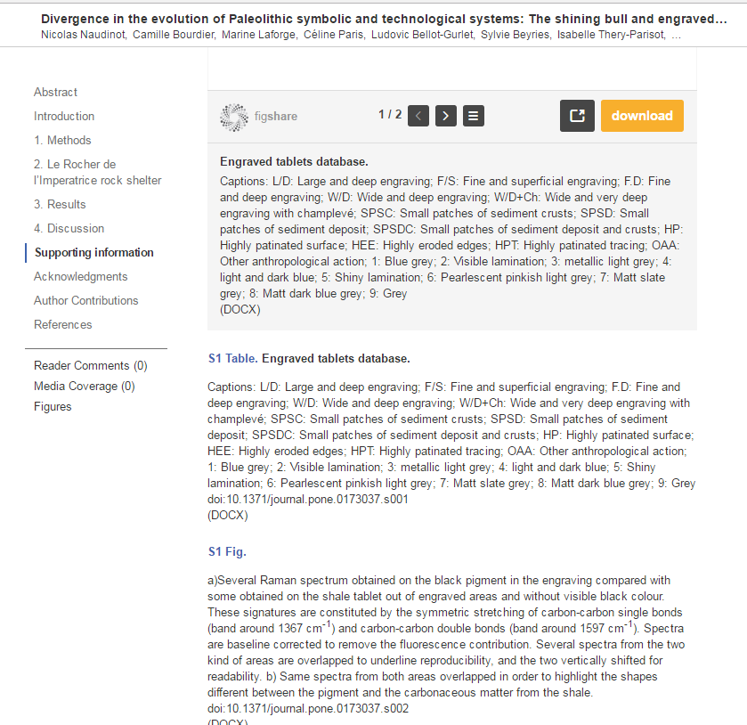
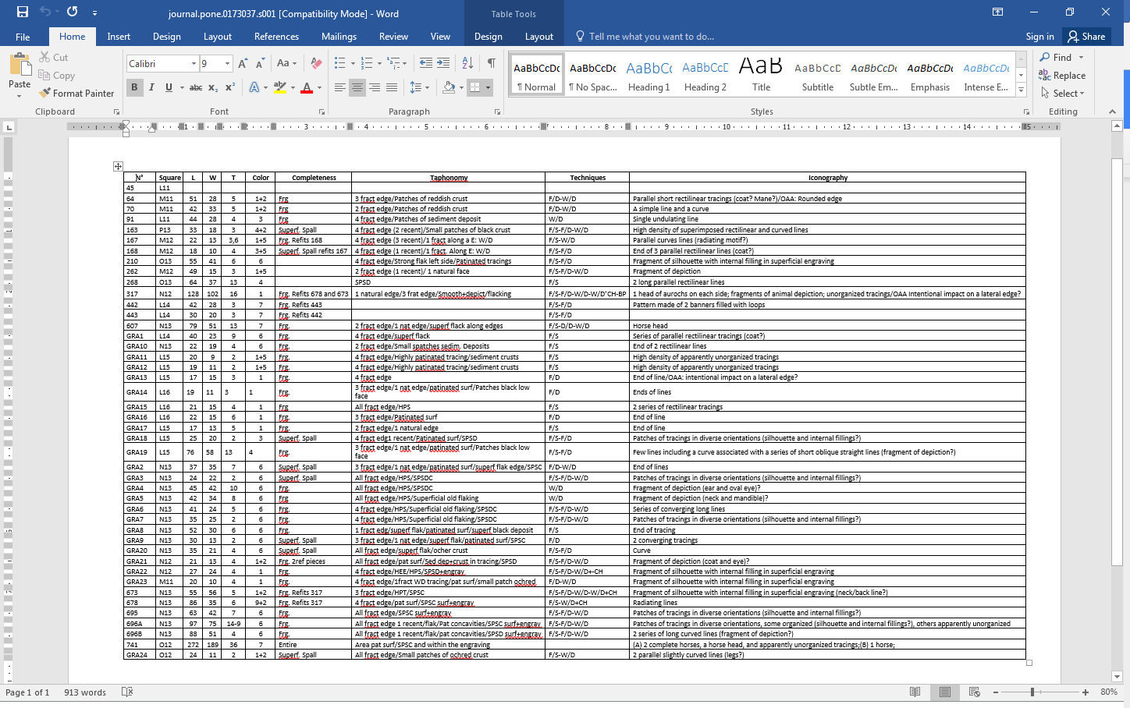
Datasets can be linked to articles
Naudinot N, Bourdier C, Laforge M, et al. (2017) Divergence in the evolution of Paleolithic symbolic and technological systems: The shining bull and engraved tablets of Rocher de l'Impératrice. PLOS ONE 12(3): e0173037.

Slide 20
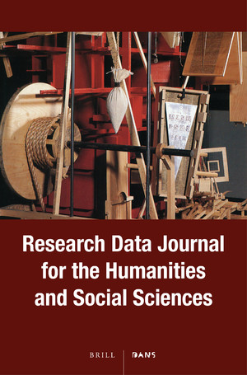
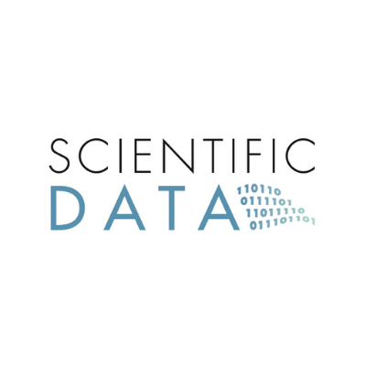
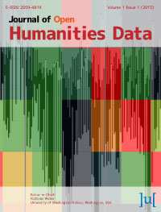
Data journals
Publish description of dataset (including possible future uses) plus dataset or link to dataset
Peer-reviewed
Can be cited liked trad. papers
Many are open access

Slide 21
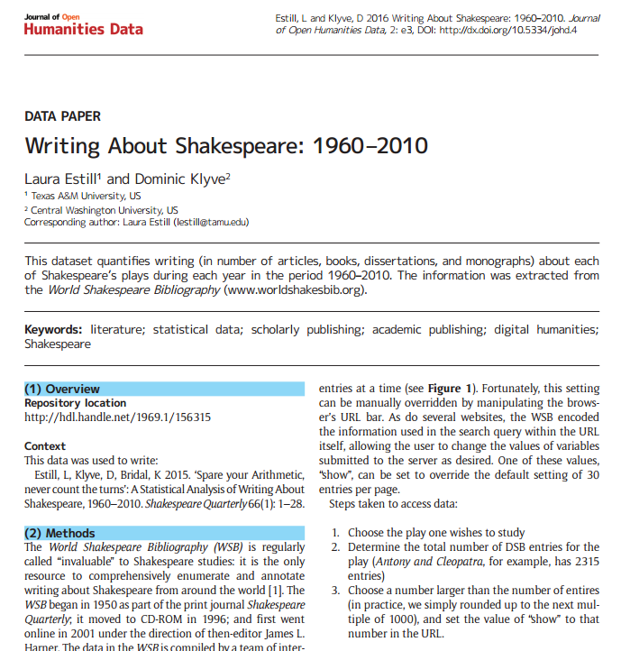
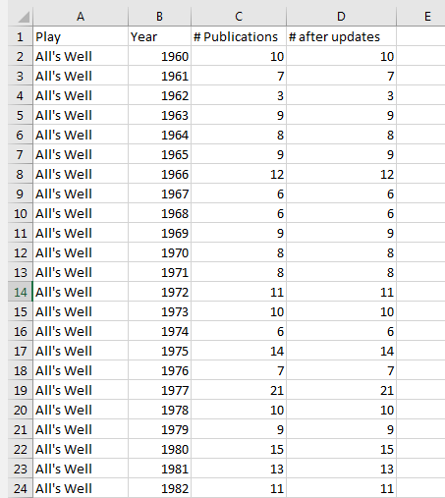
Example article in Journal of Open Humanities Data
Estill and Klyve. (2016) Journal of Open Humanities Data, 2, e3.

Slide 22
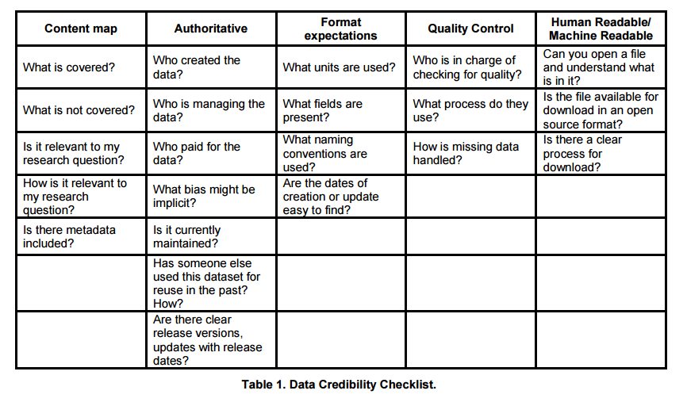
Data Credibility Checklist
Zilinski, L. and Sapp Nelson, M. (2014) Proceedings of the American Society for Information Science and Technology. 51(1).

Slide 23
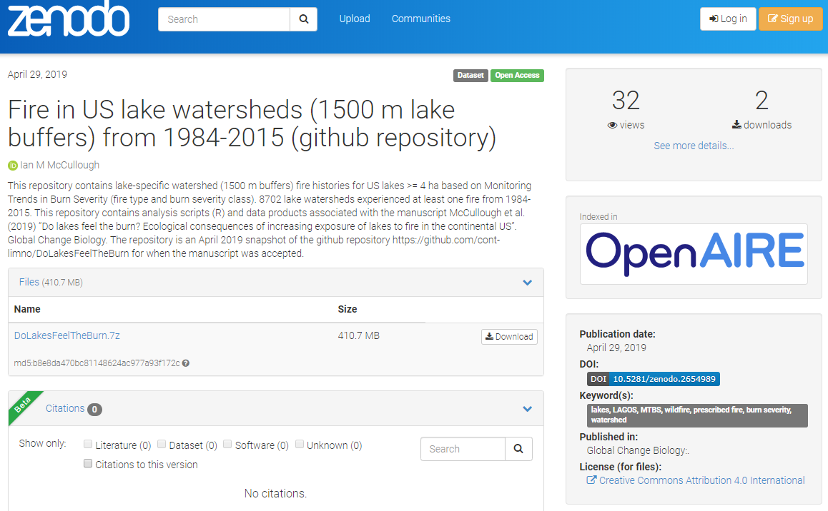
Being a good data consumer -
How can I ethically re-use this data?
Many datasets have a license, which tells you how you can (and can’t) use the dataset

Slide 24
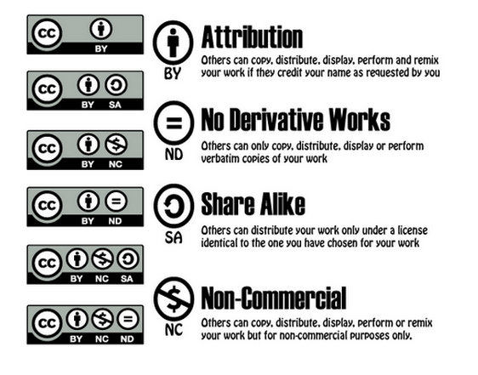
Creative Commons Licenses
Applying one of these licenses allows the creator to “retain [their] copyright while allowing others to copy, distribute, and make some uses of their work.”
Creative Commons Licensing Considerations: https://creativecommons.org/share-your-work/licensing-considerations/

Slide 25
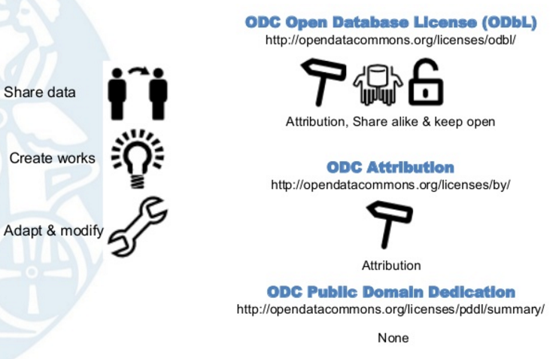
Open Data Commons Licenses
“We therefore want people to have incentives to make their data open and for open data to be easily usable and reusable — i.e. for open data to form a ‘commons’.”
Image by Garth Knight: slideshare.net/lshtm/introduction-to-data-licences
Open Data Commons FAQs: opendatacommons.org/faq/

Slide 26
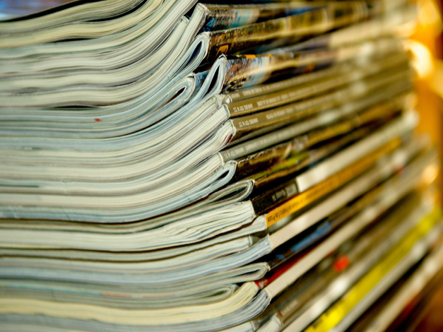
Open Research
Image by jackmac34 via Pixabay - Pixabay Open License

Slide 27
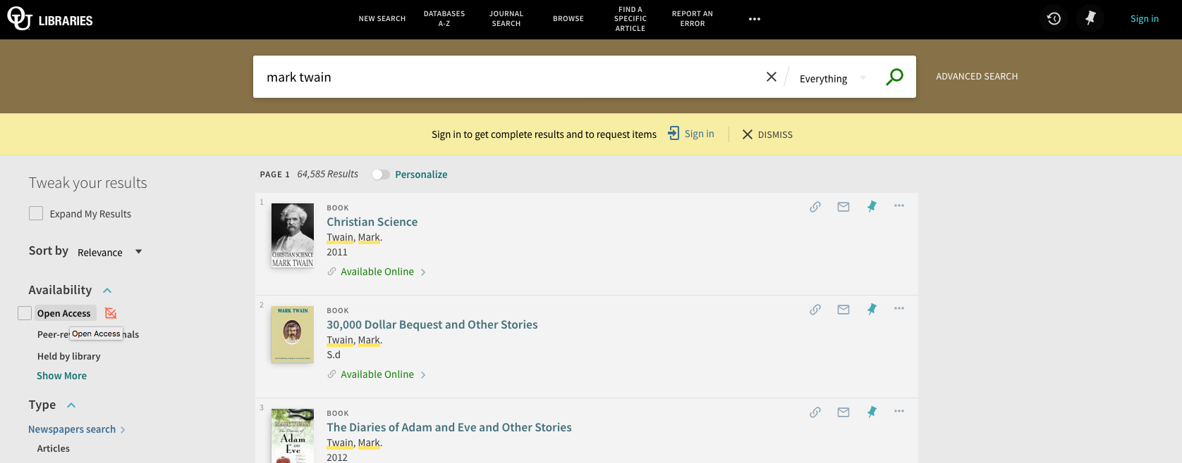
Best Places to Find OA Literature
OU Libraries’ Library OneSearch library.oakland.edu
  Filter results by Open Access under Availability!

Slide 28
Best Places to Find OA Literature
Directory of Open Access Journals (DOAJ): doaj.org
  Online directory of high-quality, peer-reviewed open access journals
  Journals must undergo a rigorous application process to be included in DOAJ
Google Scholar: scholar.google.com
  Not everything in Scholar is open access, but still a great place to locate OA literature

Slide 29
PubMed Central
ncbi.nlm.nih.gov/pmc
National Library of Medicine’s free archive of biomedical & life sciences literature
Designated open repository for publications resulting from publicly (and some privately) funded research:
  aka NIH Public Access Policy
  NIH, CDC, Gates Foundation, EPA, FDA, NASA, & more
Also a European equivalent: Europe PubMed Central

Slide 30
Institutional Repositories
Directory of Open Access Repositories (OpenDOAR): opendoar.org
  Includes links to over 2600 academic and governmental repositories
  Searchable – search for repositories OR search the contents of all repositories using the site's Google custom search box
OUR@Oakland: our.oakland.edu
  Oakland University’s institutional repository maintained by OU Libraries

Slide 31
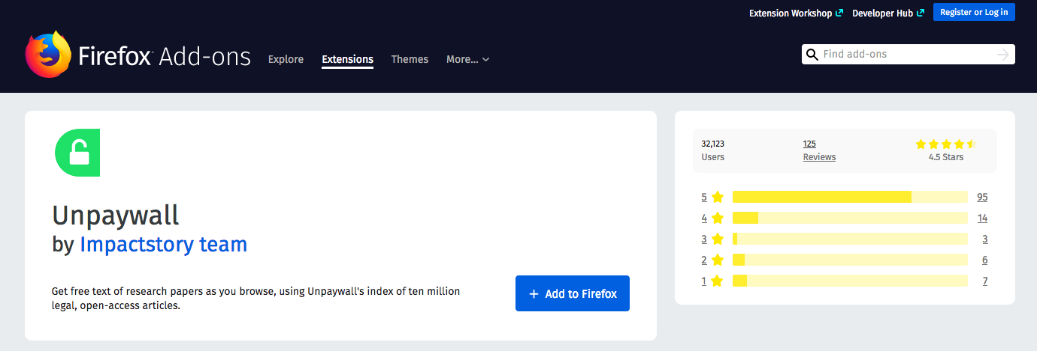
Unpaywal1: http://unpaywall.org/
Run by Impactstory
Chrome & Firefox extension
Legally pulls PDFs of scholarly content if it is openly available

Slide 32
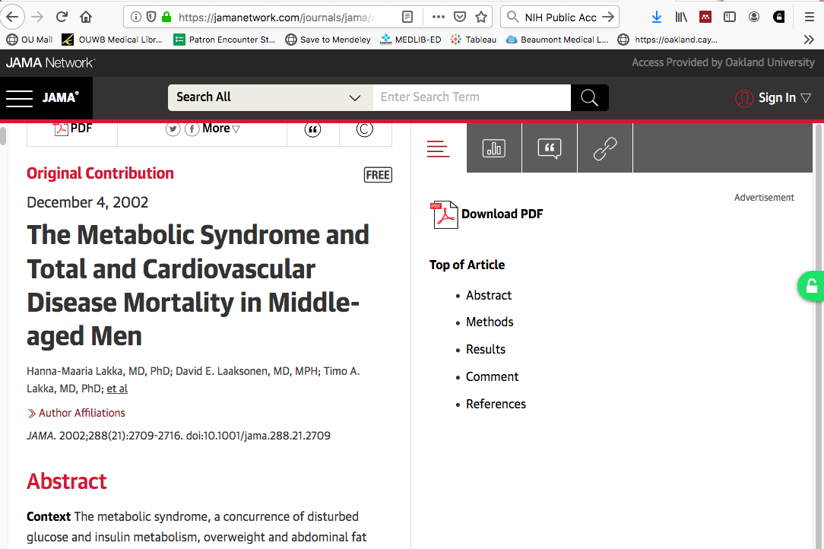

Slide 33
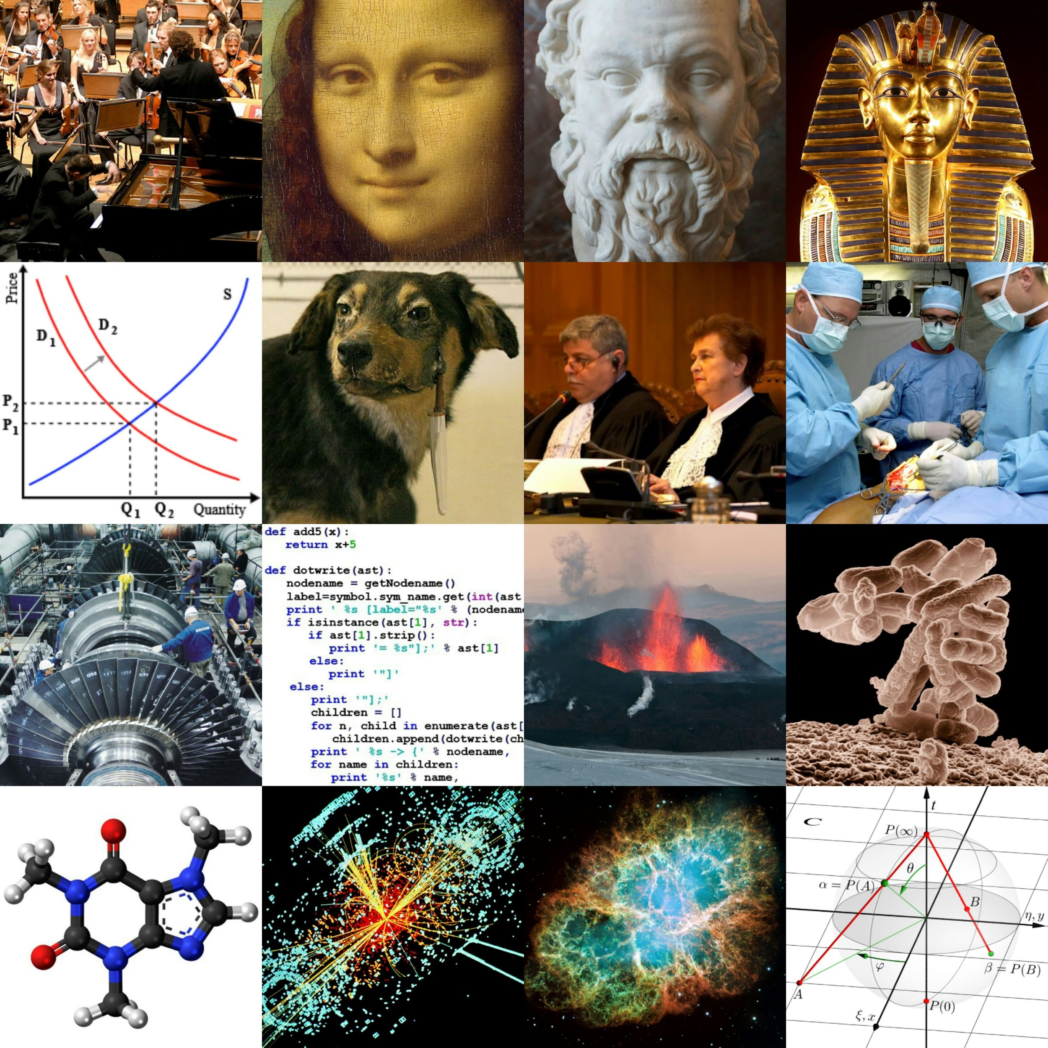
“Free” Images
Image: Academic disciplines (collage) via Wikimedia Commons - Creative Commons Attribution-Share Alike 3.0

Slide 34
Best Places to Find “Free” Images
Google Images: images.google.com
  Conduct a typical search > Select Search Tools > Usage Rights > Labeled for Reuse
Creative Commons Searcher: search.creativecommons.org
  Searches many different “free” image resources
  All images are under a CC license
•

Slide 35
Best Places to Find “Free” Images
CDC’s Public Health Image Library (PHIL): phil.cdc.gov
  All images in the public domain!
  Search is not precise
Others:
Wikimedia Commons: https://commons.wikimedia.org
Flickr - not all images are “free”
Pixabay
For Stock Photos: freeimages.com
For ClipArt: openclipart.org

Slide 36
Summary
Open access allows equal access to a variety of works including:
Books & textbooks
Data and datasets
Research articles
Images
Check these out next
time you start a
search!

Slide 37

Questions?
Julia Rodriguez
juliar@oakland.edu
Stephanie Swanberg swanberg@oakland.edu
Joanna Thielen
jthielen@oakland.edu
Image: Question Question Mark Request Matter Requests by geralt via Pixabay - Pixabay Open License

