Slide 1



2016
“OPEN IN ACTION”

Slide 2
Collaborative tools
For professional & Research Projects
Keith Engwall, MSI, AHIP
Assistant Professor, Web & Emerging Technologies Librarian
Oakland University William Beaumont School of Medicine
engwall@oakland.edu, October 25, 2016
Notes:
Good

Slide 3
Objectives
Identify collaboration features of Google Drive (collaborative authoring)
Identify features of the Dataverse Project
(collaborative data management)
Identify features of the Open Science Framework (collaborative project management)
Discuss how access and data security impact collaborative research

Slide 4
AUTHORING
Google drive
Shared documents & folders
Access Control
Simultaneous authoring
Communication
Change tracking
Revision history
https://drive.google.com
Notes:
Show shared folders in “my drive”
Show share window
Link
Invite via email (they will need a google account)
Edit vs View
Open document
Show change tracking vs. editing
Show revision history
Return to PPT to show screens for simultaneous editing and chat

Slide 5
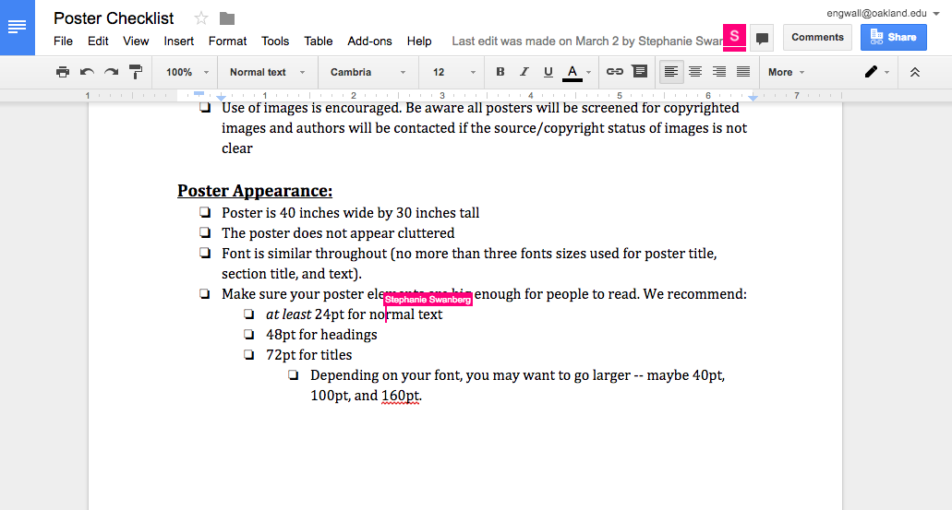

Slide 6
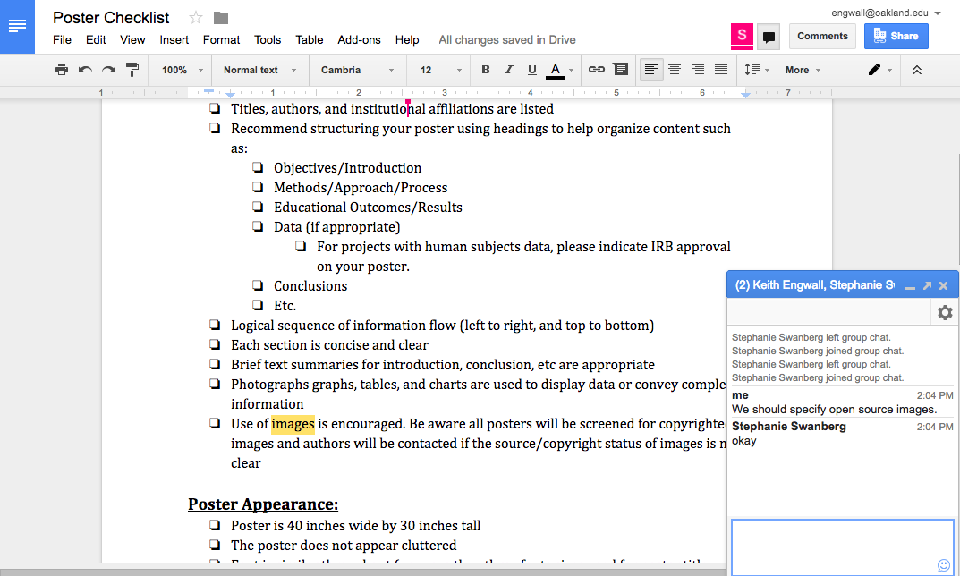

Slide 7
Data Management the Dataverse Project
Developed jointly by the Institute for Quantitative Social Science (IQSS) & Harvard University Library
Free and Open Source
Actual data: https://dataverse.harvard.edu
Testing: https://demo.dataverse.org

Slide 8
Data Management the Dataverse Project
Shared collections (“dataverses”), data sets, data files
Access control to collections, data sets, data files
Private until published
Terms of access to published datasets
Robust description through metadata
DOI assigned to data sets
Individualized API token for integration
Notes:
Go to dataverse.harvard.edu
Show search functions
Select 2015, Herschel-Bat Photometry
Citation, DOI, Files, Metadata, Terms, Versions
click sign up
Go to demo.dataverse.org, Log in and show dashboard (My Data), API
Show Create Dataverse
Go to dataverse
Permissions: Access, Roles, adding users & groups (FOR SETTING UP COLLABORATORS)
Groups
Show Create Dataset
Go to data set
Metadata (settings)
Metadata Templates (from Dataverse menu)
Permissions: Roles, adding users & groups
Private URL (for sharing unpublished data with those who do not have a dataverse account)
Files menu
Metadata
Restrict
Tags

Slide 9
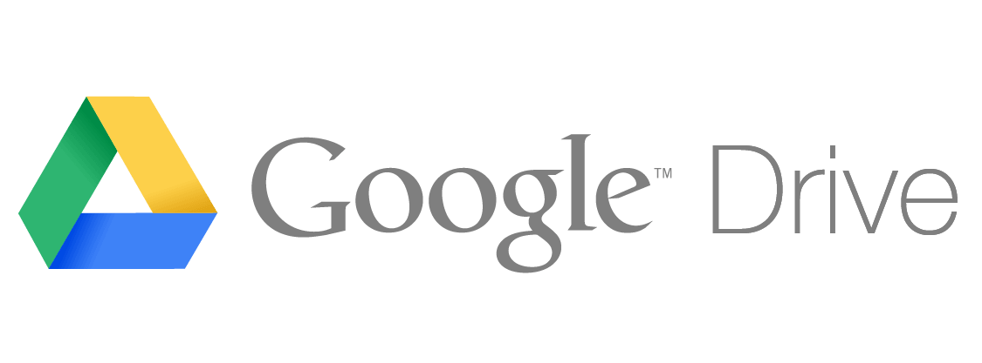








Project Management
Open Science framework
Developed by the Center for Open Science
Free and Open Source
3rd party integration
https://osf.io

Slide 10
Project Management
Open Science framework
Collaborative Project Space
Access control
Private until published
Markdown wiki for documentation
Create snapshots (”registrations”)
Sub-projects (”components”)
Link to or fork off of existing projects
Notes:
Go to osf.io and Browse Registry
Show filters on left
Registry search (*) vs. Global search
Search for Mathematics, select All, then Default Bayesian Hypothesis
Show Wiki, Files (including GitHub), Components, and Activity
Show sign up and then sign in
Return to Project
Show Bookmarks, Duplicate and Share
Return to Dashboard and click Create New Project
Return to Dashboard and select Data Analysis Elective
Settings
Contributors (FOR SETTING UP COLLABORATORS)
Wiki
Files
Dataverse entry (DOI doesn’t work because unpublished)
Citations
Components
Links
Forks
Return to Dashboard and select Account Menu
Profile, Social, Employment, Education
Account Settings (Two-Factor Authentication)
Configure add-on accounts
Notification (emails)
Developer Apps
Personal Access Tokens

Slide 11
Issues
Access
  Multiple accounts / passwords
  Familiarity
  Firewalls
Data Sensitivity
  HIPAA, FERPA, CIPSEA, Privacy Act
  IRB, Institutional Recommendations
  Online solutions under development
  Limits access to collaborators

Slide 12
Questions?

