Slide 1
Doing the Donor Dance
Lessons learned from talking to donors and donor relations staff
MI-OER Summit 2022

Slide 2
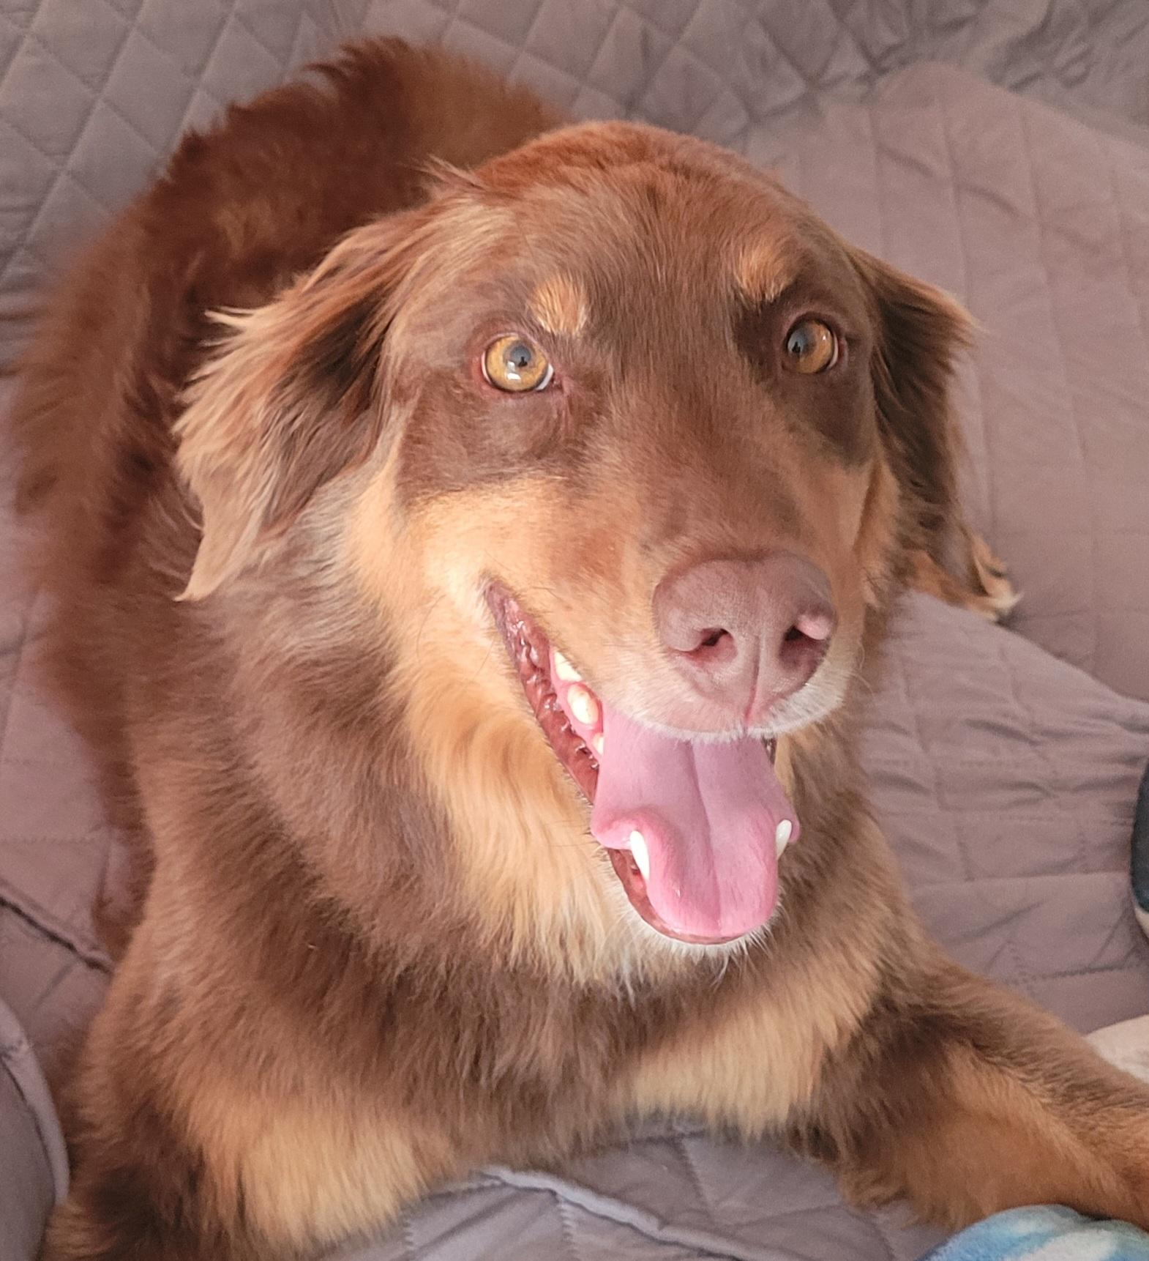
Hello!
Julia E. Rodriguez
Health Sciences & Scholarly Communications Librarian
Affordable Course Materials Initiative Team Lead
Oakland University Libraries

Slide 3
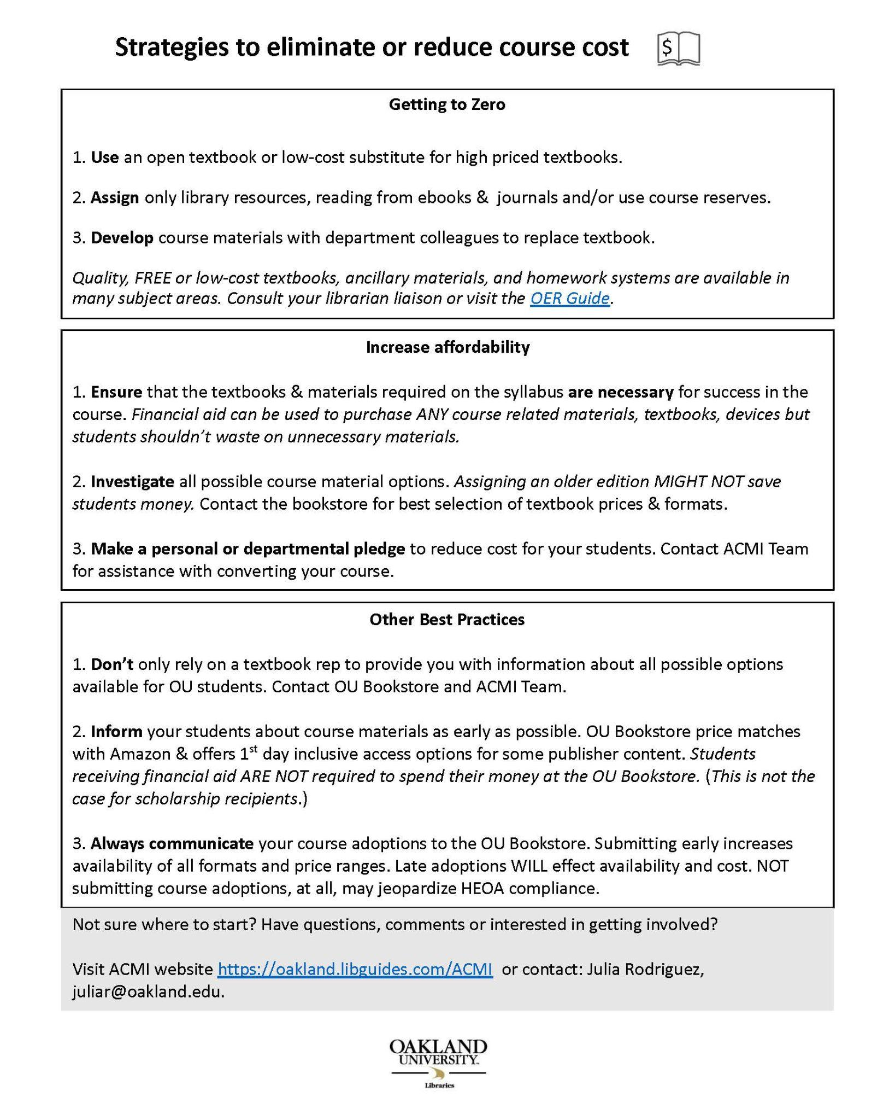
Goal
Recognize and reflect on how messaging for donors and philanthropy staff is different from other outreach we do.
Assist with developing materials and be better prepared for donor outreach and events.
*Presentation is for the novice fundraiser.
Do not have a magic bullet or any supreme wisdom.
Notes:
The goal of this presentation is to have participants consider how we communicate to donors and philanthropy staff and how the messaging and marketing elements we create are different than almost all the other types of outreach we do.
Hopefully you will feel better prepared for donor outreach and able to more effectively create marketing materials.
I was start by saying I don’t have a magic bullet or any supreme wisdom, the knowledge shared here is intended for novices, those just getting started with outreach to donors.

Slide 4
Outline
Oakland University in context
Background about OU’s Affordable Course Materials Initiative (ACMI)
  ACMI timeline
  AMCI student engagement
Donors Engagement
  Print
  Presentations
Donor Outreach Story
Lessons
Resources
Discussion - Questions
Notes:
The presentation will follow this outline, I will begin by providing some background about my institution and our affordable initiative and then discuss the different donor engagements methods. I’ll tell you a little story and discuss the lessons learned and share with you a presentation template I developed. Perhaps we will also have time for you all to share some of your stories and lessons learned.

Slide 5
How many of you have experience talking directly to donors about OER?
Put in chat - A LOT - SOME - NOT MUCH - NONE
Notes:
Because we are not in person which I really miss and I can not survey you easily or see all your pretty faces, I’d love for you to please share in the chat whether you have had experience with talking directly to donors.Please post in the chat box the word that best matches you - ALOT - SOME - NOT MUCH - NONE.

Slide 6
Background on OU
Oakland University - Rochester Hills/Auburn Hills, MI (Detroit metro-area)
20,000+ students - R2 classification
70% from Oakland or Macomb county
12% residential on campus
75 % full-time undergraduate students received scholarships and grants
  86% for FTIACs
43 % full-time undergraduate students received need-based financial aid
Approximately 50% of OU graduates are transfer students
Average debt of undergraduates $26,724.00
Notes:
So a little background about Oakland University- we are located in Rochester Hills/Auburn Hills, MI in the Detroit metro-area.
We have approx 20,000+ students - R2 classification
70% from Oakland or Macomb county
12% residential on campus
75 % full-time undergraduate students received scholarships and grants
86% for FTIACs
43 % full-time undergraduate students received need-based financial aid
Approximately 50% of OU graduates are transfer students
Average debt of undergraduates $26,724.00

Slide 7
OU Affordability program
Fall 2017 - College of Arts & Science OER Task Force formed, report to the Dean
2018 - OU College Assembly, OU Faculty Senate & Student Congress passed resolution in support of OER or an affordable initiative
February 2019 - Launched Affordable Course Materials Initiatives (ACMI) with presentation to Senate after Provost endorsed and funded campus plan.
Winter 2020 - ACMI Stipend pilot program launched
Winter 2021 - 2nd round ACMI stipends with library Day of Giving pledges
Summer 2021- Zero and low-cost course markings added to Banner
Fall 2021 - OUSC passes new resolution in support of ACMI - conducts petition campaign
Winter 2022 - Provost announces creation of the Affordable Education Materials Gift Fund and endorsed support for ACMI
Winter 2022 - Round 3 ACMI stipends awarded
Notes:
OU affordability initiative started in 2017 with a task force in the College of Arts and Sciences. That led to the development of a campus plan which was accepted by our Provost and officially launched in Feb 2019. We received $5,000 at some point during that year which was used as seed money for our pilot stipend program but we had no further engage from Provost office.
This pilot stipend program was pretty successful, we had a presentation by several participants for OE Week just after we moved to all remote work because of COVID. Because of the success of the pilot and attendance of some library donors at the OE Week presentation we were able to concentrated our Library Day of Giving fundraising on the Affordable Initiative which allowed us to run another round of stipend in Winter 2021. In summer 2021 we quietly launched our Zero and low-cost course markings addition to our registration system. Fall 2021 saw a lot of activity as our Student Congress re-engaged with this issue and called on the administration to fund and support the program. In Winter 2022 - our Provost announced the creation of the Affordable Education Materials Gift Fund and endorsed support for ACMI.

Slide 8
OU Affordability program
2018 - OU College Assembly, OU Faculty Senate & Student Congress passed resolution in support of OER or an affordable initiative
February 2019 - Launched Affordable Course Materials Initiatives (ACMI) with presentation to Senate after Provost endorses and funds campus plan. $5,000
Winter 2020 - ACMI Stipend pilot program launched
NO ACTIVITY COVID 😟
Winter 2021 - 2nd round ACMI stipends with library Day of Giving $5,000
Summer 2021- Zero and low-cost course markings added to Banner
Fall 2021 - OUSC passes new resolution in support of ACMI - conducts petition campaign Pledges $5,000
Winter 2022 - Provost announces creation of the Affordable Education Materials Gift Fund and endorsed support for ACMI - Library Day of Giving $5,000
Winter 2022 - Fundraising event scheduled for summer by administration
Notes:
Before I move on I want to just highlight a few things that may not be apparent when looking at the long list of activities. Some of this, particularly the repetition of events, may feel familiar to you all.
In 2018 our Student Congress passed a resolution in support of OER which they presented to our BOT. Things went quiet after that. Those students moved on and we had some but not very effective engagement with their replacements. In Fall 2021, the newly elected Congress became very engaged. They passed an new resolution in support of the official affordable initiative and even pledged some funds which we had been previously told they could not do. They had focused leadership that took very public actions. Which I will talk more about in a minute.
Notice the little frowning face in the middle- we essentially had no activity and no outreach for almost year because of the pandemic. During this time my Team dissolved and I have been working solo since then.
You may also notice that our Provost endorsed the initiative both in 2019 and 2022. One Provost left our institution, and he took his Associate Provost with him. Basically wiping out a lot of institutional knowledge. So in 2020 we started with an entirely new Provost office and essentially had to do a re-education campaign.

Slide 9
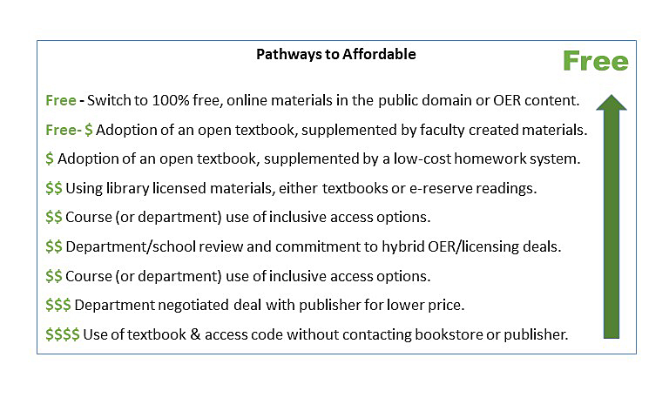
Notes:
While the original task force and report focused specifically on OER, the Affordability Initiative that came out of this work was deliberately designed to initially be very broad. Based on a lot of campus conversations we came up with a pathway toward transitioning courses to affordable. OER is seen as the goal but support was also put in place for faculty to transition courses in other ways such as using library materials.

Slide 10
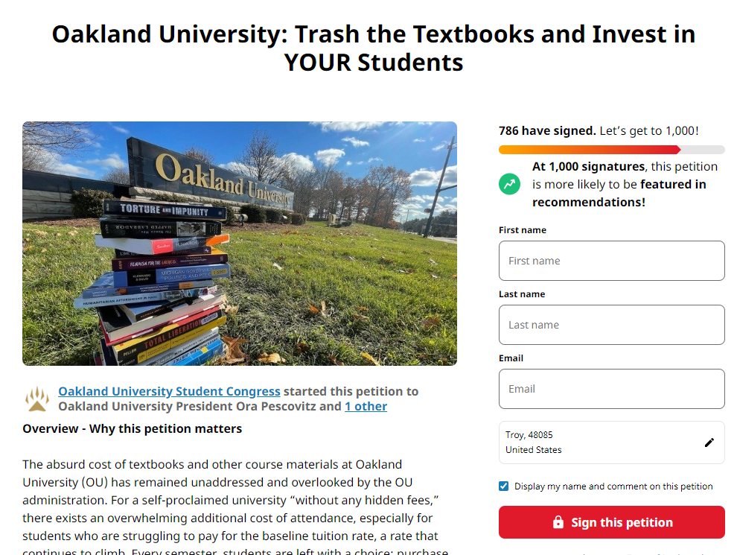
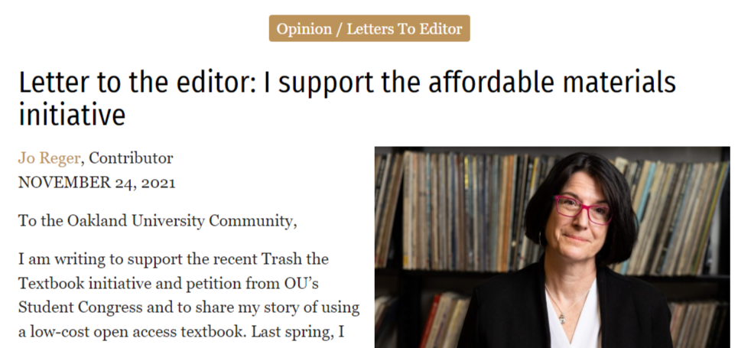
“We, the students and all of the OU community, are standing up today to urge the OU administration to invest in the Affordable Course Materials Initiative (ACMI) and work to implement Inclusive Access by investing $250,000 in cost reducing programs.”
Notes:
As I mentioned our students really re-engaged with the Affordable Initiative in the Fall 2021. I had reached out to the new student congress to share some survey data we had gathered just prior to COVID that strongly suggested that out faculty rarely heard from students about not being able to purchase textbooks. I believe their strong re-engagement is due to the fact that new Student Congress President is a campus activist who had previously taken on the administration regarding student working conditions during the pandemic. He quickly launched a campus that included a public petition calling out the administration to fund our initiative. He also invited faculty who had received stipends and student leaders to write letter to the editor of the student newspaper. I share all this history with you as it was the impetus for quick uptick in engagement and fundraising for the initiative.

Slide 11
Requests
Interviewed by student newspaper about Provost announcement
Encouraged to submit written grant to local group
Spoke with Telafund group answering phones supporting new fund
Present at salon dinner event at the President’s house group 20+
Present to Golden Grizzly Summit - All Boards for university 100+, and Deans, Philanthropy staff
Print
  None of already available content on web or print were created with donors as audience
Face-2-face
  Presentations were designed for faculty and administrative audiences or students
Notes:
The student activities resulted in me receiving a number of requests. Not only did one of the newly appointed Associate Provosts (we have 3 now, to replace the one that left) contact me and we had a series of meetings that ultimately only led to the Provost re-endorsing the initiative and publicly encouraging faculty to use OER and affordable materials. The Provost also announced the creation of the Library Affordable Education Gift fund, which has already been in the works for awhile.
With the creation of the new gift fund, our student volunteers who answer calls for our Telafund office needed to be properly informed about the initiative so I met with that group. I also was interviewed by the student newspaper about the Provost’s announcement and encouraged by the Administration to submit grants to local groups, which I did. None of those were funded.
The big TA-DO that was a direct result of the student campaign was I was asked to present for a group of donors at the President’s house in what is known as a salon dinner. This was the first fundraising event sponsored by President at her house for the library.
Because of the success of the salon dinner I was invited to also present at our Golden Grizzly Summit. This is a large meeting of all the Boards for university, about 100+ people including the Deans and Philanthropy staff.

Slide 12

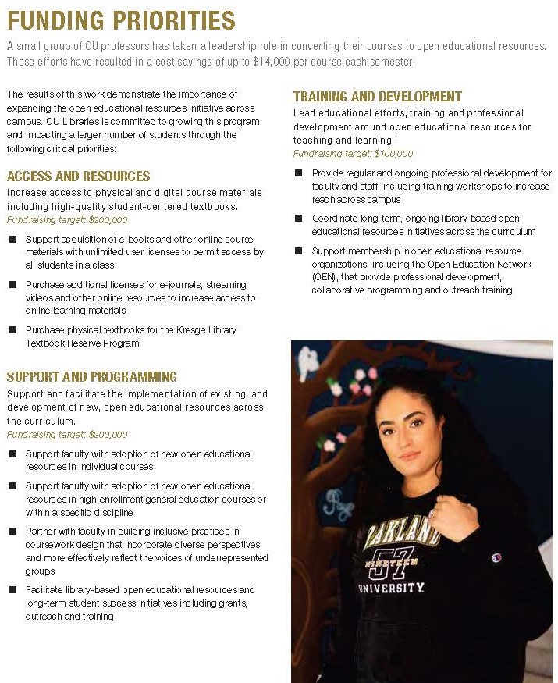
Day of Giving Brochure
Language change from ACMI - to Affordable Education
Examples pulled from OUSC Letters to the Editor
  marked as OER but actually low-cost
  push to put hard numbers of savings
In 2020, OU professors redesigned five courses to replace expensive textbooks with open educational resources. These five courses alone saved 229 students up to $40,000 in one semester. These cost savings continue every semester that these materials are used.
Large fundraising targets
View brochure https://tinyurl.com/nuhhnaa
Notes:
All of the different requests and activities required new marketing and outreach materials. I’ll briefly discuss print materials and then cover creating presentations.
The Day of Giving campaign required the development of a large glossy brochure. Prior to this all the outreach materials were created by me or me with the Team. This one was done by the Philanthropy staff and campus marketing team.
This type of print material has some advantages, it had enough space to include context, background and stories. But in print the wording and phrases become very important.
A few things I encountered as we developed this new outreach piece was that the Philanthropy staff and campus marketing team changed the title of the Affordable Course Materials Initiative to simply Affordable Education. Which aligned with the name of campus fund. This sounds simple enough but gets confusing when all my other materials and the webpage say ACMI.
For the 1st edition we only had some quotes from stipend faculty reports to use to illustrate the stories. For the 2nd edition, they pulled examples and statements from the Letters to the Editor faculty had written (mentioned earlier) but in one case they used the header Faculty use Open Educational Resources but the story they highlighted was of a faculty member who used a low-cost resources NOT OER. I had to be very clear about why this different matters.
There was also a strong push for me to provide solid savings and impact statements not just from what we had already done but what a specific pledge amount could do in the future. I’m sure you all know how tricky these can be. When we initially created the brochure we were just wrapping up the pilot stipend program which did provide some information to confidently use but I had to tweak their language several times to feel that it accurately stated what we knew.

Slide 13
Donors Presentations
Differences with donors as audience
Typically shorten time to communicate message
Familiar with university less so about courses/teaching techniques /policy /process
Want to know big picture - not so much the details
Interested in what other local institutions are doing
Want to feel connected with project - know they are having impact
Want specified ask - clearly articulated needs, what it takes to get results
Notes:
If we think about presenting it’s probably true for you all to that you have many different versions of a presentation, depending on whether you are talking to librarians, teaching faculty or administrators even students. But when it came to putting a presentation together for donors, I realized that none of these previous presentations were really going to work for this audience. Honestly, I really didn’t understand just how different this audience was until after I had a chance to present to them. Hence why I’m doing this presentation. I would have appreciated some guidance on how to reframe my message and what things I should consider. Some of the key points are:
Your audience may be familiar with university but less so about courses/teaching techniques /policy /process
You likely with have very limited time to communicate your message. Donor relation staff closely control events and interactions.
They want to know the big picture - not so much the details.
They are interested in what other local and comparable institutions are doing
They want to feel connected with project and know they are having impact
They will want a specified ask - They want to hear clearly articulated needs, what it takes to get results

Slide 14
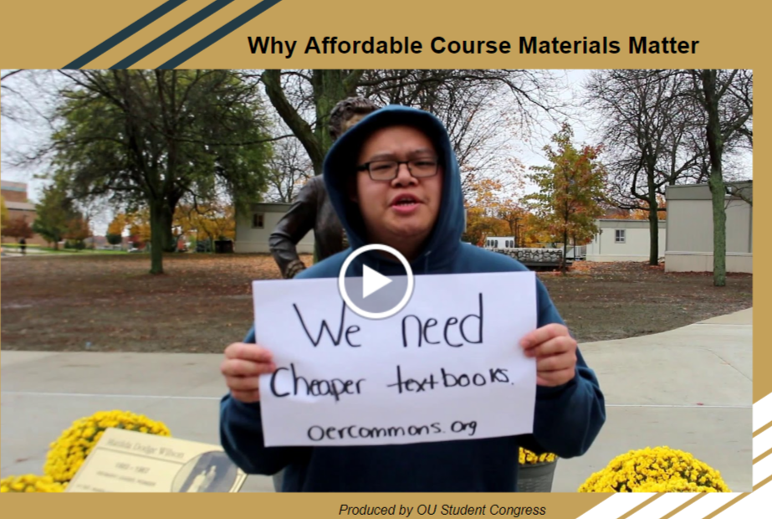
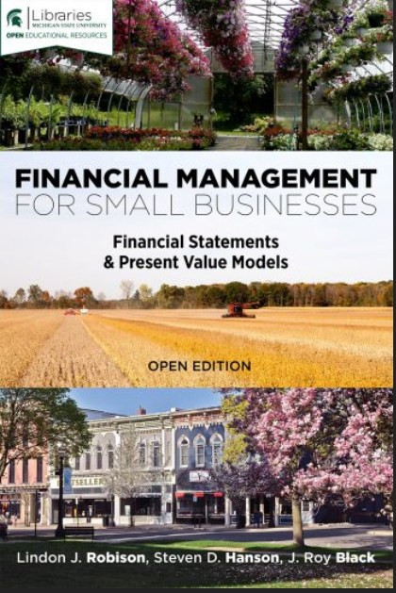
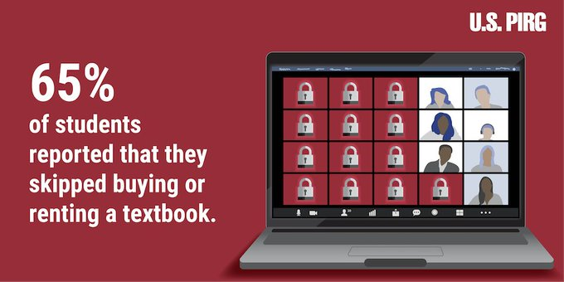
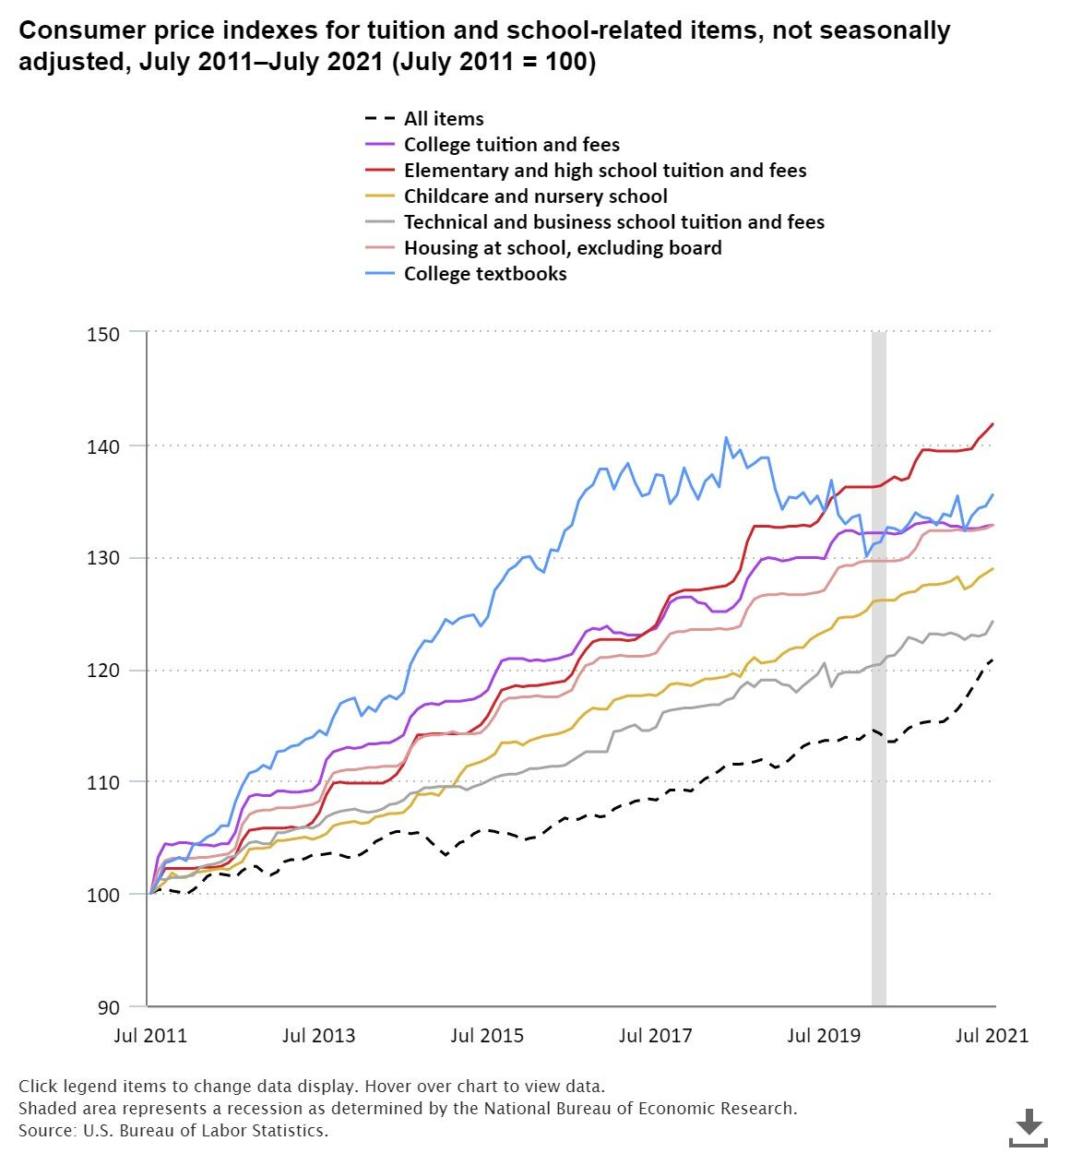
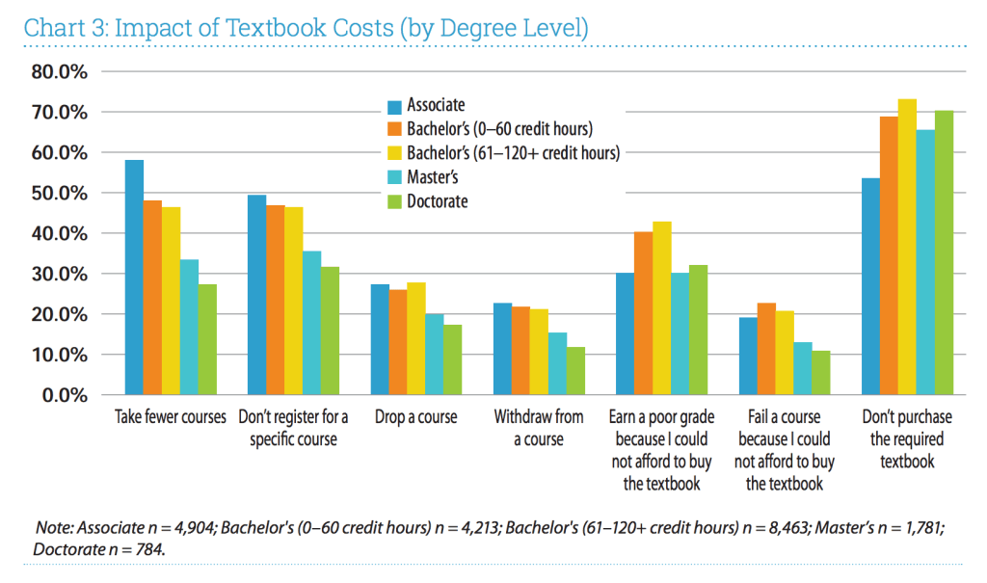
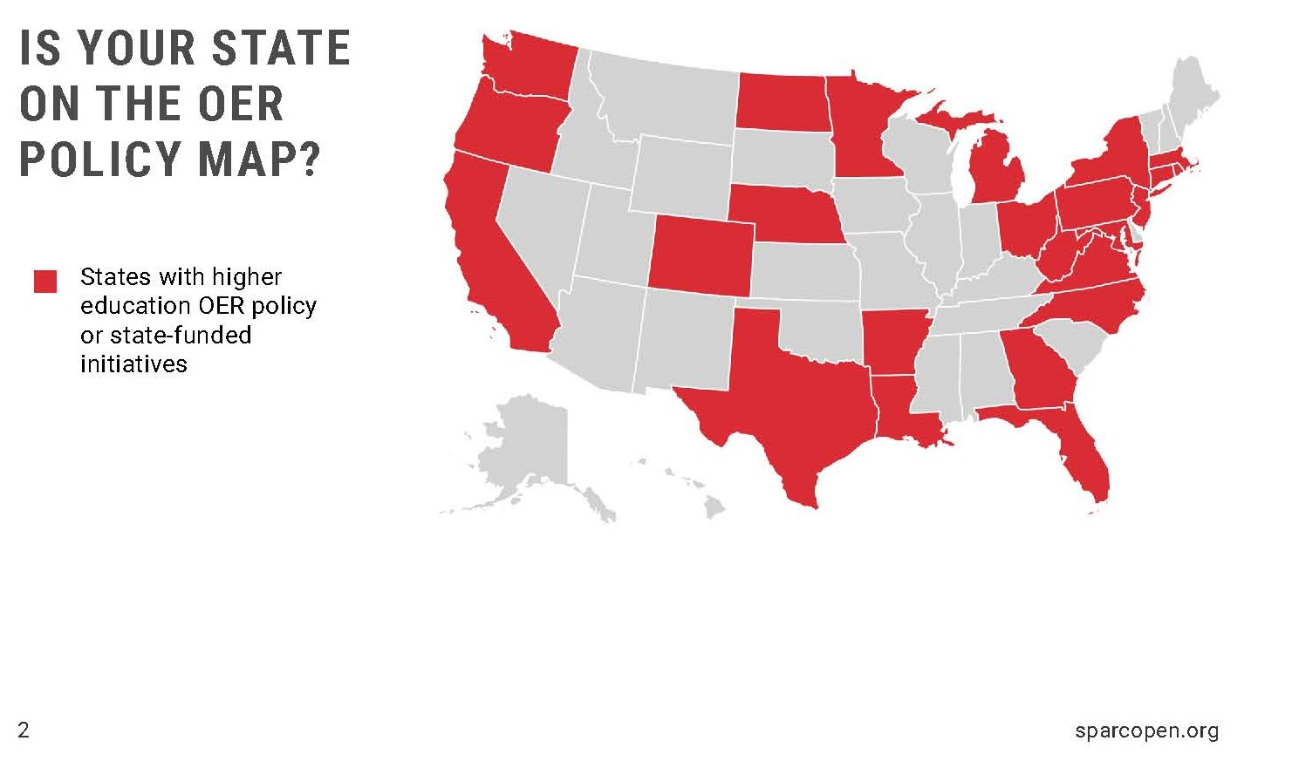
Notes:
So if you’re like me you tend to include include research, charts and graphs. Discussion how OER can assist or impact teaching and pedagogy. You show examples of other similar projects or examples of open textbooks. We want to include all the charts we can that emphasize our point and yeah definitely the video the students made.

Slide 15
Stories
First semester savings for 2 rounds of stipends = $50,843.00 - $97,144.00
Pilot Program - $5,000 investment
Students impacted in 2020 = 229
First semester savings = $14,689.00- $40,181.00
Potential 5 year savings = $73,343.00 - $200,904.00
Round 2 - $5,000 investment
Students impacted in 2021 = 498
One semester savings = $36,155.00 - $56,963.00
Potential 5 year savings = $180,156.00 - $284,813.00
ROI - Return on Investment
Notes:
But what donor want is stories. OR should I should say is what they NEED are stories, successes and concrete statements about needs and impact.
Our typical presentation is about what we are doing or have done but includes nothing or very little on where we want to go or what we need to get there.
I had to learn to switch from teaching about OER, selling open textbooks to faculty as high quality alternatives to numbers and telling stories about how a donor can impact students. We were fortunate that we had some of the numbers for these stories but the numbers can only tell one type of story.
To tell effective stories you need to collect the right data and determine how best to present it. We have all struggled with how to capture and communicate savings. What formula to use, how to present ROI. Some of the data we have is helpful with donors. But the long tail of return is where this becomes difficult and the desire for donors to see quick progress and their dollars making an impact can make this more challenging. Our 2nd round of stipends had a sixteen plus months gap from the call for stipends to completion. Donors want updates and timelines that may be different that what we are accustomed to or from what fit nicely into our academic schedules.

Slide 16
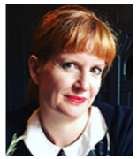
“Multiple students expressed their gratitude not only for saving them money, but because there were unforeseen issues with the speed of the postal service and other delivery sources throughout Fall 2020 it meant they weren’t waiting to get textbooks for my classes like they were for other classes. In the end I was able to provide more interesting and relevant sources while saving students money and stress.”
― Erin Dwyer Associate Professor History
Notes:
Just as important, as the data. We need to also gather the stories from faculty and from students. These are harder to get. We had some faculty stories that came with feedback from our stipend program. Some were shared in letters to the editor as part of the student campaign. But we haven’t systematically collected this information.
This was pulled together from a report by Professor Erin Dwyer who participated in pilot stipend program. She applied to convert her Civil War & Reconstruction course which used three textbooks costing students between $90 - $559 each semester depending on how they purchased the books. In Fall 2020 she had 26 students enrolled in her course for a student savings between $2,000 - $14,000.
She was so inspired that she end up also converted American History to 1877 course which had (2 sections). This course had cheaper materials costing between $25 - $33 and a total 51 students. She saved these students between $1,200 - $1,600 the first semester.
Professor Dwyer the statement on the screen expressing students’ gratitude but she also commented about how she benefited as a faculty member. She said quote “it keeps our materials adaptive and our classes accessible… I know it made classes I’ve taught for almost a decade feel fresh for me as well as I found new sources to teach that excited me.” end quote.

Slide 17
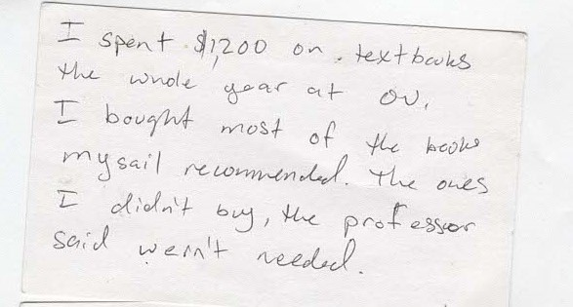
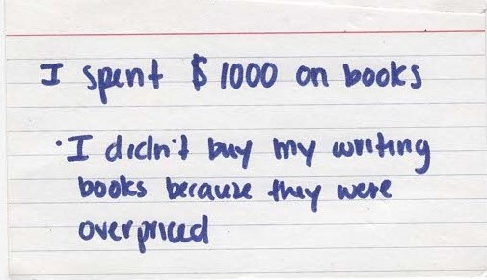
Notes:
More difficult to get were stories from students about how they were impacted by the stipend program. We could pull together how prices impact students generally and even had some quotes from a previous Open Ed week event but we hadn’t considered how to gather student stories about the impact switching a course to a free textbook had on a students. We wanted to hear from those students in the courses that had converted to OER or low-cost. We reached out to OU Student Council for assistance but weren’t able to get what we were looking for on short notice. Thinking to the future this is something that could be included as the faculty do their end of semester assessment or as part of OE week events.

Slide 18
Donor Engagement
Planning
Who’s in charge of what? What role does each person play?
  Donor relations staff
    Event planning, donor engagement, running the narrative
      Knowledge of donors invited
Consensus on goal of event
  Agreement between library and fundraising staff
What do you have the liberty to speak about / or not?
What’s the ASK and who is doing it?
Notes:
Another learning curve was exactly how donor engagement events work.
I am sure each institution is unique but I imagine there are similarities across institutions.
We have a Director of Philanthropy for the library, she reports to the V.P. of Philanthropy and he has all sorts of staff that do different aspects of the event planning. The Library Director of Philanthropy had the knowledge of the donors connected to the library but not so much for the donors invited by the V.P.
After the first event, there were several things I wished I had known and was better prepared for. These seem pretty straightforward but I hadn’t thought to ask beforehand.
Who’s in charge of what? What role does each of these people play. There were staff specifically for organizing the dinner, others for running narrative, talking to the donors.
What was our overarching goal of the event?
What do I have the liberty to speak about and what shouldn’t I say?
What is our ASK and who is doing it?

Slide 19
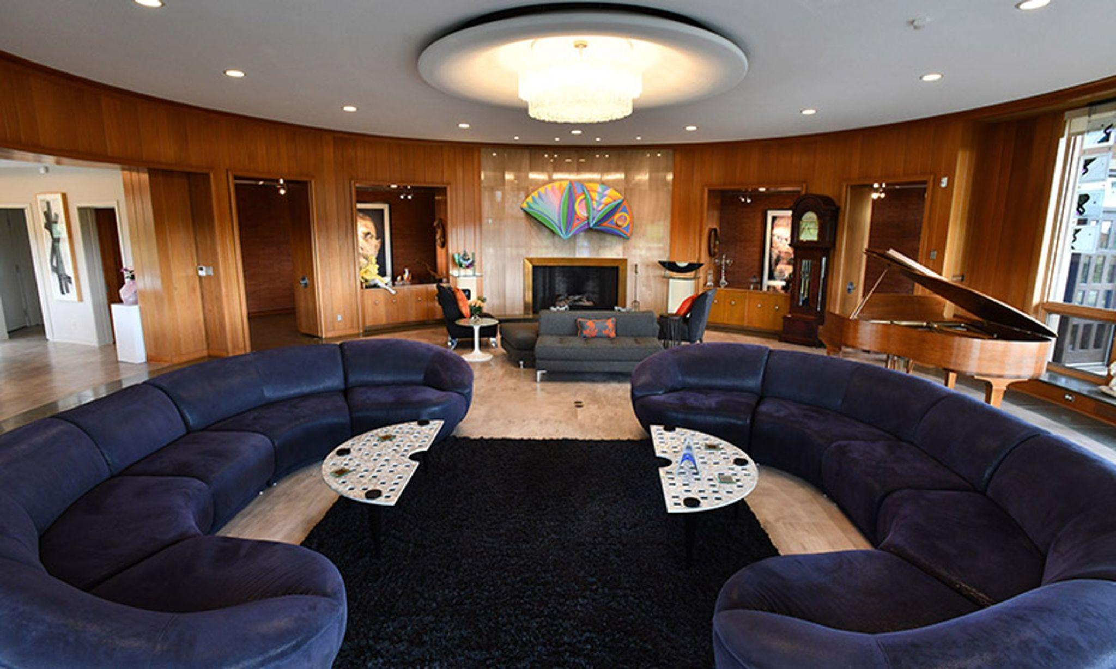
Story
Reflection
Meetings were about the flow of the evening. Unnecessary information.
Never discussed as a group what our goals were. Who would answer these donor questions.
V.P. of Philanthropy wanted to take a passive approach, “we are testing the water on this campaign and want your reactions.”
Donors were energized. Wanted clear goals. Missed opportunity.
President’s Salon Dinner
May 2022
Twenty people plus staff
Presentation btw dinner & dessert
Notes:
So, I’m going to tell you a brief story, as demonstration of the power of storytelling to connect an audience.
As a result of the student petition and outreach campaign a special dinner called a salon was scheduled at the President’s house, Sunset Terrace with a modest group of donor. If your not familiar with the location, this is a fairly well known building because it was the retirement home of Alfred and Matilda Wilson. It was modeled after houses designed by Frank Lloyd Wright in the prairie home design. It has 40-foot round living room intended to host up to 200 guest. The dining room is in the shape of a horse shoe.
For the Salon dinner we had three planning meetings about whose coming, where they are sitting, whether there will be one or two tables. That was a very big topic! These were meetings with the donor event planning people. One meeting was with the President and V.P. of Philanthropy. During this meeting, I gave an overview of what I would be presenting. I didn’t receive any feedback other than it was suggested we get student stories to share. Marketing set me up with a recording service that students could use to submit their video stories. This happened only a few weeks before the event which fell during finals week. Hence, we did not manage to get any student video submissions. We used quotes gathered from an Open Ed week event years earlier and we had access to a Student Congress survey that we were able to take quotes from. We wouldn’t have had any student voices without these.
The event started with cocktails and mingling. I don’t drink and I didn’t really mingle because I realized upon arrival the unique nature of the room and I needed to determine how I was going to both see my slides and the audience and be able to refer to my notes which thankfully I had printed out.
We had dinner and the presentation took place between dinner and dessert. They went with a 2 table set up to allow from additional space between people and I was seated at the table with the Director of Philanthropy, my Dean was at the other table with the President. At our table, there was no conversation about the evenings topic during dinner. I gave a 20 minute presentation, which was a strange auditory experience because when you stood in the exact middle of the room your voice sounded like it was reverberating around the room in a circle. My kids and I have printed out and pasted student quotes onto postcards that I was going to ask several the audience members to read. I forgot them at home so instead read them from the screen. Despite my experience, the audience was really engaged and quickly jumped in afterwards with questions and wanting to know what was were asking for.
During the entire planning process and evening I relied on the Library’s Director of Philanthropy and the Library Dean to provide guidance and strategy. They were passive and deferred to the V.P. of Philanthropy. We never strategized together about fundraising goals or coordinated possible responses to donors questions about needs.
In all the meetings, there weren’t any discussions of how conversations would go or what our plan of attack was. So, when I was approached by a kind donor after the presentation, I felt like I was treading water. I was asked very straightforward questions but was not able to answer them but I didn’t want to turn her away. She also thanked me for “getting in the weeds” as she said with my presentation. I thought I had cut all the weeds out of the presentation.
The dinner ran long and I was not able to stay for dessert because I’m a single parent and I had kids to pick up. I found myself going over in my head a number of things about that night that I wishing had gone differently.
We should have been proactive as a unit in our meetings with the VP of Philanthropy in determining our approach to the evening. We need to have outlined our goals the ASK we wanted to communicate to the donors and plan who would be doing it. I also wished I had a written document about the donors present that I could have referred to during the event. AND I should have assumed the event would run long and just get child care arranged ahead of time.

Slide 20
Takeaways
Print - Brochure
  Overall high-level goals with large target amounts
  Language and message tweaking to make everyone happy
Presenting directly to donors
  Super supporters of the university - want to make us great, clear picture on how we get there.
  Interested in their specific group - may want to earmark funds.
  Want regular updates, want to see progress perhaps faster than may be possible.
  Come to a consensus on goals for event between your unit and fundraising staff.
  Know what the roles are.
  Get detailed information about donors in writing beforehand.
Notes:
I’ve put together some key takeaways to consider. On the next slide I will share a slide template for donor presentations.
Print materials typically will focus on defining the project and have large high level goals. There will be lots of language and message tweaking to make everyone happy.
When you’re presenting directly to donors keep in mind they are super supporters of the university. They want us to be great, they want a clear picture on how we get there.
Donors want regular updates, they want to see progress perhaps faster than may be possible.
Donors may be interested in targeting a specific group. We had donors interested in giving to specific departments and this can get complicated for budgeting and planning.
Be sure to come to a consensus on goals for the event between your unit and fundraising staff. Know who has what role.
If you can, get detailed information about donors in writing beforehand that you can consult during the event.

Slide 21
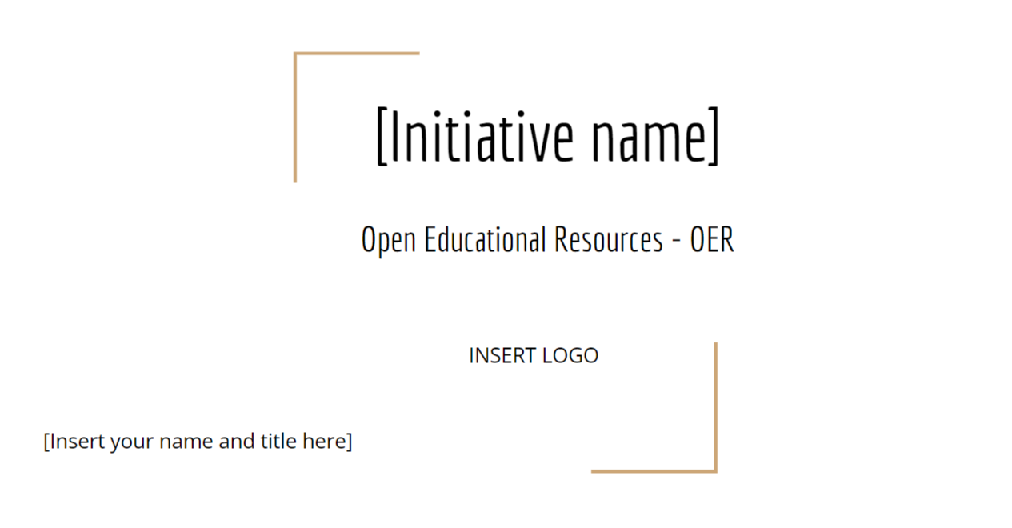
Presentation outline
Intro slide
Overall Initiative Goals in context to institution
OER definition
Example open textbooks
Benefits of OER
Rising cost of textbooks
Impact of cost / student spending
Student stories
Impact of investment
Programs available -stipends, book collection etc.
Stories related to these programs
Specific goals - targets and monetary
Questions
References
PRESENTATION TEMPLATE
https://tinyurl.com/mr3zpef4
Notes:
As part of this presentation I have created an outline and accompanying sample temple presentation that is shared here with the url. Included are example of elements you can use to represent different aspects of story. I hope you find it helpful and a good starting point.

Slide 22
For me school in general is really expensive, I don't get help from my family and I pay for school with my own money. This semester I almost decided to not get my textbooks/access codes due to not being able to afford it…For me these books are necessity if you don't get them you fail.
― OU Student 2022
Notes:
You should plan now to collect stories from students and faculty of the successes and concrete statements and impacts that you may need later, build this into your programs and events.

Slide 23
Share.
Brief stories
(if time permits)
Feel free to post reflections in chat

Slide 24
Thank you!
Do you have any questions?
Julia E. Rodriguez
juliar@oakland.edu

Slide 25
Credits.
Presentation Template: SlidesMania
Sample Images: Unsplash
Fonts used in this presentation: Frank Ruhl Libre & Play Fair Display
This presentation was created by Julia E. Rodriguez and is licensed under a Creative Commons Attribution-NonCommercial 4.0 International License.

