Slide 1
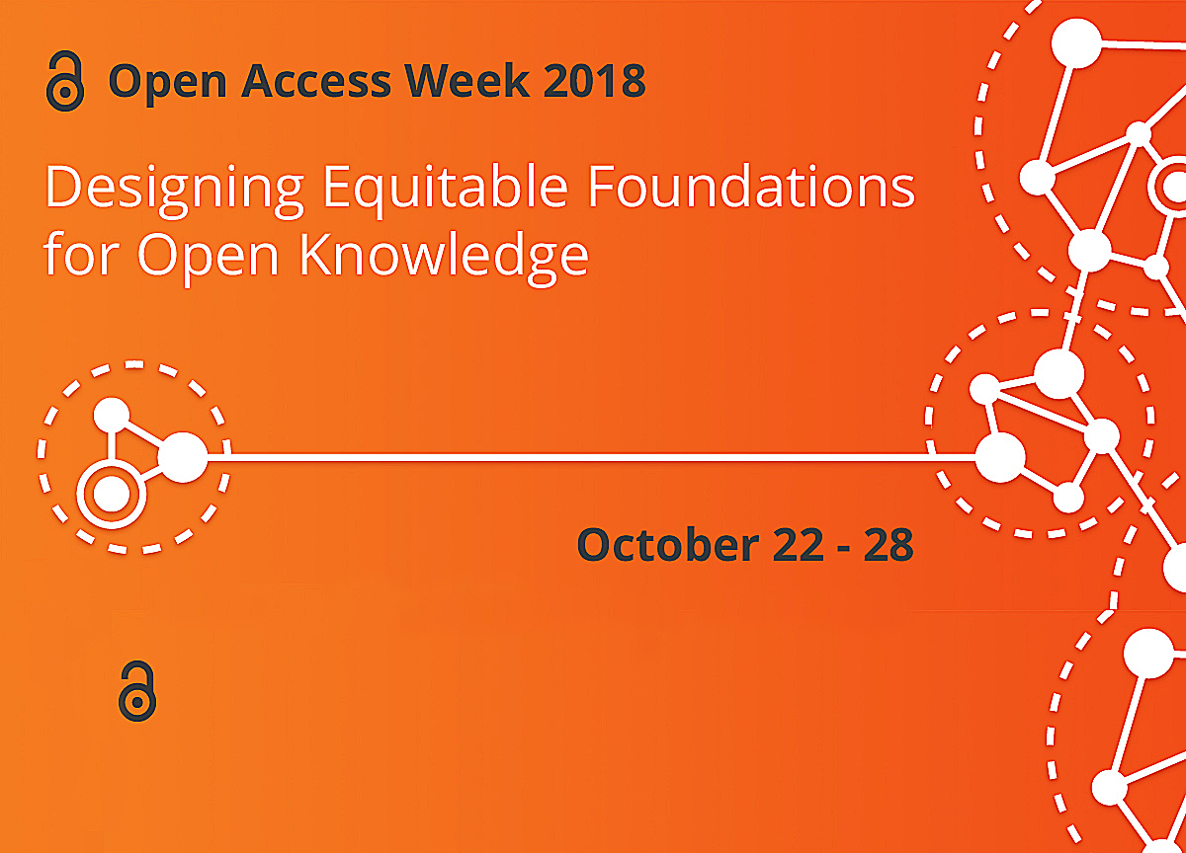


SPONSORED by Oakland University Libraries and OUWB School of Medicine

Slide 2

*Open Access (OA) is free, immediate access to scholarly information online, along with the right to use and reuse that information. (SPARC)
OA WEEK is a global event to promote the potential benefits of Open Access and to help inspire wider participation in helping to make Open Access a new norm in scholarship and research.

Slide 3

OPEN =
Free to read
Widely available
Unlimited peer-review/ sharing/ collaborating
Free to use/reuse
Shorter publishing cycle
Great Discoverability

Slide 4
Stories from the Field
Choosing Authentic Journals to Publish Your Work
Stephanie Swanberg, MSI, AHIP
Associate Professor, Information Literacy & eLearning Librarian
Oakland University William Beaumont School of Medicine

Slide 5
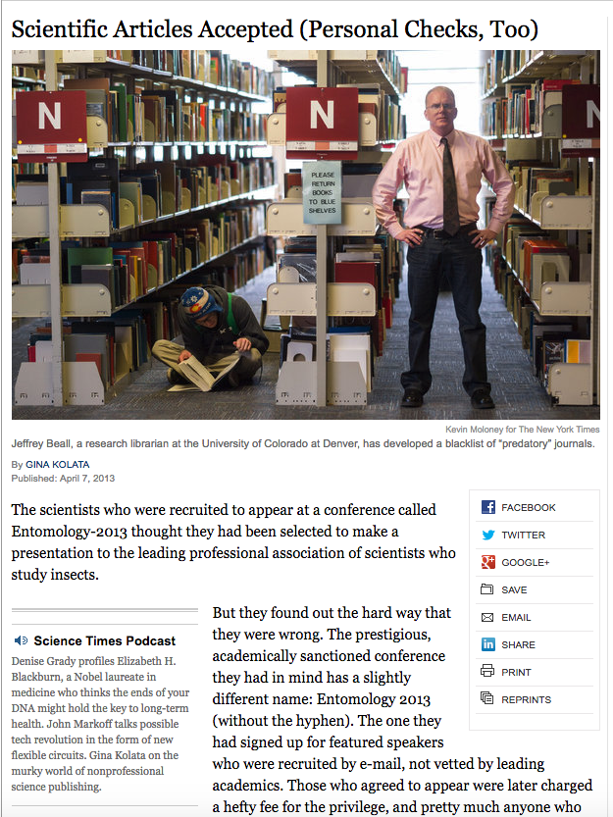
2013
The
New York
Times
Notes:
Kolata G. Scientific articles accepted (personal checks, too). The New York Times. 2013. https://archive.nytimes.com/www.nytimes.com/2013/04/08/health/for-scientists-an-exploding-world-of-pseudo-academia.html Accessed October 24, 2018.

Slide 6
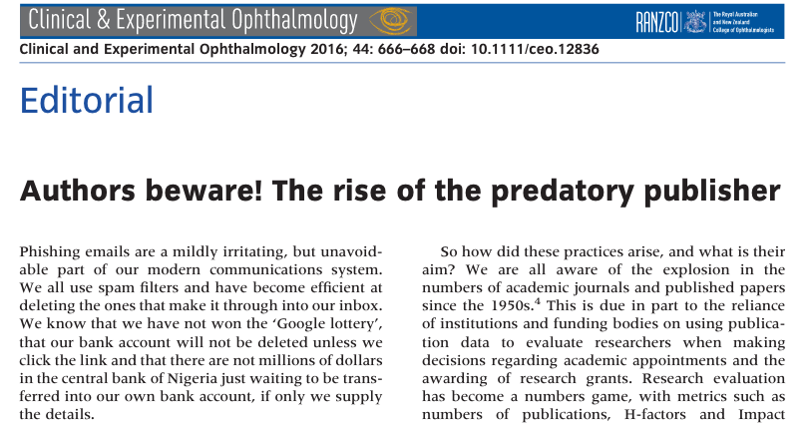
2016
Notes:
Cartwright VA. Authors beware! The rise of the predatory publisher. Clinical & Experimental Ophthalmology. 2016;44:666-68.

Slide 7
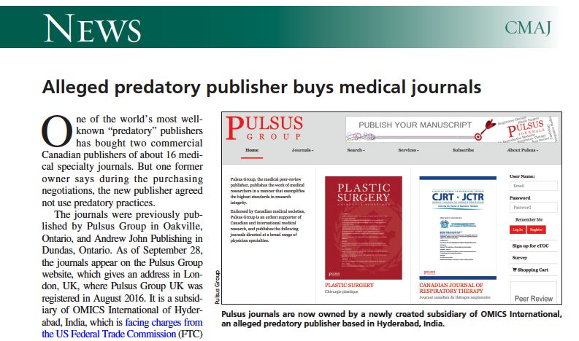
2016 Canadian Medical Association Journal
Notes:
Brown C. Alleged predatory publisher buys medical journals. CMAJ. 2016;188(16):E398.

Slide 8
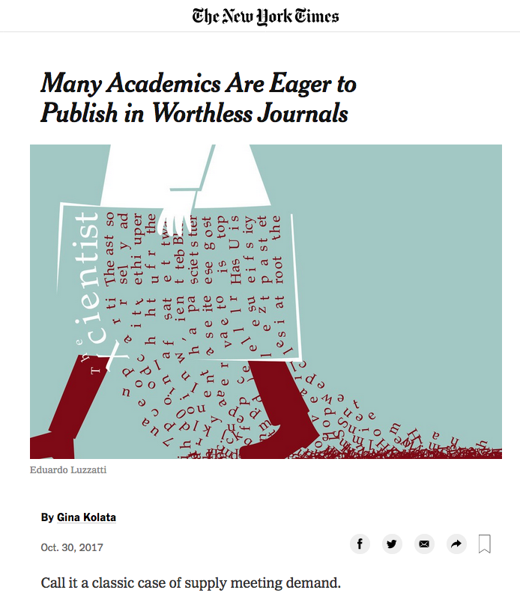
2017
The
New York
Times
Notes:
Kolata G. Many academic are eager to publish in worthless journals. The New York Times. 2017. https://www.nytimes.com/2017/10/30/science/predatory-journals-academics.html Accessed October 24, 2018.

Slide 9
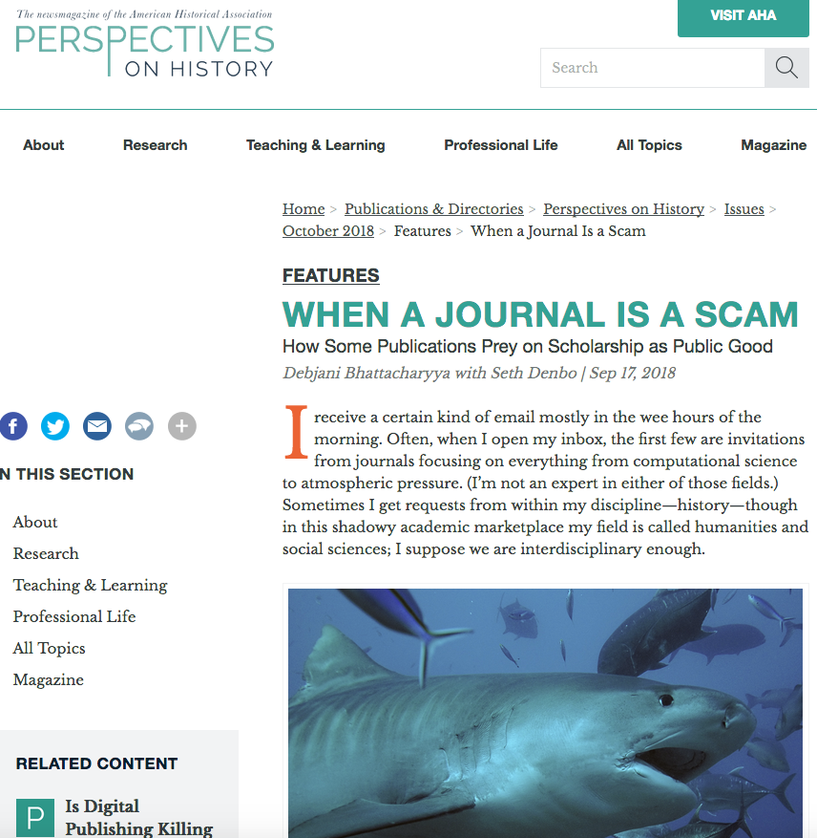
2018
Perspectives on History
News Magazine of the American Historical Association
Notes:
Bhattacharyya D. When a journal is a scam: how some publications prey on scholarship as public good. Perspectives on History. https://www.historians.org/publications-and-directories/perspectives-on-history/october-2018/when-a-journal-is-a-scam-how-some-publications-prey-on-scholarship-as-public-good Accessed October 24, 2018.

Slide 10

Objectives
Define predatory publishing and the implications on academia
Identify appropriate resources for assessing the quality of publishers and journals
Discuss personal experiences and lessons learned when encountering predatory journals

Slide 11
Spectrum of ‘Authentic’ Publishing
Authentic
Possibly Predatory
Probably Predatory
Confirmed Predatory
(Adapted from Beall 2015)

Slide 12
Defining Predatory
Predatory = publishers/journals whose sole concern is collecting $$$$$
  Unsolicited emails
  Promise of rapid publishing
  No or little peer review
  No indexing
  Unprofessional website
Predatory publishing has skyrocketed in the last decade
  Coincided with the push for open access (OA) publishing as scammers are taking advantage of the OA model
  Stigmatized serious OA journals
(Shen & Bjork 2015)

Slide 13
Why Discuss Predatory Publishers?
Immense pressure (“publish or perish”)
  increase ‘impact’
  gain recognition in our field
  promotion & tenure
Yet, article acceptance rates are extremely low and it may take years to be ‘recognized’
Temptations to publish in predatory OA journals:
  Lack of awareness
  Lack of experience in selecting journals
  Pressure to publish

Slide 14
Checklist for Assessing
Journal Authenticity

Slide 15
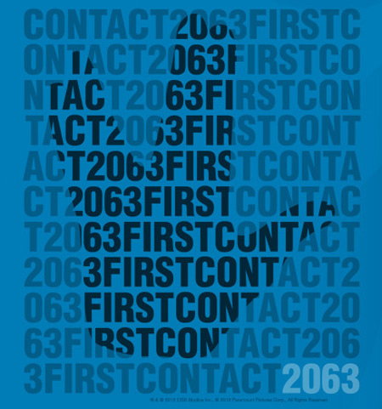
Checklist: First Contact
How did you first hear of the journal/publisher?
  Did you get an email solicitation?
  Did a colleague recommend it?
  Did you search online?
Image: Copyright, Paramount Pictures
(Beall 2015; Berger & Cirasella 2015)

Slide 16
Checklist: Editorial Board
Editorial Board
Is an actual person identified as the editor?
  Is their contact information and affiliation listed?
Is an editorial board listed?
  If so, what is the make-up of the editorial board?
    How many members?
    Are affiliations & degrees included?
What is the geographic diversity of the editorial board/staff?
  Are they all from the same country or institution?
(Beall 2015; Berger & Cirasella 2015)

Slide 17
Checklist: Contact Info
Contact Information
What type of contact information is provided?
  Is it just an web form or email address?
  Is the email address ‘official’?
    or is it a Yahoo, Gmail, or other?
Is a physical mailing address or location included?
(Beall 2015; Berger & Cirasella 2015)

Slide 18
Checklist: Publication Process
Publication Process
Are author fees explicitly stated?
  Hint: Look for specific $ amount
What is the average time from submission to publication?
  Is the peer review process described?
  Does the journal boast ‘fast track publication’ and charge an additional fee?
Does the journal require transfer of your copyright?
(Beall 2015; Berger & Cirasella 2015)

Slide 19
Checklist: Journal Info
Journal Information
Does the journal list an ISSN number?
  Verify at: http://journal-index.org/ISSN-validator
What, if any, resources index the journal?
Is the journal included in:
  Ulrich’s Periodical Directory (subscribed to by OU Libraries)?
  Directory of Open Access Journals (DOAJ) - https://doaj.org/?
(Beall 2015; Berger & Cirasella 2015)

Slide 20
DOAJ Requirements for Inclusion
All content must be available for free without delay
Each published article must have its own unique URL
Journal must have an ISSN number
Journal homepage must include:
  Links to current and past/archive issues
  Search & browse capabilities
  About webpage
  Editorial Board information
  Contact Us
(Directory of Open Access Journals 2016)

Slide 21
DOAJ Requirements cont.
Editorial Board information must include:
  Current Editor (name, affiliation, email)
  Name of each editorial board member
Clearly described peer review process and links to author guidelines on journal homepage
Disclosure of publishing fees
(Directory of Open Access Journals 2016)

Slide 22
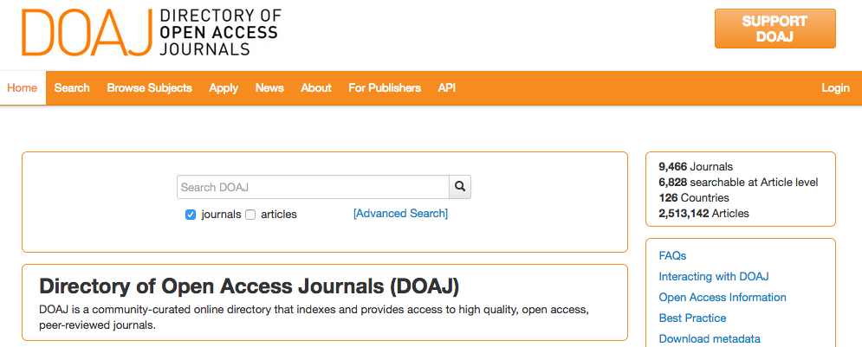

Slide 23
Best Practices in Selecting Journals
Make a Journal List:
  Check your manuscript reference list
  Re-do literature search to find similar articles
  Ask colleagues for advice
Ask a Librarian!

Slide 24
Best Practices in Selecting Journals
Do Your Homework:
  Verify journal indexing using Ulrich’s Periodical Directory and/or DOAJ
  Review journal website for professionalism and key indicators of a quality
  Read sample published articles from target journal

Slide 25
Summary
Predatory publishing is a genuine concern for scholars and you can take steps to protect yourself
Take the time to assess journals before submitting a manuscript or agreeing to be a reviewer or editor
  Use the checklist provided today as a starting point
When in doubt, contact your librarian!

Slide 26

Photo Courtesy: Question Question Mark Request Matter Requests by geralt, Pixabay, http://pixabay.com/en/question-question-mark-request-63916/ (public domain)

Slide 27
References
Beall J. Criteria for Determining Predatory Open-Access Publishers. 3e. https://scholarlyoa.files.wordpress.com/2015/01/criteria-2015.pdf. Accessed October 6, 2016.
Berger M, Cirasella J. Beyond Beall’s List: Better Understanding Predatory Publishers. College & Research Libraries News. 2015;76(3):132-135.
Directory of Open Access Journals (DOAJ). Information for Publishers. https://doaj.org/publishers. Accessed October 6, 2016.
Shen C, Bjork BC.‘Predatory’ open access: a longitudinal study of article volumes and market characteristics. BMC Medicine. 2015;13:230.

Slide 28
Stories from the Field
Inaya Hajj-Hussein, PhD
Assistant Professor, Foundational Medical Studies
Oakland University William Beaumont School of Medicine
Julia Rodriguez, MLIS
Associate Professor, Health Sciences, Nursing &
Scholarly Communications Librarian
OU Libraries
Stephanie Swanberg, MSI, AHIP

Slide 29
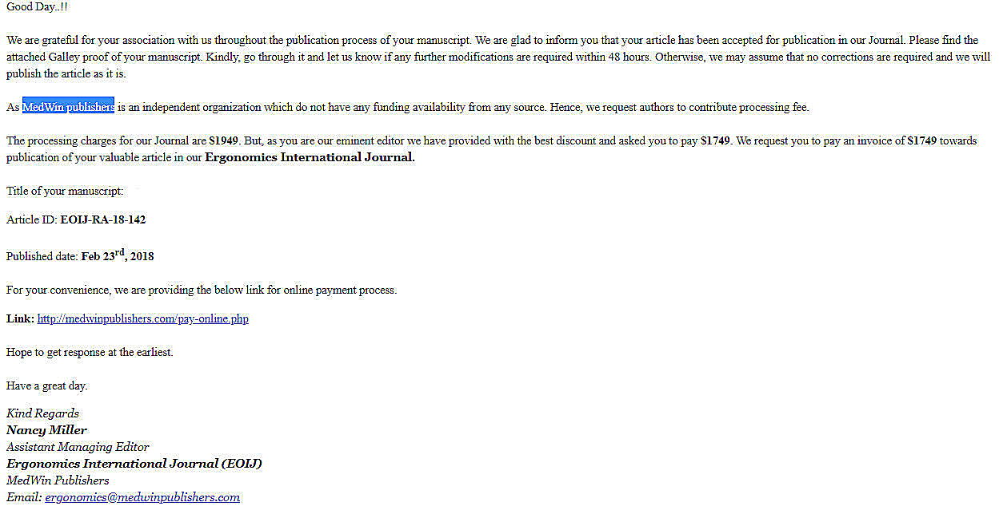
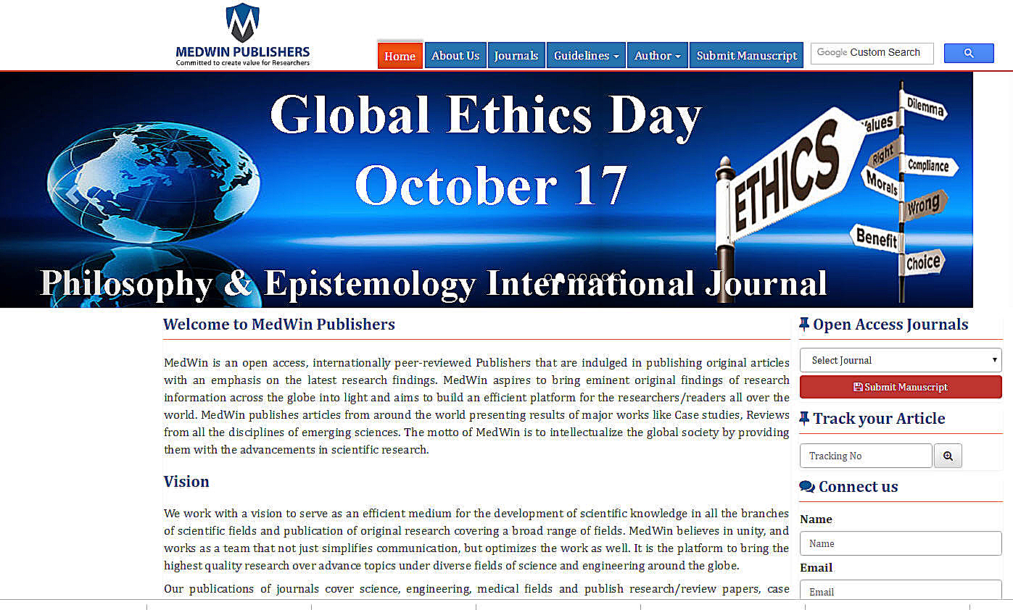

Slide 30

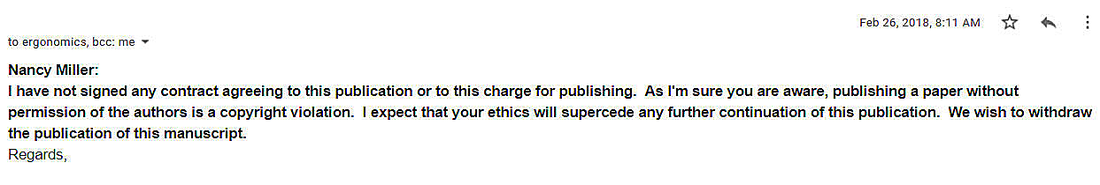
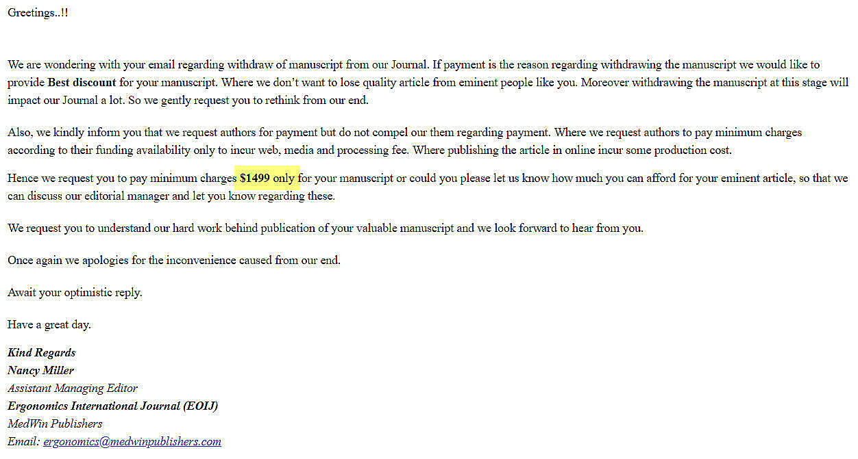
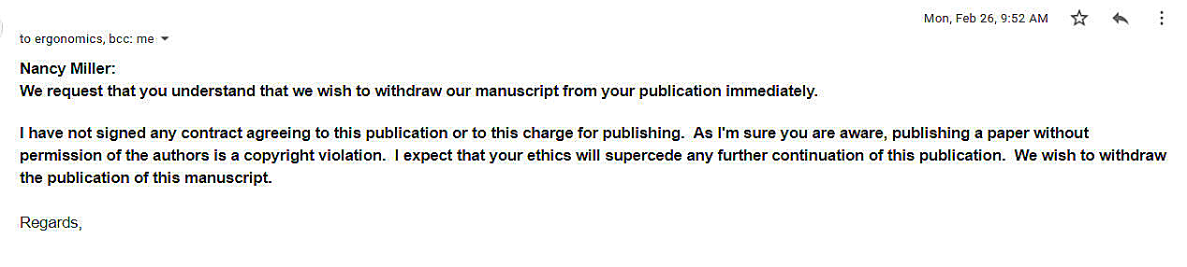

Slide 31
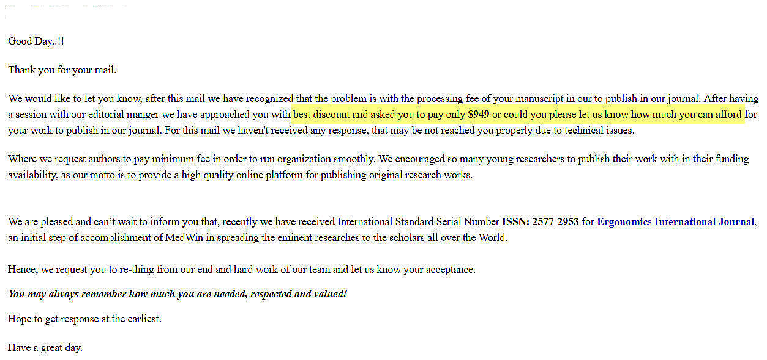

Slide 32
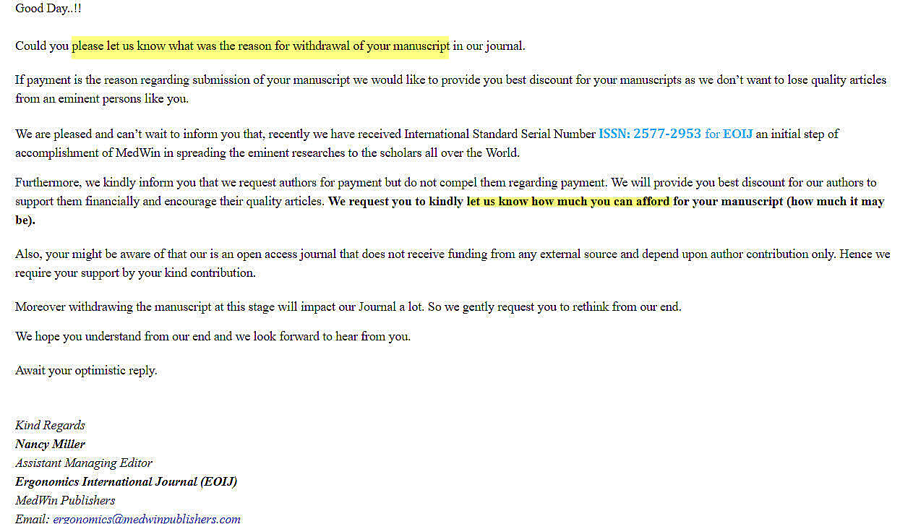
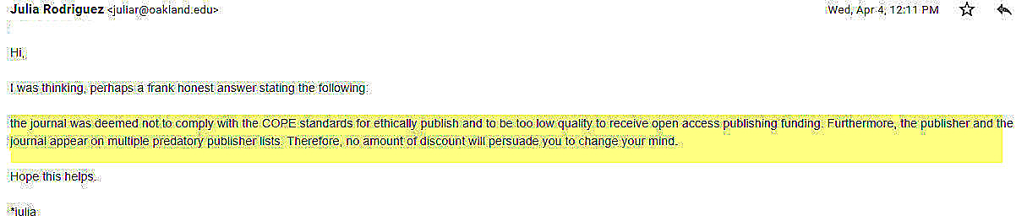

Slide 33
