Slide 1
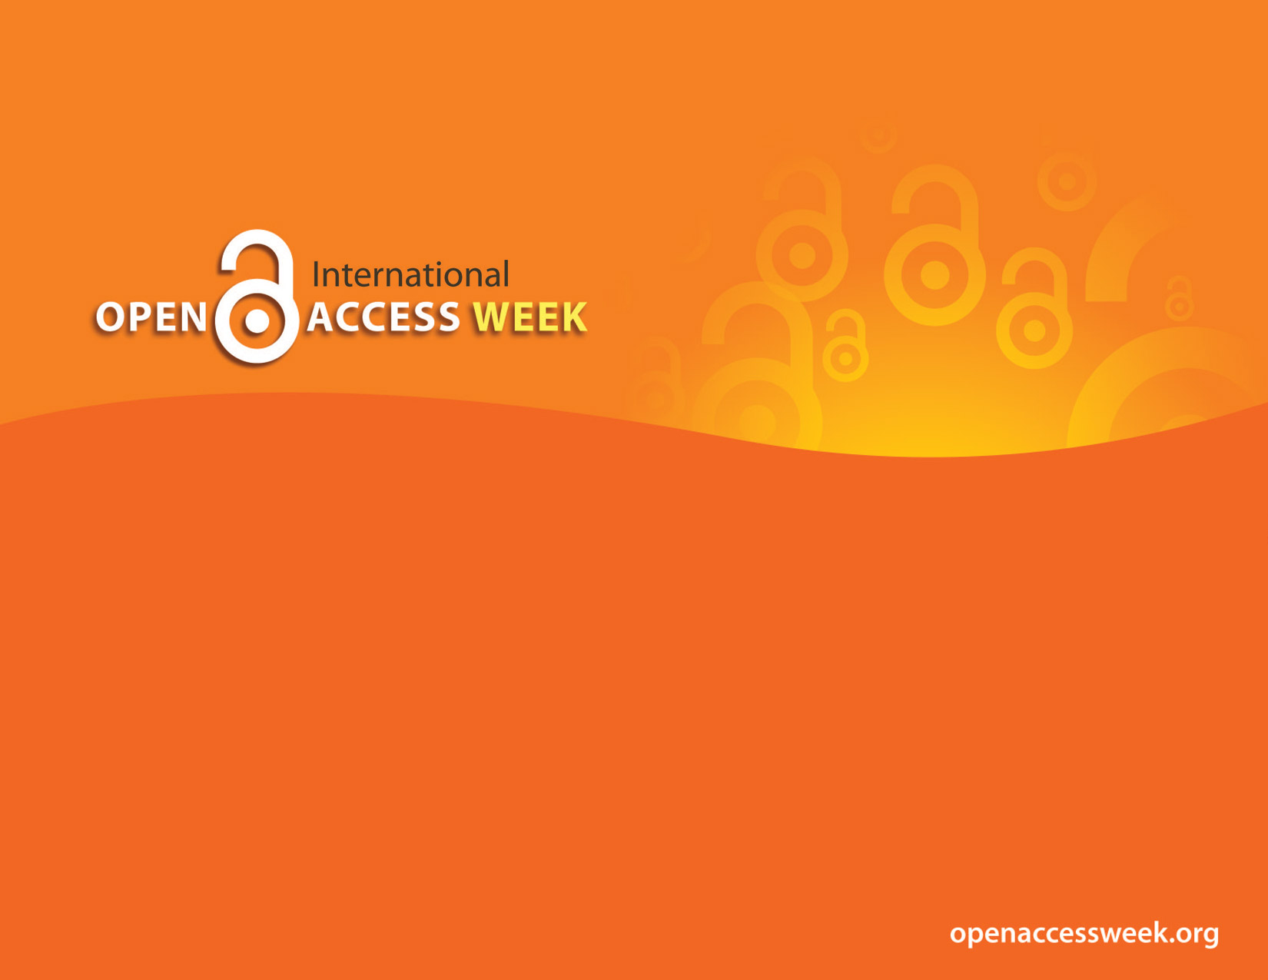


2017
OPEN IN ORDER TO:
Enable Global Participation in Research
Raise Research Visibility
Enable Public Health
Collaborate

Slide 2

DITCH YOUR TEXTBOOKS
Save your students’ $ and support student success
Julia E. Rodriguez
Nursing, Health Sciences & Scholarly Communications Librarian
juliar@oakland.edu
Caterina Pieri, Special Lecturer - Italian
This work is licensed under a Creative Commons Attribution-ShareAlike 4.0 International License.

Slide 3

OER’s and Open Textbooks
Open textbooks and (supplemental resources) are:
Free to use
Adaptable
Openly licensed content
Made available online to be used by students, teachers and members of the public
Distributed in either print, e-book, or audio formats that may be downloaded or purchased at little or no cost.
*Learn About Open Textbooks, from the Student PIRGs

Slide 4
OER’s and Open Textbooks
Open Educational Resources (OER) movement
“materials offered freely and openly to use and adapt for teaching, learning, development and research.” (Commonwealth of Learning)
MOOCS - Massively online open course
MIT OpenCourseWare credited for having sparked a global Open Educational Resources Movement after announcing in 2001 free online courses
The UNESCO 2012 Paris OER Declaration, otherwise known as the Paris declaration on Open Educational Resources,urged governments to promote the use of open educational resources (OERs) and called for publicly funded
educational materials to be released in a freely reusable form.

Slide 5

Origin of open textbooks
In 2012, OpenStax (Rice University) was created from the basis of the Connexions project (an open repository of educational materials).
Supported by eight major funders include Bill & Melinda Gates Foundation and William and Flora Hewlett Foundation.
OpenStax hires subject matter experts to create college-level textbooks that are peer-reviewed, openly licensed, and available online for free. Available under Creative Commons CC BY licenses that allow users to reuse, remix, and redistribute content as long as they provide attribution.
Stated mission is “to create professional grade textbooks for the highest-enrollment undergraduate college courses that are the same quality as traditional textbooks, but are adaptable and available free to students.”

Slide 6
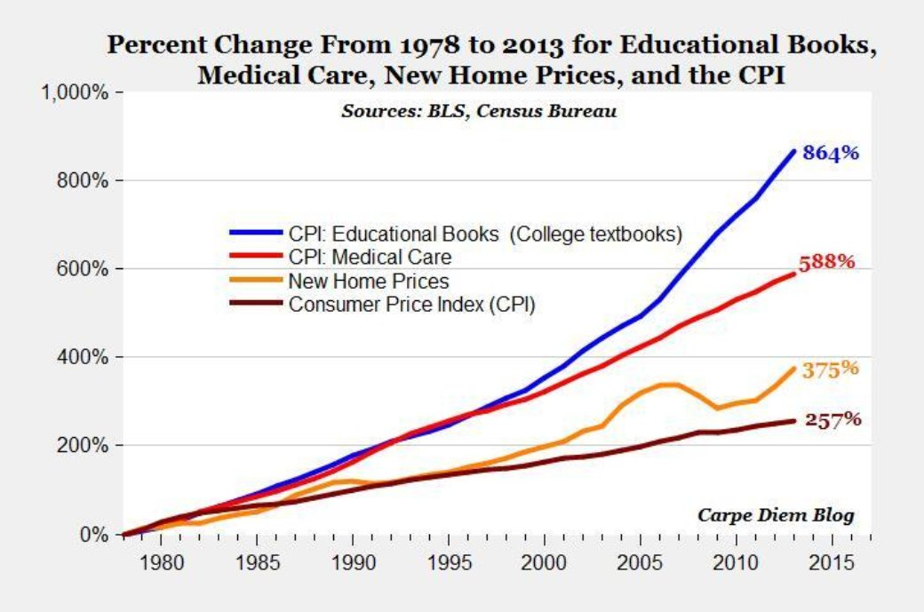
Textbook data

Slide 7
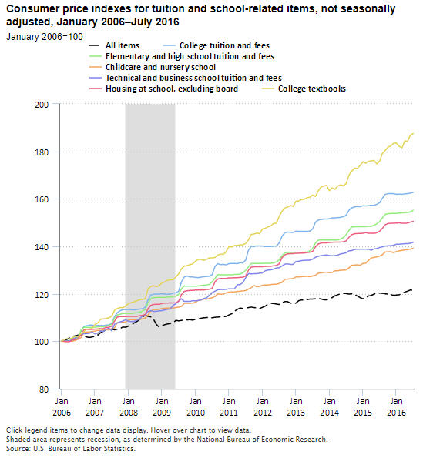
Notes:
https://www.bls.gov/opub/ted/2016/college-tuition-and-fees-increase-63-percent-since-january-2006.htm

Slide 8
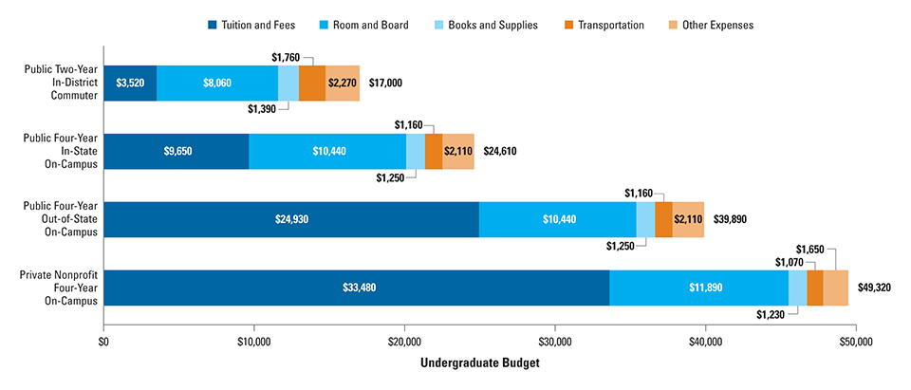
Costs for college
https://trends.collegeboard.org/college-pricing/figures-tables/average-estimated-undergraduate-budgets-2016-17
Books and supplies range from $1,230- 1,390 per year

Slide 9
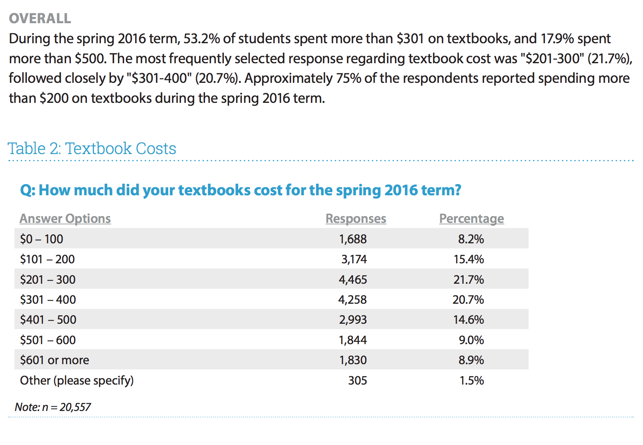
Student textbook spending
Florida Survey 2016 -
The cost of textbooks is negatively impacting student access to required materials and their learning and extending time to graduation.
66.6% did not purchase the required textbook
37.6% earn a poor grade 19.8% fail a course
47.6% occasionally or frequently take fewer courses 45.5% do not register for a course
26.1% drop a course
20.7% withdraw from courses
https://florida.theorangegrove.org/og/file/3a65c507-2510-42d7-814c-ffdefd394b6c/1/2016%20Student%20Textbook%20Survey.pdf
http://studentpirgs.org/sp/oer-digest#seventeenth
Notes:
Rationale for California's bills http://www.20mm.org/infographics/embracing-the-future-free-college-textbooks/

Slide 10
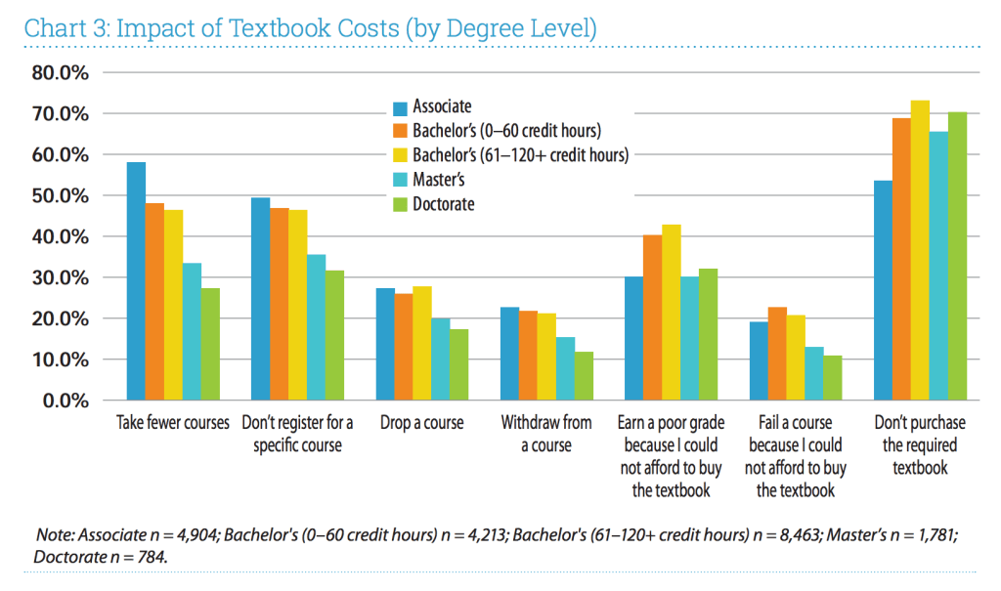
2016 Student textbook and course materials survey. Florida Virtual Campus.
https://dlss.flvc.org/documents/210036/361552/2016+Student+Textbook+Survey.pdf

Slide 11
Support for change
Federal
S.1714 - Open College Textbook Act of 2009
H.R.4575 - Open College Textbook Act of 2010
The Affordable College Textbook Act seeks to reduce the cost of textbooks
at U.S. colleges and universities by expanding the use of open textbooks (and
other Open Educational Resources) that everyone can use, adapt and share
freely. The bill was introduced in the 114th Congress as S.2176/H.R. 3721
and did not advance.The bill was originally introduced in the 113rd Congress
in 2013 and again in 2015 but did not advance.
Reintroduced in Congress Sept. 26, 2017!
American Institute of Mathematics (AIM) encourage the adoption of open source and open access mathematics textbooks. Developed evaluation criteria to identify the books suitable for use in traditional university courses.
*Spreadsheet of legislation *List of OER projects

Slide 12
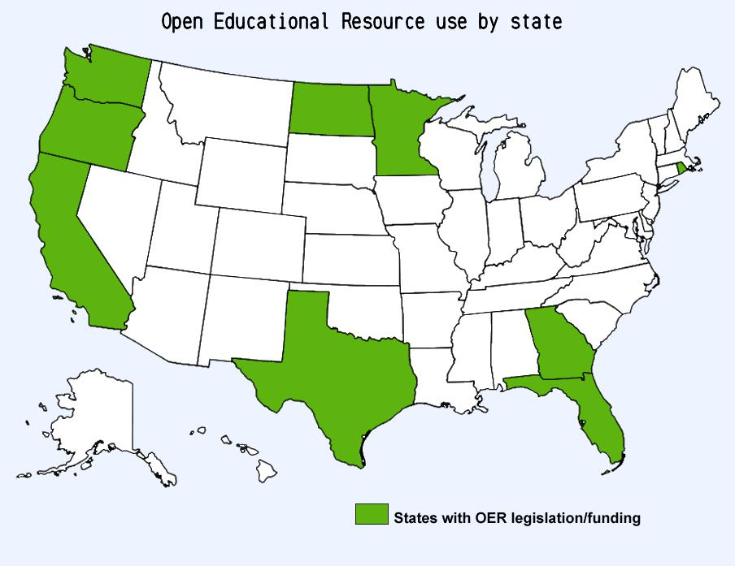
State support for change
CA-Governor Brown (2012) signed two bills (SB 1052 and SB 1053) that provided for the creation of free, openly licensed digital textbooks for the 50 most popular lower-division college courses offered by California colleges.
Florida- 2010 Statue 1004.085 -Textbook affordability (2012) House bill 5201- Requires the Florida Virtual Campus "Promote and provide recommendations concerning the use and distribution of open-access textbooks and education resources as a method for reducing costs and work with public postsecondary education institutions in developing a standardized process for the review and approval of open-access textbooks.”
Minnesota (2013)- State bill passed SF1236 - Open Textbook Network, expanded use of OER as a performance goal for the MnSCU system.
North Dakota (2013) State resolutions passed HCR3009 and HCR3013 calling for the study and use of open textbooks in North Dakota’s higher education institutions.
Oregon Legislature (2015) passed HB 2817, which establishes and OER grant program and funds a staff position to support outreach and implementation.
Rhode Island - RI Office of Innovation, in partnership with Rhode Island College and all ten other higher education institutions in RI, launched a statewide Open Textbook Initiative to save students $5 million over five years.
Texas - (2017) Gov. Greg Abbott signed Senate Bill 810 supporting the adoption of open educational resources.
Washington (2012) State bill passed in HB2337 creating K-12 open textbook initiative. Open Washington initiative to support creation of OER for community colleges- “All digital content created or funded by or produced by grant funds are to be released under CC.”
HB 1768 (2017) - Creates the Washington open educational resources pilot grant program.
British Columbia Government Lends Support to Open Textbooks (2012) - 40 highest-enrolled first and second year subject areas in the province’s public post-secondary system.

Slide 13
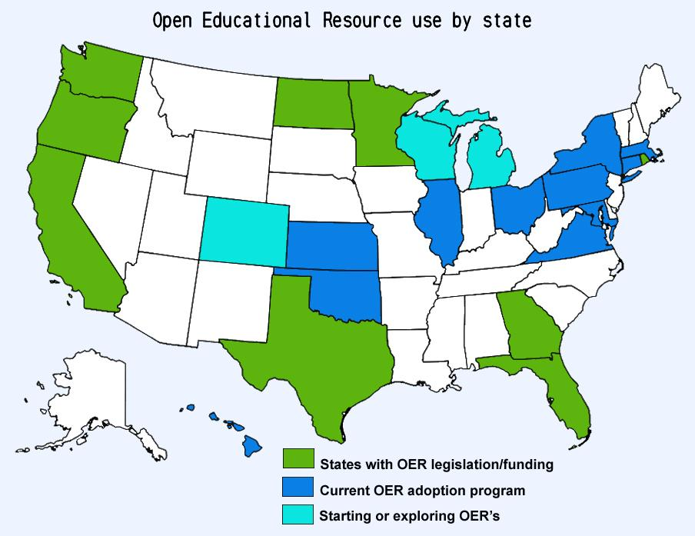
OER Textbook - Initiatives $$
California - Senate Bills apportioned $5,000,000, William and Flora Hewlett Foundation and the Gates Foundation also funded included three higher education segments (CCCs, CSUs and UCs). Campuses submit proposals for up to $50,000 to start textbook affordability programs - Code4Ed library. Required by law to identify courses using OER.
Georgia - (2014) State of Georgia began supporting the University System of Georgia (USG) Initiative to provide grants for libraries, institutions, and faculty seeking to transform their textbooks and learning materials. The Affordable Learning Georgia initiative offers Textbook Transformation Grants now in 11th round.
Kansas State University Libraries’ Open/Alternative Textbook Initiative provides grants to faculty to create or curate free learning materials for their courses
Ohio State U- Affordable Learning Exchange grants. Cross-campus partnership for open educational resources and other low-cost alternatives. Already funded 30 projects and are on track to save students $10M by 2020.
Oregon - (2014) Open textbook initiative is a collaboration between OSU Libraries, OSU Press and OSU Extended Campus. Open Oregon Educational Resources grant projects. Total program costs through 2016 -$43,216.72’ Estimated student savings to date - $607,700
North Dakota - (2015) Implemented a system-wide OER initiative state appropriation appropriation was $110,000. The first four funded proposals include estimated student cost savings of more than $2 million for school year 2016-2017.
Rhode Island - (2016) Governor Gina Raimondo announced a statewide Open Textbook Initiative. Seven state colleges started using open-license textbooks in hopes of saving students at least $5 million in the next five years.
University of Illinois - Open textbook initiative - Congressionally-directed $150,000 grant to “design, create, and implement open-source educational materials for use in introductory college courses.”
University of Minnesota - Open Textbook Library is the first of its kind hosted at a major research institution- U of M faculty review the texts in this collection.
UMass Amherst Open Education Initiative has saved students over $1 million by working with faculty to replace expensive textbooks with OER and free materials.
New York State - 8+million dollar investment - Open SUNY Textbooks OA textbook publishing initiative established by State University of New York libraries and supported by SUNY Innovative Instruction Technology Grants.
Notes:
Rationale for California's bills http://www.20mm.org/infographics/embracing-the-future-free-college-textbooks/
https://uwm.edu/cetl/initiatives/open-educational-resources/

Slide 14
OER Textbook Initiatives - National
OpenStaxCollege – Nonprofit organization based at Rice University – leaders in open textbook movement.
Provides free, high quality, openly licensed peer-reviewed textbooks to nearly 1.5 million college students per year.
Meet the W3C-WAI Web Content Accessibility Guidelines (WCAG) 2.0 at Level AA and Section 508 of the Rehabilitation Act.
Partnering with Open University’s UK Open Textbooks initiative to bring OpenStax’s textbooks to the United Kingdom.
Open Textbook Network - University of Minnesota premiere resource for peer-reviewed academic textbooks, member organization with textbook library.
Global Textbook project - initially funded by the Jacobs and Saylor Foundations. U-Georgia global effort to offer access to textbooks for students in the developing world.
*List of universities already adopting OpenStax is long
*Community College Consortium for Open Educational Resources (CCCOER)

Slide 15
OER Textbook Initiatives - Michigan
Bay College - entire AA degree using OER - saved students over $300,000 on textbooks since fall 2015 semester, 28 courses that use OER.
Delta College - entire Liberal Arts degree using OER will be available by Fall of 2018.
Ferris State University - Faculty Learning Community with funding to develop or adopted open textbook
Grand Rapids Community College (2016) has replaced almost $590,000 in textbooks with free or substantially less expensive versions resulting in 2.5 million in saving since fall 2016.
Kellogg Community College - grants for adopting or adapting OER
Lansing Community College - (2016) 2,950 students enrolled in 93 sections of 11 courses saved an estimated $295,000 in textbook costs in a single semester.
Mid-Michigan Community College - Grant from Michigan Colleges Online converted to OER and worked cross-disciplines
Saint Clair Community College - Since Fall 2016, SC4 Faculty using OER, free, and library resources in 48 sections have managed to save students a potential of over $395,000. spreadsheet
Northwestern Michigan College - NMC students saved an estimated $657,700 since Fall 2015 due to instructors using free and low-cost textbooks.
Michigan Colleges Online - 28 Michigan Community Colleges member participating to reduce costs for students, increase student success and completion, and allow for inter-institutional collaboration with faculty. Creating, sharing, and collaborating on high-quality OER for use in today's classrooms.

Slide 16
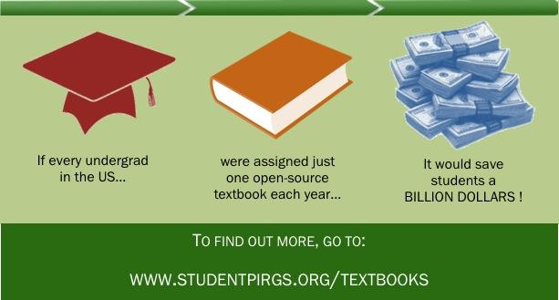
Studies - Cost savings
Reduced students’ annual textbook bill from $900 to $184
Study of 10 college campus (2010) The Student Public Interest Research Group survey, “A Cover to Cover Solution.”
Student saves approximately $128 per course, per semester
Pilot programs five different campus (2015) replace the traditional textbook with openly licensed educational resources (OER) and open textbooks.
The Student Public Interest Research Group survey, “Open Textbooks the Billion Dollar Solution.”
If every college student in the USA was enrolled in just one course using an open textbook the projected savings is $1 billion annually. The Student Public Interest Research Group survey, “Open Textbooks the Billion Dollar Solution.”
Notes:
Rationale for California's bills http://www.20mm.org/infographics/embracing-the-future-free-college-textbooks/

Slide 17
OER Textbook Initiatives - Savings
Open Stax - Rice U Nearly 1.5 million U.S. college students are expected to save an estimated $145 million in the 2017-18 academic year by using free textbooks from OpenStax.
Tidewater Community College (TCC) (2013) Norfolk, Va., first in nation to offer a “Z-Degree,” a degree path in business administration where all textbooks and learning materials were available to students at no cost using OERs. Four years after introducing the Z-Degree, the program has served 10,200 students, with total textbook cost savings of over $1 million.
Affordable Learning Georgia #1 system in the nation for saving money by using free textbooks.
Since Fiscal Year 2014-2015, ALG programs have saved students a total projected $31.8 million dollars in textbook costs, affecting 259,509 students. In Summer Semester 2017, ALG programs have already saved students $5,671,829 in textbook costs, affecting 37,190 students.
University of Minnesota - Open Textbook Network reports student savings of $1.5 million from open textbooks (2015)
British Columbia first Canadian jurisdiction with an open textbook program.(calculating savings)
2012-2017 Student savings between $470,400 and $706,221
Number of B.C. students using open textbooks - 45696
Number of B.C. institutions currently adopting - 38
  Now includes Alberta and Saskatchewan - tri-province MOU collaboration

Slide 18
Student Studies - Grades
Feldstein et al. (2012) Virginia State University Researchers found that students in courses that used OER more frequently had better grades and lower failure and withdrawal rates than their counterparts in courses that did not use OER.
Grewe and Davis (2017) North Virginia Community College found positive relationship between the use of OER and student academic achievement in an online history course.
Hilton and Laman (2012) Houston Community College use of OER textbook correlated with an increase in class grade point average, an increase of the average score on the departmental final examination, and a lower course withdrawal rate.
Pawlyshyn et al. (2013) Mercy College, NY found that the pass rates of a basic math course increased to 68.9% when all courses were taught with OER. Similarly, students who were enrolled in OER versions of a reading course performed better than their peers who enrolled in the same course using non-OER materials.
Robinson (2015) Brigham Young University- Project Kaleidoscope found that students using open textbooks in the business and psychology courses earned lower average grades and were less likely to pass the course with a C- or better. Students in five other courses showed no significant difference in average grades or successful pass rates.
NEGATIVE EFFECT
NEUTRAL
POSITIVE
Allen et. al (2015) Researchers found no significant differences in individual learning gains between students in an open textbook course and traditional course.
Croteau (2017) Affordable Learning Georgia found no significant differences in student pass-rate before and after implementing OER.
Hendricks, Reinsberg and Rieger (2017) University of British Columbia found that in one year of OER adoption students student final exam scores and grade distributions remained the same after OER adoption as they had been previously.
Ozdemir and Hendricks (2017) Found 55% of 51 faculty using California Open Online Library reported that student learning outcomes remained the same or improved after adopting an open textbook. None reported that student learning declined.
Open Education Group Research reviews http://openedgroup.org/review
Notes:
Rationale for California's bills http://www.20mm.org/infographics/embracing-the-future-free-college-textbooks/

Slide 19
Student Studies - Enrollment
Chiorescu (2017) Georgia College students were either as likely or more likely to pass the class when OER was used; moreover, significantly fewer students withdrew when OER were implemented.
Fischer et al (2015) found there was a significant difference between the students enrolled in classes using OERs and those that used traditional textbooks, with OER subjects enrolling in approximately 1.5 credits more than controls.
Wiley et al. (2016) Tidewater Community College found a statistically significant difference in students’ dropping courses with traditional courses 3.57% versus 2.79% with zero textbook costs.
Notes:
Rationale for California's bills http://www.20mm.org/infographics/embracing-the-future-free-college-textbooks/

Slide 20
Student Studies - Student Success
Fischer, L., Hilton, J., Robinson, T. J., & Wiley, D. A. (2015)
Largest study to date, over 5000 students using OER across 10 institutions enrolled in 15 different courses.
Three key measures - students whose faculty chose OER generally performed as well or better
course completion
final grade of C- or higher
course grade
Progress toward graduation:
Students in courses using OER enrolled in a significantly higher number of credits in the next semester
Notes:
Rationale for California's bills http://www.20mm.org/infographics/embracing-the-future-free-college-textbooks/

Slide 21

Research Conclusions
The use of OER sometimes correlated with higher test scores, lower failure, or withdrawal rates - causality was not claimed. More than 25,000 students have utilized OER materials across the (reviewed) studies compared with approximately 100,000 students using traditional textbooks.
Even if the use doesn’t significantly increase student learning outcomes, important findings:
  (1) students and teachers generally find OER to be as good or better than traditional textbooks,
  (2) students do not perform worse when utilizing OER
  (3) students, parents and taxpayers stand to save
  literally billions of dollars without any negative impact
  on learning through the adoption of OER.
Notes:
https://www.flickr.com/photos/pyth0ns/6773415631/in/photolist-bjxwu8-8pvSWc-eZPAXE-6YTeg5-dynb6k-2JNeAw-2TcoEu-mpgrkA-bsSo3-zV2x5-EykCH-7G9fHf-4xWMzG-6m1PW8-dsxGqc-6HLhYf-5v4A14-6CK1od-7Cby3b-8MF9B5-9t3zWm-38hJJt-9ezxHt-bsSoM-b4jsc2-6ch2aS-8YyqSQ-ayP4oL-4Kp7mS-9K29J9-9uv3gC-6YFiWi-M4Xwq-6FQEh7-9ggca5-89NBaJ-mEaGhn-9feCJd-4PNHrt-8JLpaW-ojFSLz-Byvan-7JGpz4-7w11jC-a48nxr-aL22G2-q1ic-sZMVW-84NAEC-7dw3d7

Slide 22
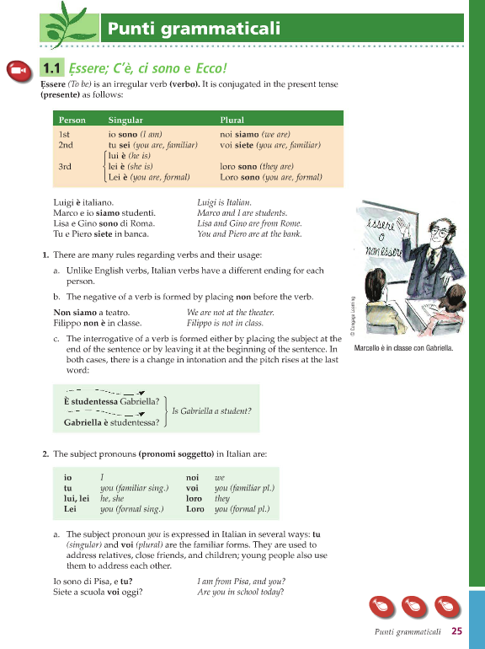

Faculty Profile
Caterina Pieri
Special Lecturer - Italian
OU bookstore price w/online access code $213.95

Slide 23
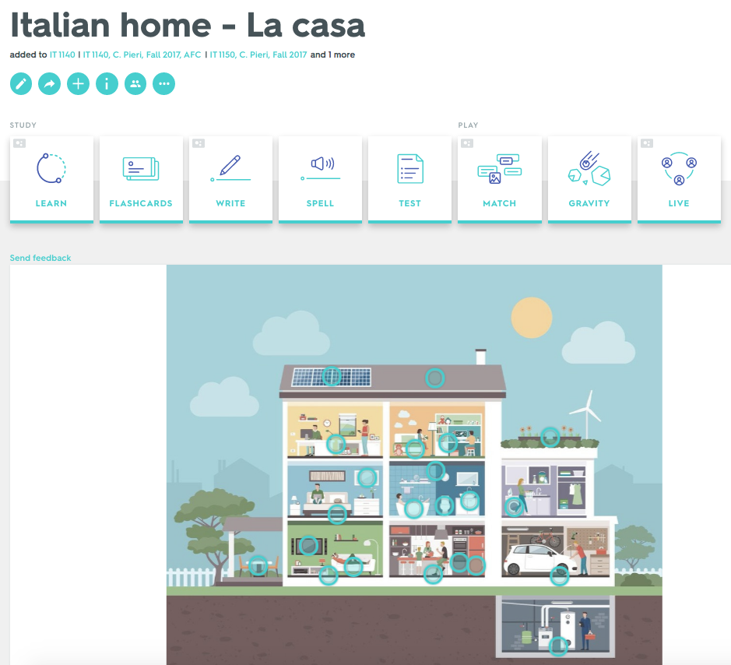
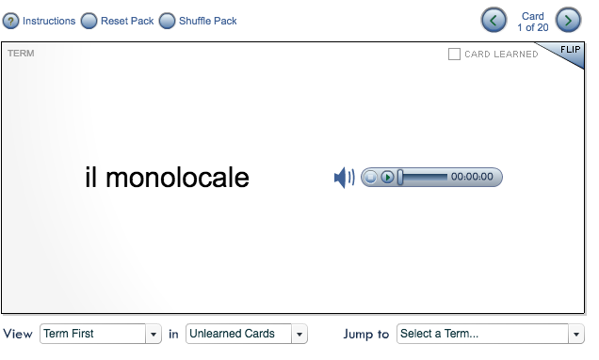
Faculty Profile -Caterina Pieri
Flashcard from Ciao
Created on Quizlet.com

Slide 24
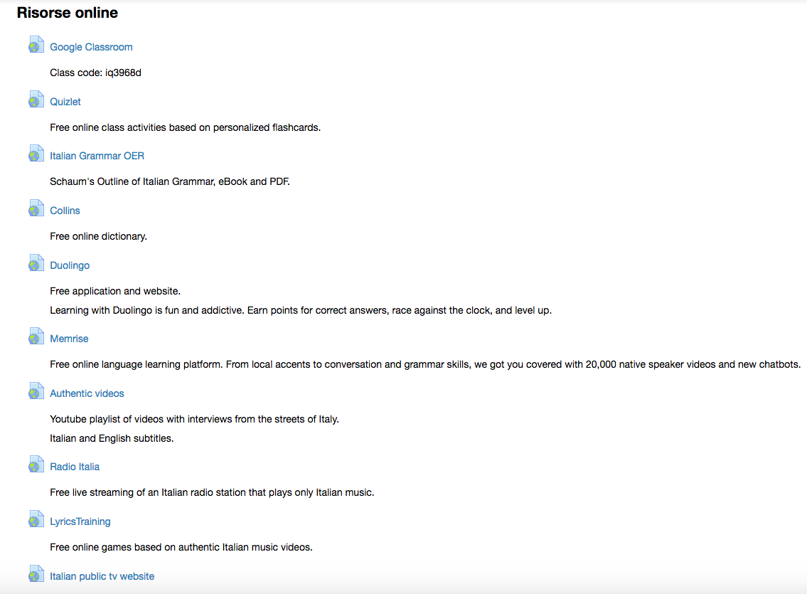

Slide 25
OU & OER
Dikka Berven - Special Instructor of French - adopted open textbook instead of $256.25 traditional text
Kieran Mathieson - Decision & Information Science - wrote his own textbook, used internationally
Writing Department - Grizz Writes: a Guide to First-Year Writing
Written by faculty, students use in all 3 WRT courses. Partnership with Fountainhead Press, cost $32.85 / $10.95.
Dept. of Music in the School of Music, Theatre and Dance
Phyllis White uses two open source texts for her MUS1001.
Ben Fuhrman uses Open Music Theory textbook

Slide 26

How to adopt a textbook
Step 1: Explore Open Textbooks in your subject
Step 2: Review and Select an Open Textbook
Step 3: Customize your Selection as desired
Step 4: Get necessary approvals and disseminate the open textbook to students.
Step 5: Disseminate Your Open
Textbook to Your Students
Step 6: Share with your colleagues
*Open Textbook Adoption Worksheet

Slide 27

Resources:
Your Librarian Liaison
Kresge Library Open Education Topic Guide
Library homepage>Course&Subject guides>Topical guides tab
Openstax adopt a textbook guide
College opentextbooks.org adoption guide
Image courtesy Legohttp://minifigures.lego.com/en-us/Bios/Librarian.aspx

Slide 28
References
2016 Student textbook and course materials survey. (2016). Florida Virtual Campus. https://florida.theorangegrove.org/og/file/3a65c507-2510-42d7-814c-ffdefd394b6c/1/2016%20Student%20Textbook%20Survey.pdf
BLS, Census Bureau, Carpe Diem Blog, “Percent Change Since 1978 for Educational Books, Medical Services, New Home Prices, and CPI” Campus Riot. Web. 31 Oct. 2016. http://campusriot.com/wp-content/uploads/2013/01/American-Enterprise-Institute-Textbook-Inflation-Graph.jpg
Bureau of Labor Statistics, U.S. Department of Labor, The Economics Daily, “College tuition and fees increase 63 percent since January 2006.” https://www.bls.gov/opub/ted/2016/college-tuition-and-fees-increase-63-percent-since-january-2006.htm
College Board, Annual Survey of Colleges. “Average Estimated Full-Time Undergraduate Budgets (Enrollment-Weighted) by Sector, 2016-17.” https://trends.collegeboard.org/college-pricing/figures-tables/average-estimated-undergraduate-budgets-2016-17
2012 Florida student textbook survey. (2012). Florida Distance Learning Consortium.
Robinson, T. J. (2015). The effects of open educational resource adoption on measures of post-secondary student success (Doctoral dissertation, Brigham Young University)
Allen, G., Guzman-Alvarez, A., Smith, A., Gamage, A., Molinaro, M., & Larsen, D. S. (2015). Evaluating the effectiveness of the open-access ChemWiki resource as a replacement for traditional general chemistry textbooks. Chemistry Education Research and Practice, 16(4), 939-948.
Croteau, E. (2017). Measures of student success with textbook transformations: the Affordable Learning Georgia Initiative. Open Praxis, 9(1), 93-108.
Hendricks, C., Reinsberg, S. A., & Rieger, G. W. (2017). The Adoption of an Open Textbook in a Large Physics Course: An Analysis of Cost, Outcomes, Use, and Perceptions. The International Review of Research in Open and Distributed Learning, 18(4).
Ozdemir, O., & Hendricks, C. (2017). Instructor and student experiences with open textbooks, from the California open online library for education (Cool4Ed). Journal of Computing in Higher Education, 29(1), 98-113.
Feldstein, A., Martin, M., Hudson, A., Warren, K., Hilton III, J., & Wiley, D. (2012). Open textbooks and increased student access and outcomes. European Journal of Open, Distance and E-Learning, 15(2).
Grewe, K., & Davis, W. P. (2017). The Impact of Enrollment in an OER Course on Student Learning Outcomes. The International Review of Research in Open and Distributed Learning, 18(4).
Hilton III, J., & Laman, C. (2012). One college’s use of an open psychology textbook. Open Learning: The Journal of Open, Distance and e-Learning, 27(3), 265-272.
Pawlyshyn, N., Braddlee, D., Casper, L., & Miller, H. (2013). Adopting OER: A case study of cross-institutional collaboration and innovation. Educause Review. Retrieved from
http://er. educause. edu/articles/2013/11/adopting-oer-a-case-study-of-crossinstitutional-collaboration-andinnovation
Chiorescu, M. (2017). Exploring Open Educational Resources for College Algebra. The International Review of Research in Open and Distributed Learning, 18(4).
Fischer, L., Hilton, J., Robinson, T. J., & Wiley, D. A. (2015). A multi-institutional study of the impact of open textbook adoption on the learning outcomes of post-secondary students. Journal of Computing in Higher Education, 27(3), 159-172.
Wiley, D., Williams, L., DeMarte, D., & Hilton, J. (2016). The Tidewater Z-Degree and the INTRO model for sustaining OER adoption. Education Policy Analysis Archives/Archivos Analíticos de Políticas Educativas, 24.

