Slide 1
How much do faculty think students should pay for course materials?
Understanding faculty cost tolerance and selection authority
Mi-ALA 2023 - Holland, MI
Slides https://tinyurl.com/4h9udr8c
Notes:
Hello welcome. The title of my presentation today is ….

Slide 2

Hello!
Julia E. Rodriguez
Health Sciences & Scholarly Communications Librarian
Oakland University Libraries
Affordable Course Materials Initiative Team Lead
SPARC OER Leadership Fellow 2018-2019
MI-OER Network - Exec. Team member
MHEC - OER Action Team Mi- rep
Rodriguez, J. E. (2022). How Much Do Faculty Think Students Should Pay for Course Materials? A Survey of Instructors' Use of Current Course Materials and OER Use. Journal of Librarianship and Scholarly Communication, 10(1).
Notes:
My name is …
Team Lead for the campus Affordable Course Materials Team, was a SPARC OER Fellow in 2018-19 and I am also a member of several state and regional OER Groups.
This study along with the survey instrument was published in the Journal of Librarianship and Scholarly Communication, which is open access. There is a link in the slides or you can search Google.

Slide 3
OER - Affordability Initiatives
Open Educational Resources (OER) are free of cost, and include built-in permission to retain, reuse, revise, remix, and redistribute the material which means users can edit, modify, customize and share them.
Open textbooks are published textbooks and ancillary materials that are free, adaptable, openly licensed peer-reviewed quality textbooks and supplemental materials that are available to download and print in various formats.
Affordability Initiatives strive to lower the cost of textbooks for students by encouraging and supporting faculty to utilize OER, open textbooks, library materials and other free resources.
Notes:
I want to start by providing the context for this research and the presentation to ensure everyone understands the terminology being used. These are the same definitions presented in the survey instrument for this research.
Open Educational Resources or OER are teaching and learning materials that are free of cost, and include built-in permission to retain, reuse, revise, remix, and redistribute the material which means users can edit, modify, customize and share them.
Open textbooks are published textbooks and ancillary materials that are free, adaptable, openly licensed peer-reviewed quality textbooks and supplemental materials that are available to download and print in various formats.
Affordability Initiatives strive to lower the cost of textbooks for students by encouraging and supporting faculty to utilize OER, open textbooks, library materials and other free resources.

Slide 4
Outline
01.
Background
03.
Results
02.
Methodology
04.
Conclusions
*OU’s Affordable Initiative
*Study development - what we wanted to know
*Overview of cost tolerance findings
*Overview of selection authority
*Survey instrument
*The very long process
*What the data told us
Slides https://tinyurl.com/4h9udr8c
Notes:
Originally, I outlined this presentation to focus just on the solely on the research data, I’d was going to present the typical background and methodology, results and conclusions. Which is fine. But also pretty boring. You can all read the article. Like I said it’s open access.
But then in one of the many walks around the neighborhood with my dog I realized what I am excited about is that you all aren’t stuck in little boxes on my computer screen but we are here together face to face and can have a conversation. So I hope we can do that as I moved through sharing about my research.

Slide 5
Why care about this topic?
OER & Affordable Initiatives
How faculty think about and include library resources in teaching
Encouraging use of library resources - impact and relevance to campus
Social justice & equity -educating faculty about impact of prices on students and student success
Notes:
So I want to start by reflecting on why we are asking these questions?. Why did you choose to attend this session and how does this research impact our work as librarians?
Yes, the obvious answer is this research informs OER or Affordable initiatives on our campuses. But I believe that even those who do not have these initiatives will see some implications for their work.
Learning what faculty think about textbook costs and how they make their selections helps us understand how they are designing their courses and whether they consider the library at all in this process. It provides us an opportunity to engage with them about our resources that many of us are fighting to keep. When we encourage and assist faculty to use library resources and other low and no-cost materials for their courses we further cement our relevance to the campus and directly impact learning and student success.
Librarians, understand deeply the imbalance in the publishing system and increasingly are the ones doing the social justice work and having discussions about equity on campus, we are the best advocates to educate faculty about the impact of high textbook prices on our students.

Slide 6
OU’s Affordable Course Materials Initiative (ACMI)
Increase the use of affordable course materials by OU faculty.
Review current policies and practices about material selection, purchasing and notification to ensure that they are student centered.
Campus plan emphasis affordability as priority ~ over OER
Notes:
This research was conducted to support Oakland University’s affordable course materials initiative. I thought it might be helpful to start out with some background information about the Initiative which is known as the ACMI on campus. It has been a slow and often arduous journey.
The initiative has 2 basic goals.
Increase the use of affordable course materials by OU faculty.
Review current policies and practices about material selection, purchasing and notification to ensure that they are student centered.
The campus plan by design put an emphasis on affordability over OER because at the time we felt this was the best and more realistic option for our campus.

Slide 7
2017 - College of Arts & Science OER Task Force formed
2018 - Resolutions passed in support of affordable initiative OU College Assembly, OU Faculty Senate & Student Congress
February 2019 - Affordable Course Materials Initiatives (ACMI) launched, Provost endorses and funds campus plan. $5,000
Winter 2020 - ACMI Stipend pilot program launched
NO ACTIVITY COVID 😟
Winter 2021 - 2nd round ACMI stipends
Summer 2021- Zero and low-cost course markings added to Banner
Fall 2021 - OUSC passes 2nd resolution in support of ACMI - conducts petition campaign Pledges $5,000
Winter 2022 - Creation of the Affordable Education Materials Gift Fund
Winter 2022 - Round 3 ACMI stipends awarded April 2022
Fall 2022 – Launched OER & Affordable Champion Program & ebook purchasing program
Winter 2023 – Round 4 ACMI stipends awarded April 2024
Winter 2023 – OUSC Pledges $10,000
Winter 2023 – 1st semester savings reaches $100,000
Notes:
The ACMI was started as an task force in the College of Arts and Sciences in 2017 by two instructors concerned about the cost of textbooks for their courses.
This work resulted in 2 resolutions in support of an affordable initiative being passed. One from the College and another from University Senate. The Student Congress also passed a resolution in support at the time.
From this, a campus wide initiative was launched now known as the ACMI which has been endorsed by 2 Provosts. The Library administers the funds which come from many generous donors including the our Student Congress who have pledged a total of $15,000 over the past two years. They also passed a 2nd resolution specifically naming the ACMI.
Note the sad face in the middle of the slide - that is represent the year when no work at all took place during the 1st part of the pandemic.
Since restarting things have been quite active.
The ACMI was instrumental in implanting low and no-cost course marking in our registration system. As of Winter 2023, 2,658 students have been enrolled in low and no-cost courses. We also have reached a 1st semester savings of $100,000 and just awarded our 4th round of course conversion stipends.
I provide this background and timeline mostly to demonstrate that our journey has slow with stops and detours along the way.

Slide 8
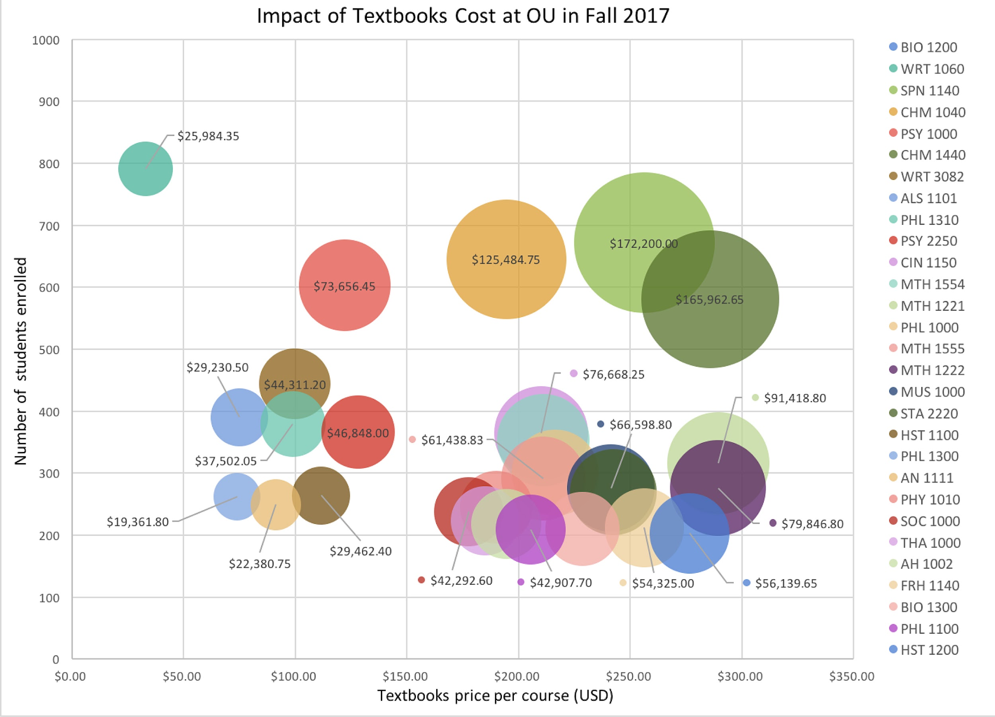
What we knew
Notes:
So this is what we started with. This data is from 2017 showing us textbook prices and student enrollments for highly enrolled courses in the College of Arts and Sciences. In case you can’t see, the small print in the bubbles show the cumulative textbook cost per academic year for a course. So the biggest green bubble indicates that students are spending over $170,000 each year on textbooks for that course!

Slide 9
“I have several classes where I can’t afford to purchase my textbooks. There are some classes where textbooks are up to $500.”
—OU student
Notes:
We also knew what we are being told by students. Textbooks were too expensive they can’t afford them.

Slide 10
What we wanted to know
Understand what practices are currently taking place on campus
  Selection what and how
  Selection authority - can they choose
  Cost tolerance, awareness, steps to mitigate
  Awareness of low-cost and OER alternatives
Understand barriers to adoption
Notes:
As a group we decided on what we wanted/needed to know.
We wanted to collect data on:
What faulty were selecting and how these selections were being done
We wanted to know about their selection authority - can they choose to adopt OER or no-cost materials
We wanted to know what their cost tolerance for their these materials is.
We wanted to know if they are aware of the price of their materials they assign and were they taking steps to mitigate costs
And of course we wanted to know about their awareness and use of OER
Ultimately, we were trying to understand what practices are currently taking place on our campus and the barriers to adoption.

Slide 11
Methodology
Research
Analysis
Publication
Instrument
Conducted in Feb. 2020
Closed week before COVID switch all online
Fall 2021 during sabbatical
Fall 2022
Journal of Librarianship & Scholarly Communications
https://doi.org/10.31274/jlsc.13273
Qualtrics
Available with publication
Notes:
We reviewed other survey instruments and came up with a tool that ultimately was way long. Part of the reason this happened was because we were going to conduct a separate survey to ask about OER specifically but then decided to include those questions with this one which actually turned out to be a good thing because of what happened with COVID disruptions.
The survey was developed in Fall of 2019, analysis of the data took place in 2021 and the publication came out in 2022. While this may be a typical time period for a research lifecycle I think we can all agree the last few years haven’t been typical. I believe or want to believe that more faculty may use free or low cost materials or may think about the price of their textbook now post COVID. In my experience though, it’s only been in the last year that they have had the mental capacity to engage in converting a course and we have seen this reflected in the interest and applications for course conversion stipends.

Slide 12
Study Sections
Types of materials
Textbook selection
OER
Awareness
Use
Which materials they use
Utilization of access methods
Percentage of materials used to mark item required
Selection authority
Factors influencing choice
Believes about student purchasing habits
Cost knowledge & tolerance
Motivations for choices
Use of alternatives
Demographics
Rank
Tenure Status
Years teaching
School/Dept.
Notes:
The study had several sections. We asked about a lot of things. In hindsight this wasn’t the best strategy. There were so many data points and the survey was quite lengthy. I have tried to highlight in this presentation the areas that are unique to this research.
We asked about the types of materials faculty utilize. The access methods for these materials and the percentage of a item that would need to be used to mark item required.
We asked about textbook selection, which included authority, factors influencing choice, beliefs about student purchasing habits, their knowledge of cost, use of alternative and motivations.
We asked about their knowledge and use of OER and of course the obligatory demographic questions.

Slide 13
Why Ask
Environmental scan but not really
Had anecdotal evidence from faculty
  About selection barriers - can faculty choose their own books?
  About price tolerances - no-one has asked this question
  About OER knowledge and use - lost of people have asked this
Need alignment between goals, faculty perceptions, practices, students
Inform ACMI work
Notes:
Why did we asked these questions. First, we were a new group working on the initiative and we had so many questions and felt really clueless about practices and policies on campus.
So, we sort of did an environmental scan but not really. We needed data to validate what we were hearing about selections barriers, prices of textbooks and faculty understanding of OER.
We also needed to align the ACMI work with where our campus was at at the time and that ment having data we could point to.

Slide 14
Basic Demographics
Response rate
Ranks
(42.9% tenured, 17.5% tenure-track faculty)
Remaining 39.7% in the many different non-tenure-track instructor roles.
  Only 6.4% of the non-tenure-track group are instructors with some form of job security; the remaining have no job security.
172 individual responses (approximately 16.3% response rate)
full completion rate of 128 (12.1%)
Majority from College (57%)
Next largest group HS (10.16/%)
47 was the maximum number of years, and 15.5 years was the mean
Notes:
The next few slides are the are data heavy ones. I will go through these quickly because as I said you can read the article, if someone has a specific question I can refer back to these.
The intention of the study was to capture a sample of voices from across faculty ranks, which was achieved.
The survey received 172 individual responses for a (16.3% response rate); not all respondents answered all the questions probably because the survey was too long. This resulted in a full completion rate of 128 response which was 12.1% response rate.
More than half of the respondents were tenured professors, associate professors, and tenure-track assistant professors with the remaining 39.7% of respondents in the many different non-tenure-track instructor roles. Only 6.4% of the non-tenure-track group were instructors with some form of job security; the remaining had no job security.
The majority of respondents taught undergraduate courses and slightly over 50% were affiliated with the College of Arts and Sciences which is the school with the highest number of faculty at the university.

Slide 15
Types of materials used
Hard copy textbooks (16.4%)
Created by me (16.25%)
Free online (15.1%)
Library materials (12.85%)
e-books (11.4%)
Online Platforms (10.04%)
+5 other categories
Hard copy textbooks
One full professor
79.5% of associate professors
85.0% of assistant professors
*Survey didn’t distinguish at this point between commercial and open textbooks; instead, the focus was on format.
Notes:
Types of materials used.
Not surprisingly Hard copy textbooks were used more the most. The second highest category (materials created by me), third highest (free resources found online), and fourth highest (library materials) are all resources considered free to students. The survey didn’t distinguish at this point between commercial and open textbooks; instead, the focus was on format.
Tenure and tenure track professor overwhelming said they use hard copy textbooks.

Slide 16
Selection Authority
Final decision
Multi-section courses
62.3% of respondents make the final decision
17.5% “I do, for most of my courses”
remaining 20.1% relied on a committee, the entire department, the department chair, or only full-time faculty or were unsure
64.8% were able to provide input on textbook selections
11.5% did not have a role
Notes:
Selection Authority
We saw that faculty had varying abilities to select materials for their courses. Multi-section courses appeared more likely to utilize a group to select and had more faculty saying they didn’t have a role.
More than half of respondents (62.3%) make the final decision about their materials for all their courses, 17.5% choose “I do, for most of my courses,” and the remaining 20.1% either relied on a committee, the entire department, the department chair, or only full-time faculty or were unsure. We found that our campus was nearly 10% behind the selection authority number reported in the National Association of College Stores (NACS) multi-campus study.

Slide 17
Selection Authority & Rank
Over 80% of tenured and tenure-track faculty make the final decision for all of their classes
50% of job-secure non–tenure-track
56.4% of non–job-secure non–tenure-track faculty make final decisions for all their courses.
63.3% of instructors teaching multi-section courses can choose to use different materials, or no textbook at all.
19.5% were not able to choose different materials
17.2% were unsure
Notes:
When we looked at selection authority by rank we saw some correlation with rank yet we recognize we had a relatively small sample size and some department weren’t represented.
This data did back up what we had been hearing from non-tenure track faculty particularly for multi-section courses. We also saw a fair number of respondents who just weren’t sure how selection for multi-section courses was handled for their programs.

Slide 18
More Selection data points
The most important factors for selecting required course materials:
high-quality factually accurate content
cost to student
comprehensive content
The least important factors
compatibility with the learning management system
whether the resources are adaptable/editable
Asked about assigning supplemental materials and who sends selections to the bookstore
Notes:
We asked about the most important factors faculty considered when selecting course materials. High-quality factually accurate content, cost to student, and comprehensive content were the top three factors. The least important were compatibility with the learning management system and whether the resources are adaptable/editable.
We also asked about what types of supplementary materials they assigned and who sent selections to the bookstore.
The majority were responsible for sending their textbook selections to the bookstore and many faculty indicated that they assign supplementary materials such as clickers, calculators, data sets, software, lab supplies and, videos or films.

Slide 19
Utilization of access methods
allow the use of older textbook editions
utilize free materials
use library reserves
supply their own readings
ask for the textbook and online codes to be bundled
negotiate directly with the publisher
loan out books
provide online resources they create
encourage students to purchase materials online
Primary motivation - to reduce costs to students, best option for course
Notes:
Respondents could indicate which types of access methods they had utilized and then were asked what their primary motivations were.
They indicated they used a variety of ways to make their resources available to students including allowing older editions, using library reserves, using free resources and the primary motivation was cost followed by “it was the best option for the course”.

Slide 20
% of an item used to require purchase
Use approximately 68.4% of a textbook in one semester
  standard deviation 20.79%
Most popular choice 61-81%
2nd most popular choice 81% or higher
34.3 % chose a range less than 60%
No policy or even standard of practice for marking a textbook required or recommended.
Notes:
We asked faculty approximately what percentage of a textbook do you think your students need to utilize in one semester for you to list the textbook as required?
Respondents indicated that students would need to use approximately 68.4% of a textbook in one semester for them to list the item as required. The standard deviation was 20.79%.
The most popular range, chosen by 41.1% of respondents was 61%–80% of a textbook must be used. The second most popular range was 81% of a textbook or higher.. The remaining 34.3% of respondents chose a range of less than 60% of a textbook.
This question brought to light that there is no policy or even standard of practice for marking a textbook required or recommended. In conversations with faculty since, I have learn that they give this very little thought and don’t realize the implications for marking multiple items required for their course.

Slide 21
Knowledge of cost
78.4% responded “yes”
21.6% responded “no.”
  Professors( 22.2%) and associate professors (25.9%) had the highest percentages unaware of their course materials costs
  37% of faculty who were unaware have been teaching for 15–26 years.
Notes:
Knowledge of Cost
We asked faculty if they were aware of the current cost for their course materials. 78,4% said yes. The interesting number here is the 21.6% that said no. Professors and associate professors had the highest percentages unaware of their course materials costs. 37% of faculty who were unaware have been teaching for 15–26 years.
The data suggested that the longer an instructor has been teaching and the higher their rank, the less likely they are to know the current price of their course materials but the survey response rate was too low to make a general assumptions.

Slide 22
Student purchasing of materials
% of students purchase all materials
Hear from student about cost
74.2% was the mean (standard deviation 23.55%).
Only 44.6% of those respondents were extremely confident or very confident in their estimate.
Overwhelmingly reported “rarely” (39.1%)
“never” (19.5%) heard from students regarding not being able to purchase a textbook
Notes:
We ask faculty what % of students the believe purchased all the required materials for their courses.
The vast majority of respondents (80.2%) believe that at least 61% of their students purchase all the required materials for their courses.
The mean number given was 74 % of student purchased all the required materials but less than half of respondents were confident about their answer.
We also discovered that overwhelming faculty rarely hear from students about not being able to purchase the textbooks. So right away we could see a correlation between these two data points. Student aren’t speaking up so of course faculty believe they are purchasing the required textbooks.

Slide 23
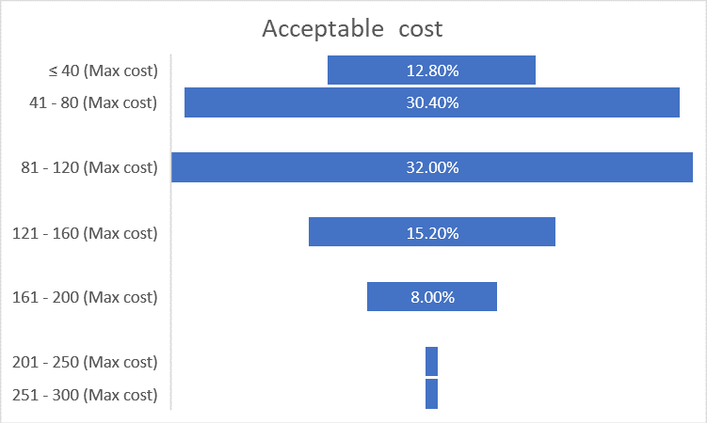
Acceptable Tolerance
Notes:
This is the part where we investigated cost tolerance. Which to me became the most simple but interesting data point of the survey.
Respondents were given a dial and asked to choose an acceptable course materials cost for their courses.
Answers were grouped into a range because the dial did not default to whole amounts.
Over 55% chose a cost above $81.
And 43.2% pick $80 or less

Slide 24
Cost Tolerance
The mean cost chosen was $98.25, with a maximum cost of $300.
Art History and Mechanical Engineering chose prices between $201 and $300.
21 departments chose prices between $101 and $200
11 departments indicated that $40 or less was acceptable
Notes:
To dig a little deeper into the data…
The mean cost chosen was $98.25 and max was $300
Of the 33 departments represented, the faculty from Art History and Mechanical Engineering chose prices between $201 and $300
21 departments chose prices between $101 and $200, with 11 departments indicated that $40 or less was acceptable
Some departments had huge splits in acceptable prices, such as Modern Languages & Literatures, whose faculty chose below $40 and indicated $160 as the top acceptable cost.
Math, Psychology, Sociology, Anthropology, Social Work, & Criminal Justice departments also had large variations of acceptable costs for course materials.
Some of these departments already have faculty within specific programs using OER, which might explain their difference in cost tolerance.

Slide 25
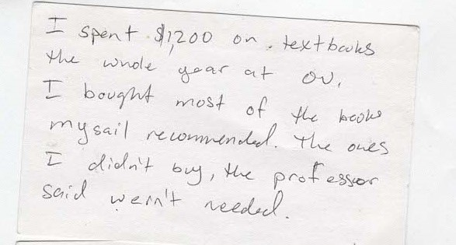

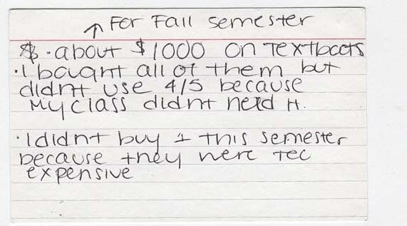
What students say about cost
Notes:
This is what we knew at the time that students were saying. During Open Educational week in 2019 we had asked students to leave comments in a box at our service desk about their textbooks. All of these cards are comments from students who spent $1,000 or more on textbooks.

Slide 26
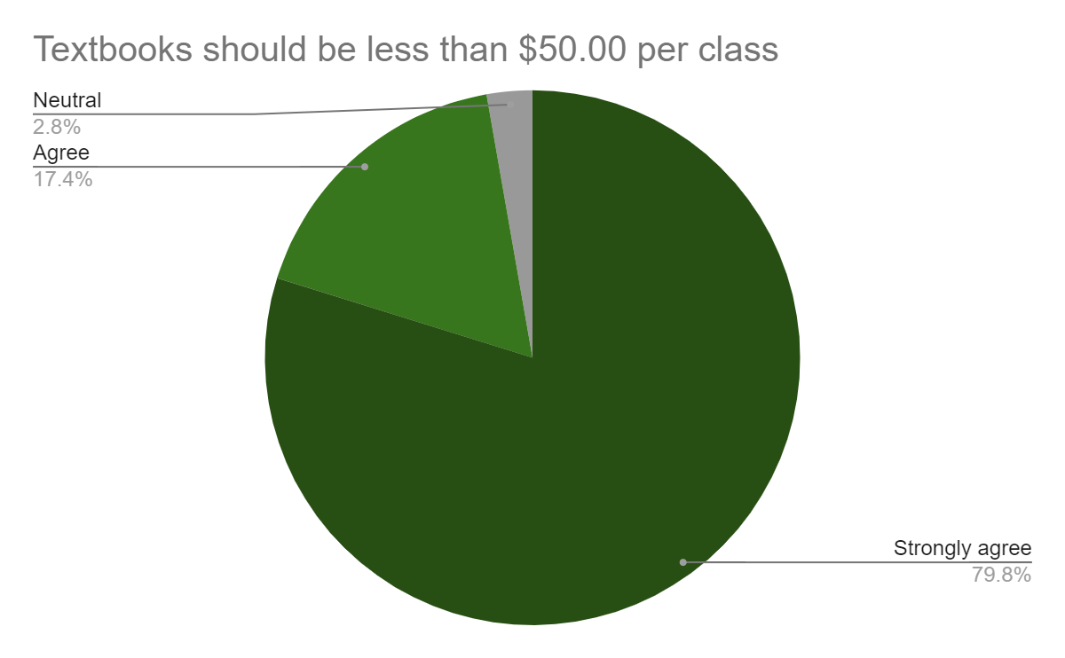
What students say about cost
OU Student Survey
Winter 2022
Notes:
Since that time the Student Congress also did a survey of students. They overwhelmingly were saying textbooks should be $50 or less for a class.

Slide 27
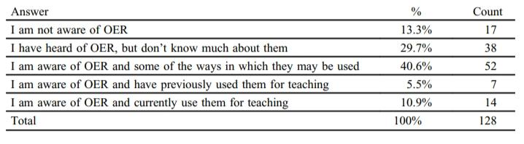
OER
Knowledge
Notes:
The final section investigated OER knowledge and use.
Before each of the OER-related questions, a definition of OER and open textbooks was provided
Most respondents (86.7%) had some awareness of OER, with only 13.3% stating that they had no knowledge.
Exploring those with no knowledge of OER, 35% were associate professors, and 35% were special lecturers.

Slide 28
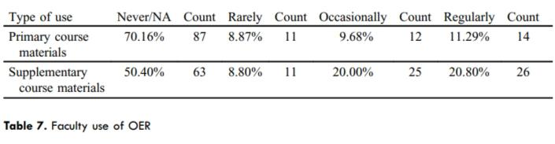
OER -USE
Small group of instructors use OER most often as supplementary materials.
Notes:
The relatively small group of instructors who use OER are using them most often as supplementary materials.
Supplemental use of OER was indicated across all faculty ranks.

Slide 29
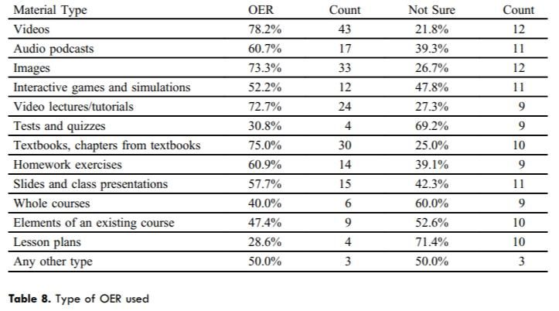
OER - USE
Notes:
Respondents using OER were asked to choose which type of OER materials they used which proved to be varied but most faculty also indicated that they were not sure whether the resource was actually OER.

Slide 30
What this told us
Faculty cost tolerance is way too high!
  Concentrated in certain departments - maybe?
Students weren’t speaking up to their instructors
Selection authority is varied by department/program & rank, particularly for multi-section courses.
  Can’t adopt if they aren’t allowed to select
Wide variation in determining if an item is required.
Faculty are using free stuff already! YAY!
They aren’t really sure what OER is.
Notes:
So what did this all tell us?
Many faculty believe they are taking steps to reduce the cost of their course materials yet, faculty cost tolerance is way too high!
Faculty need to understand how their access methods may not improve costs for student and how the higher prices impact their students.
High cost tolerances might be concentrated in certain departments - but maybe not, we need to investigate this further.
Students definitely weren’t speaking up to their instructors about their struggles with textbook prices.
Faculty selection authority is varied by department/program & rank, particularly for multi-section courses. This gave us data to back up what we were hearing from non-tenure track faculty about wanting to adopt but not being allowed to select new content.
Not only is there no standard practice for marking an item required but in most cases it’s not something faculty think about and they aren’t provided any guidance on what to do. I was told by one faculty member that they just followed what their faculty advisor did when they were student teaching.
Many, if not the majority, of faculty are already using all kinds of free materials YAY! We need more of this.
Even faculty who say they are currently using OER don’t actually know for sure if the materials is in fact OER. This finding mirrored other studies. Even with outreach efforts faculty still aren’t sure what makes a resources OER.

Slide 31
What to do
More education for faculty about impact of high cost of textbooks - in context to our students
Get students involved - let faculty know costs are too high
Focus more outreach specifically on OER - benefits connected to DEI
Replace under utilized item with library materials
Push for more flexibility in selection authority - let’s pilot a section
Notes:
What did we do with this information - or I should say “I” because by this point the committee had dissolved during COVID, several people left the university including my data person.
The data told me that the faculty needed to hear more about the high cost of textbooks and how it impacts students; specifically our students - at OU over half of new freshmen are either first generation, Pell grant recipients, or underrepresented minority students. Many check all these boxes. High textbook prices disproportionately impacts these student. So while I continue to talk about the impact of prices I have also shifted the conversation to speak specifically about OER and DEI.
I reached out to student congress and shared the data and encouraged them to speak up to their instructors about the impacts of high textbook cost.
It was also clear I needed to do more education specifically about OER along with the promoting the use of all kinds of affordable materials. If faculty could replace one of their required items that is only used sparingly with library materials than student have one less textbook to buy. One thing I heard over and over from student was how frustrating it was to buy textbooks that they don’t use.
And finally and definitely the most challenging was pushing for more flexibility for faculty teaching multi-sections courses to be able to try new materials.

Slide 32
Impact
Students now very engaged with library - donations to ACMI
More faculty using library resources for courses
  Documented needs and uses
Piloting a section has been successful in converting entire PSY 1000 course to low-cost
Faculty and students value the library
Students success & DEI efforts on campus
Notes:
The conversation on campus about the cost of textbooks got more traction after the collective trauma experienced during the COVID pandemic which not only brought to light financial stress but also access issues for students and faculty.
I encouraged students to speak up and they did. They drafted a petition for the administration to support the initiative. They had students and faculty write editorials to the newspaper, they did a survey and other outreach campaigns.. Which fundamentally escalated the trajectory of the initiative.
I increased the push for faculty to use library resources to replace course materials when OER isn’t available. The number of faculty reaching out to me without prior contact increased this past year and I’m attempting to document their needs the the uses of our collections for courses when possible.
Through continued outreach and conversations with departments we were able to successfully pilot the conversion of PSY 1000 (one of the highest enrolled courses on campus) as part of the course stipend program and now all sections of this course will use a low-cost Lumen learning system saving students $40,000 a semester.
Both faculty and students are viewing the library favorable which is invaluable at the time with we have seen 2 rounds of significant budget cuts.
We also have document evidence of our impact on students in supporting DEI and student success efforts on campus.

Slide 33
Further Research
Bundling of textbooks and homework systems
  Recent studies have demonstrated the rapid growth in this area (Seaman & Seaman, 2022).
  Address moral and ethical issue of requiring students to pay to submit homework.
Investigate courses that could use OER but are restricted by either university policy or department practice.
  Impacts on student due lack of adoption
How faculty discover their textbooks and course materials
  Library role, possible impact of providing a service.
Notes:
As it happens when doing research, more areas to investigate emerge.
This study did not specifically investigate the bundling of textbooks and homework systems, but the data did show that faculty are utilizing these materials. Recent studies have demonstrated the rapid growth in this area. I believe there are moral and ethical issues with requiring students to pay to submit homework and I recently presented to our Faculty Senate about this topic.
Another area that would be interesting to investigate are the courses that could utilize OER but are restricted by either university policy or department practices and the impact this has on the students.
It might also be useful to investigate how faculty discover their textbooks and course materials, whether they consider searching library resources or reaching out to their library liaison for assistance, and how selection choices may be impacted if faculty were provided direct assistance or a service.

Slide 34
How is this useful to you
Data points to gather from your institution - survey instrument available
Demonstrates faculty use of alternative materials - including the library - need more of this
Consider alignment of library goals and faculty perceptions
Investigate campus practices for selection & adoption
Notes:
How is this useful to you
I hope something I have shared here today will help you as you think about your library goals, perhaps some data points you may like to gather from your institution. Remember the survey instrument is openly available.
Maybe I’ve made you think about how your library or initiative goals align with the perception your faculty have about cost and use of materials?
OR realize that you aren’t sure what the campus practice are for selection and adoption of course materials.
As our budgets continue to decrease and shift, having tangible connections between classroom instruction and library resources will be invaluable. Supporting faculty in their teaching and advocating for low and no-cost course materials for students will continue to demonstrate to our campuses the value academic libraries bring to our institutions.

Slide 35
Conversation
Why did you choose to attend this session?
What data would be helpful to you that you don’t currently have?
How does it impact our work as librarians?
Slides https://tinyurl.com/4h9udr8c
Notes:
I have deliberately left time at the end for question but also I hope we can have a broader discussion and I want to hear from you all.

Slide 36
Thanks
Questions?
This text presentation is licensed under a Creative Commons Attribution-NonCommercial 4.0 International License.
Slides https://tinyurl.com/4h9udr8c

