Slide 1
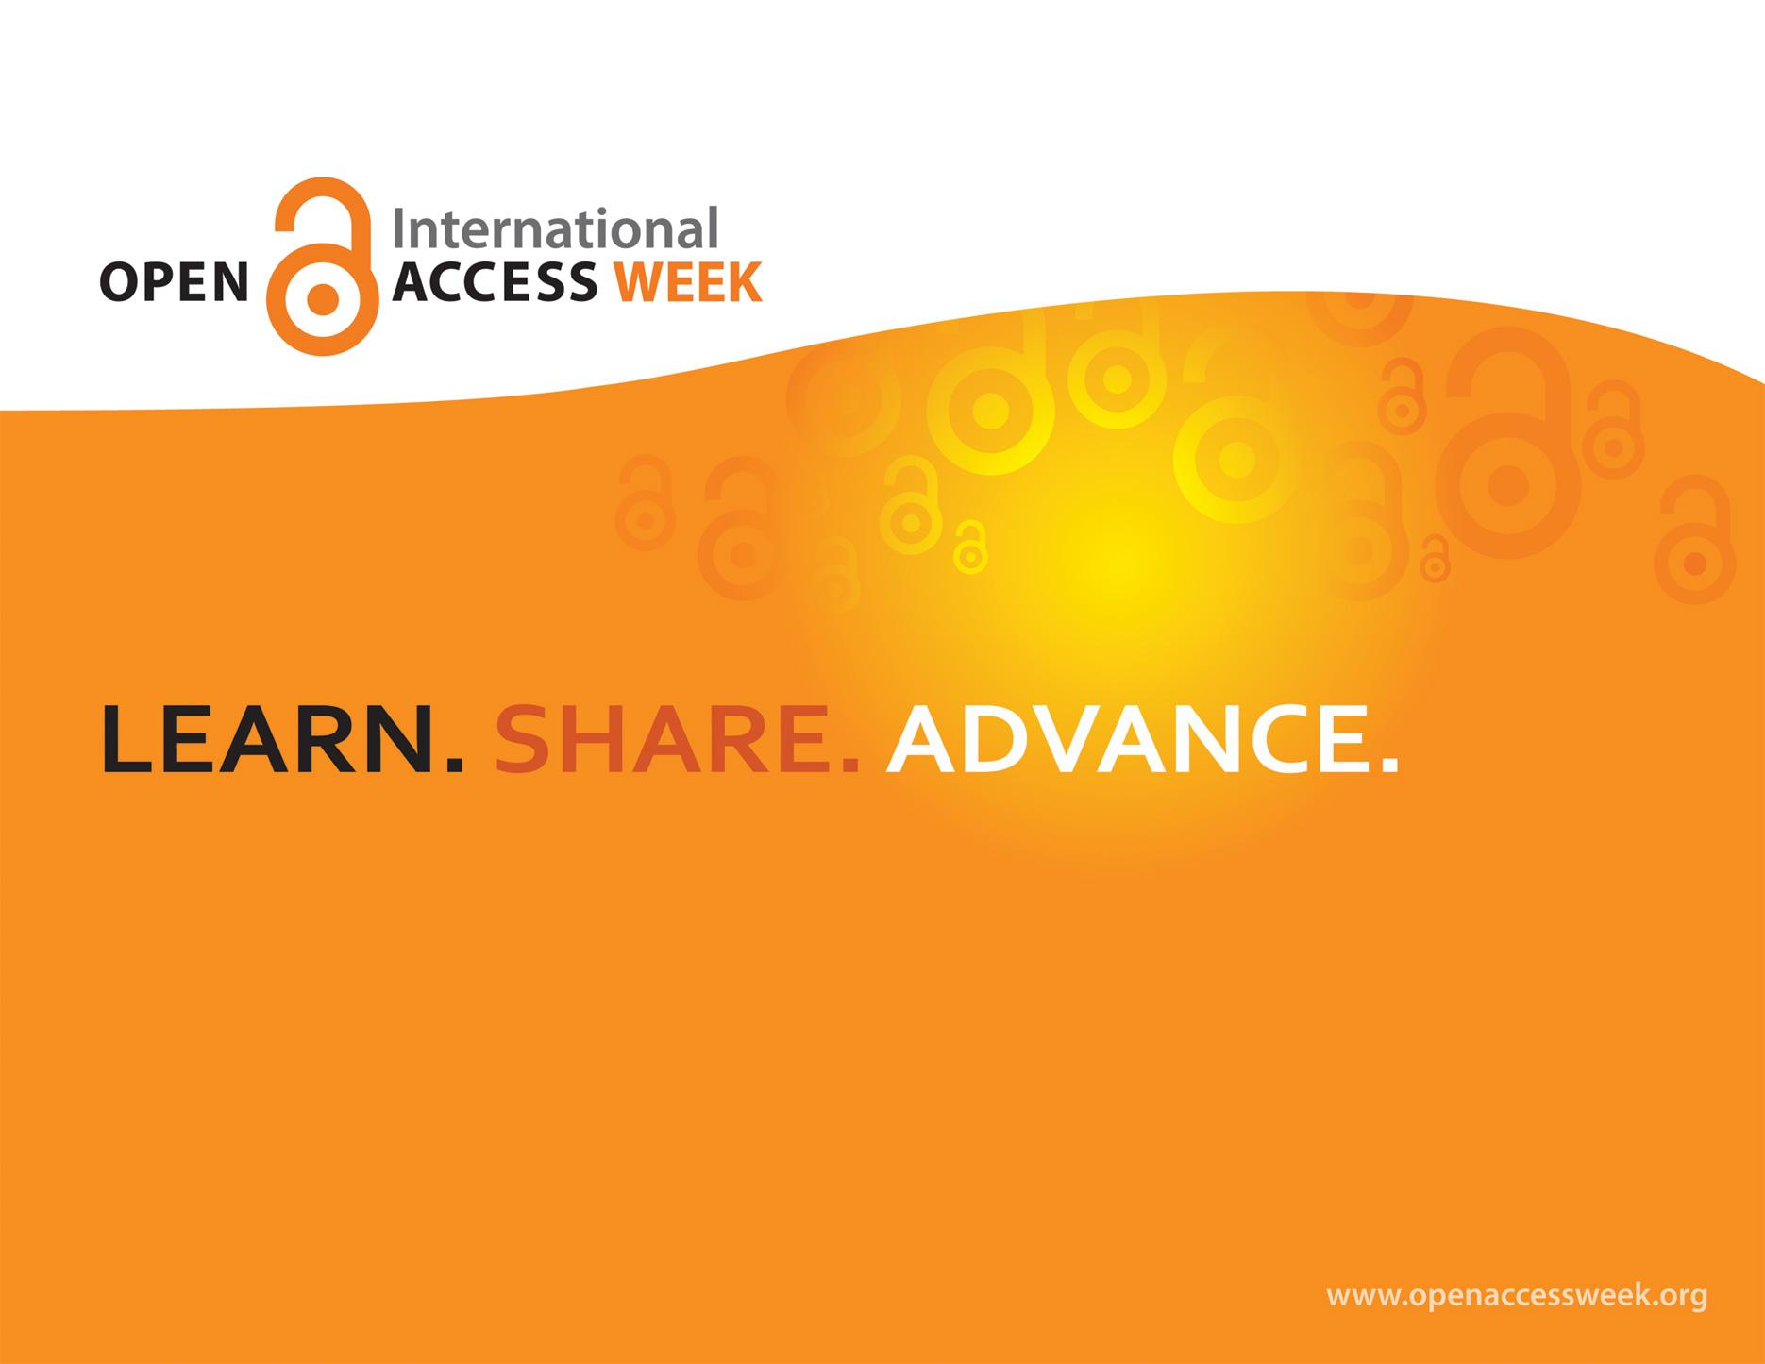


2016
“OPEN IN ACTION”

Slide 2



*Open Access (OA) is free, immediate access to scholarly information online, along with the right to use and reuse that information. (SPARC)
ABOUT OA WEEK is a global event to promote the potential benefits of Open Access and to help inspire wider participation in helping to make Open Access a new norm in scholarship and research.
JR

Slide 3
The term "open access" itself was first formulated in three public statements in the 2000s:
The Budapest Open Access Initiative in February 2002
The Bethesda Statement on Open Access Publishing in June 2003
The Berlin Declaration on Open Access to Knowledge in the Sciences and Humanities in October 2003
The idea and practise of providing free online access to journal articles began at least a decade before the term "open access" was formally coined. Movement was heavily influenced by the open source computer programming movement.
JR

Slide 4


Traditional Publishing - vs - Open Access
TRADITIONAL
OA
Pay to read
Restricted access
  Library subscriptions
  Personal subscriptions
Limited peer review
NOT free to use/reuse
Delayed publishing cycle
  Long turnaround from research – submission – publication
May have publishing fees
Free to read
Openly available
Unlimited peer-review/ sharing/ collaborating
Often free to use/reuse
Shorter publishing cycle
May have publishing fees

Slide 5
Why YOU should care about Open Access
OU Libraries in Action
Julia E. Rodriguez
Associate Professor
Nursing, Health Sciences & Faculty Research Support Librarian
OU Libraries - juliar@oakland.edu
This work is licensed under a Creative Commons Attribution-NonCommercial 4.0 International License.

Slide 6
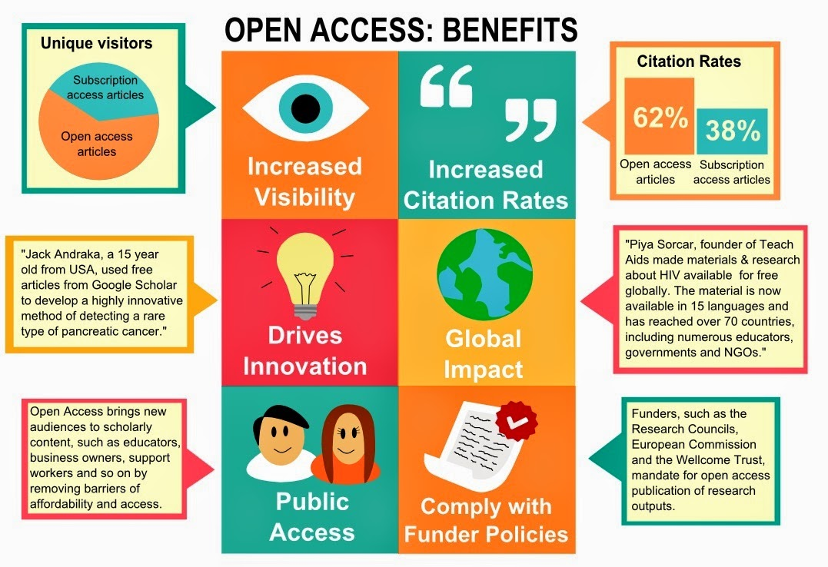
Image credit: http://www.aston.ac.uk/EasySiteWeb/GatewayLink.aspx?alId=221535 (1)

Slide 7


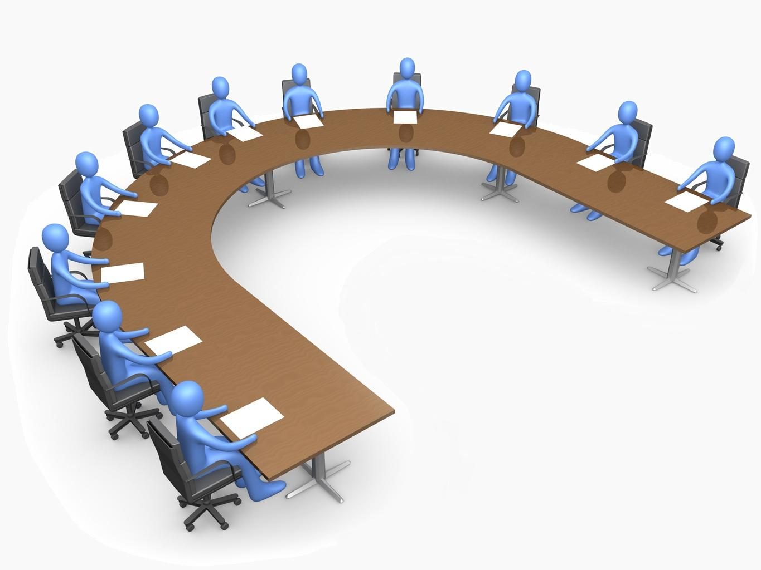
YOU
Faculty
Administration Board of Trustees
Students
Staff

Slide 8
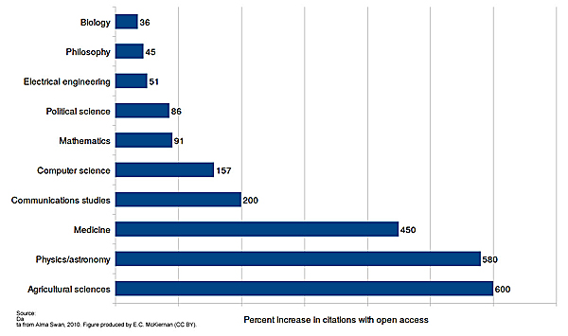
YOU- Faculty
Losing copyright to own work- Traditional publishing models
Giving away intellectual property and licensing back content
Restrictions on use of own work, no derivatives, no sharing, no distribution, no reuse
Research impact
Research locked behind paywalls can only be read by those with $ to access
Limit on research and reuse of research
  OA work has greater international impact, more citations, earlier citations
Accelerating pace of science, discoveries and scholarly knowledge
If other researchers can’t access and utilize the research then they aren’t able to build upon that knowledge

Slide 9
YOU- Faculty
Wasting limited research dollars
Avoid duplication of research - if you can’t access something you don’t know it exist. Limited access limits researchers ability to communicate with each other and collaborate
Library’s inability to continue to pay high prices for journals - faculty giving away scholarship, library buying back. Not able to subscribe to all the journals faculty publish in or increased number of important journals.
OU falling behind
OA policies at other universities COMPACT 20 major signatories, 33 universities with OA funds. - 74 universities faculty voted for OA
Example: Indiana University-Purdue University Indianapolis (IUPUI), to reward OA scholarship in the P&T process.

Slide 10
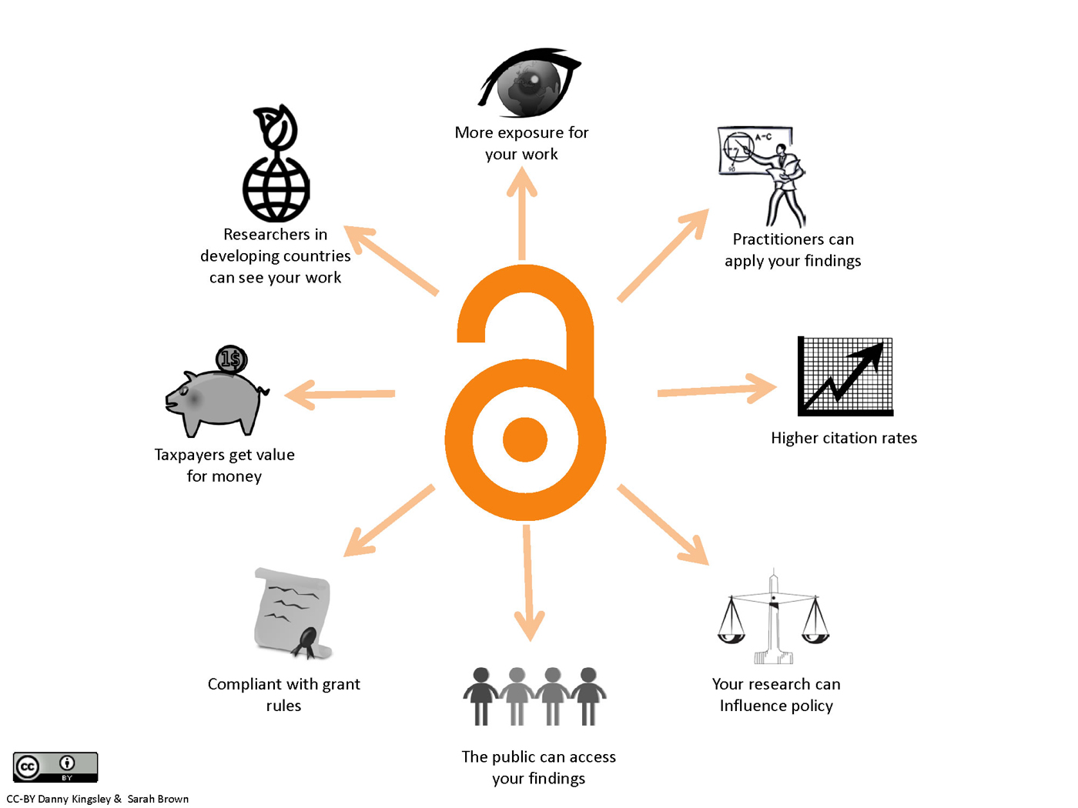
YOU- Faculty

Slide 11
YOU- Staff
Knowing about OA helps to better service patrons/students
OA provides greater access to research materials = student success
Are departments paying for materials that are available OA?
Are students paying for materials that are available OA - course packs?
Students and faculty can use OA materials freely for teaching/learning

Slide 12
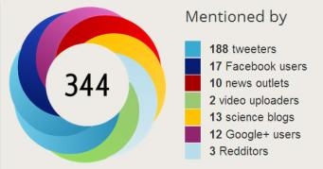
YOU- Admin-BOT
Increased recognition and prestige
Non-OA publishing limits research impact - greater international impact, more citations, earlier citations
OA policies at other universities COMPACT 20 major signatories, 33 universities with OA funds.
  Example: Indiana University-Purdue University Indianapolis (IUPUI), to reward OA scholarship in the P&T process.
  University faculty voting to self-archive or publish OA - 74 universities
Faculty research impact affects their ability to get grants
Research collections are strategic marketing tools

Slide 13
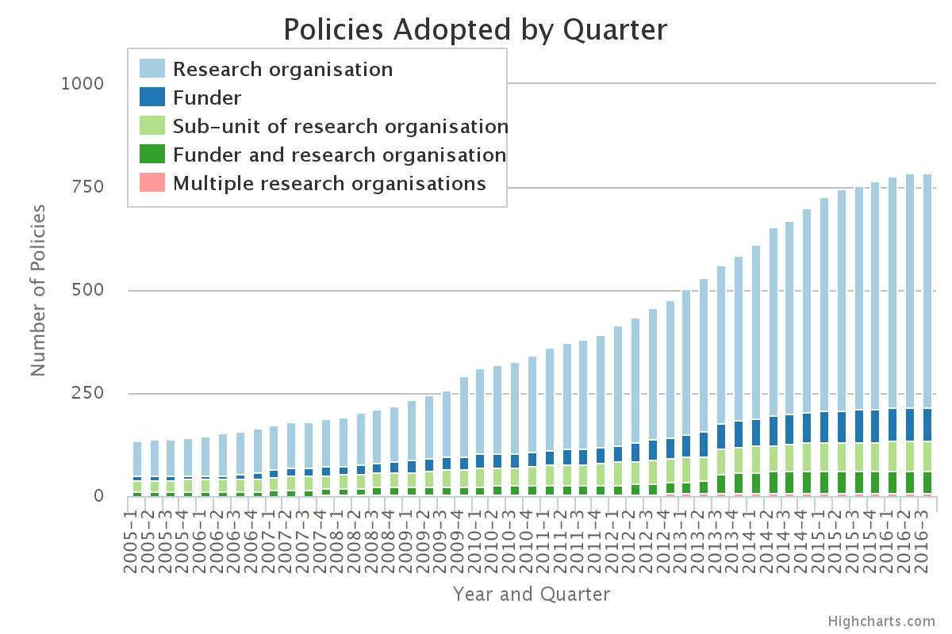
YOU- Admin-BOT
Compliance
Major US research funder open access requirements for publications and data
Wasting limited research dollars
Limited research dollars available - avoid duplication
Library’s inability to continue to pay high prices for journals - faculty giving away scholarship, library buying back. Giving away intellectual property and licensing back content.
Student success
Not just PhD and graduate students but undergraduates as well. Want and deserve access to the scholarship they need.
Public good argument
Public institutions - Give back to the community we serve. Large scale adoption> EU Horizon 2020 mandate UK-OA mandates.
Example: Research being done in Pontiac non-OU people can’t obtain results no access to the prestige, expensive journals.
Notes:
In February 2013, the Fair Access to Science and Technology Research bill was introduced into both houses of Congress. It was described as a "strengthened version of FRPAA" ^{[25]} In the same month, the White House issued a directive requiring federal agencies "with over $100 million in annual conduct of research and development expenditures" to develop, within the next 6 months, a plan to make the peer-reviewed publications directly arising from Federal funding "publicly accessible to search, retrieve, and analyze"
As of July 2016 - 16 - sixteen Federal departments and agencies have completed public access plans and posted them on their open government websites.
https://libraries.mit.edu/scholarly/research-funders/

Slide 14

YOU- Students
Access to broadest resources - students in any discipline need access to the latest research to have a complete education in their field of study.
Faculty expertise - If professors can’t read it, they can’t teach it: when professors can’t access the most recent research, they are deprived of the opportunity to bring that material into the classroom.
Access to research beyond graduation
Students' access to journals expires along with their library card at graduation.
Retaining your copyright - Long career ahead reuse of your work is vital.
Broad exposure of your research - helps with graduate school, post-docs grants etc.
Notes:
www.clipartpanda.com

Slide 15
What YOU Can Do
Faculty
Administration Board of Trustees
Students

Slide 16
YOU- Faculty
Read the copyright agreement you sign with publishers
Request to retain the rights you need
Publish in OA journals
Save a record of your accepted manuscript and post it in the institutional repository - OUR@Oakland
Advocate for your department/school to make an OA pledge to publish gold OA or post GREEN OA in the institutional repository
Teach about open access

Slide 17
YOU- Staff
Learn about OA issues
Get involved in supporting OA in your department
Check for OA versions available on the web when assisting students/patrons
Integrate OA into your workflow - ILL, course reserves etc.
Inform graduate students about OA
Assist faculty with posting accepted manuscripts into OUR@Oakland
Advocate for your department/school to make an OA pledge to publish gold OA or post GREEN OA in the institutional repository
Teach about open access

Slide 18
YOU- Admin-BOT
Help support infrastructure for promoting OA publishing at OU
  Support Institutional repository, compliance, grants/research incl. faculty and staff positions to run systems/programs.
  Build systems for OA journal publishing.
  Promote OU scholarship nationally and internationally.
Provide resources toward Article Processing Fees (OA publishing funds including monographs).
  Open Access memberships with publishers
Demand publishers remove restrictive licensing.

Slide 19


YOU- Students
Take part in the Right to Research Coalition - start an OU chapter.
Get student government involved in open access issues to educate OU student population.
Advocate for open access policies that support student success.
Talk to your faculty, connect with the librarians.
Notes:
www.clipartpanda.com

Slide 20

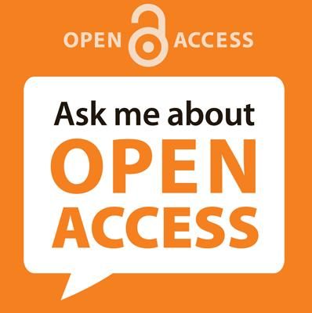
“OPEN IN ACTION”
OUWB Medical Library
Kresge Library

Slide 21

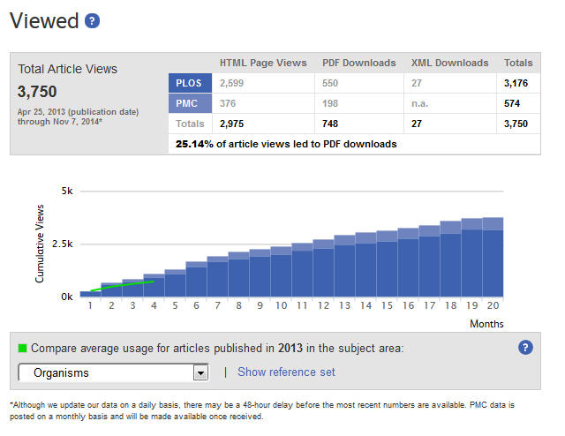
OA Fund Pilot Programs
Both Kresge Library and OUWB Medical Library launched pilot programs last year to help fund APF for faculty publishing in OA journals or traditional journals with OA options.
Find out more on each library’s website

Slide 22


Memberships
OU Libraries is now a member in BioMed Central, which means OU authors get a 15% discount off author publication fees
BioMed Central is a UK-based, they claim to be the largest OA science publisher - owned by Springer
Photo source:http://www.nmspacecenter.com/2013/06

Slide 23


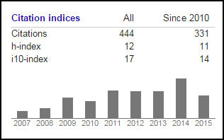

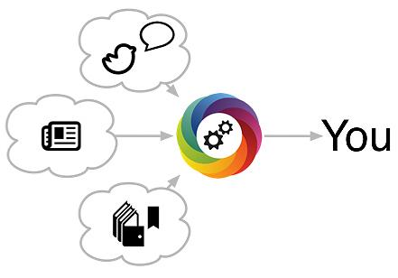
Service to Support OA Publishing
Data Librarian - Joanna Thielen
Provides individual and small group consultations and workshops on managing research data, data management plans, helping all disciplines, document, organize, store and preserve their research data.
Scholarly Communications Librarian - Julia Rodriguez
Provides individual and small group consultations related to research and publishing, consulting on scholarly communication issues, author rights, open access and coordinates OUR@Oakland repository.
OU Institutional Repository
Tracking Citations
Author Rights support
Increasing Impact of research

Slide 24
Open Access Pledge
Kresge Library
OUWB Medical Library
DRAFT LANGUAGE
Make our own research freely available whenever possible by seeking publishers that have either adopted open access policies, publish content online without restriction, and/or allow authors to self-archive their publications on the web;
Link to and/or self-archive our publications to make them freely available;
Give equal consideration to peer-reviewed articles published in open access journals during the tenure and promotion process and encourage this practice throughout the university.

Slide 25
Image credit: http://www.aston.ac.uk/EasySiteWeb/GatewayLink.aspx?alId=221535 (1)

Slide 26


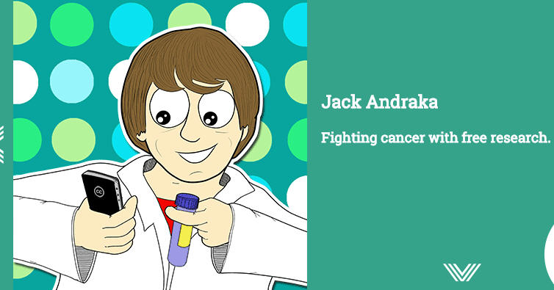
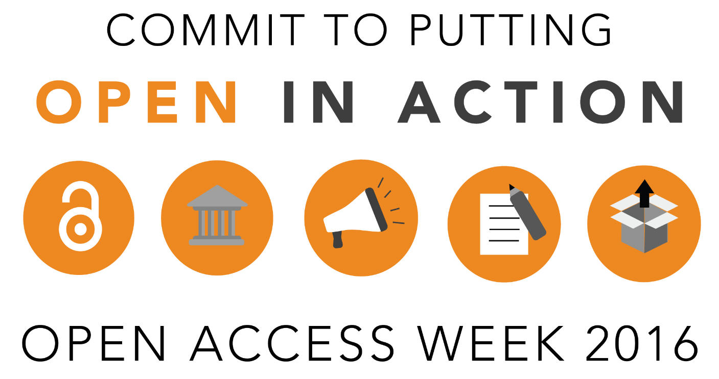
The feel good side of Open Access
Smartphone become a microscope
http://teamopen.cc/all/#science
http://www.action.openaccessweek.org/
Notes:
Select any of the actions below to commit to putting open into action this Open Access Week

Slide 27

Photo Courtesy: Question Question Mark Request Matter Requests by geralt, Pixabay, http://pixabay.com/en/question-question-mark-request-63916/ (public domain)
Notes:
Academia.edu is a website where researchers can post their articles and discover andread articles posted by others. It combines the archival role of repositories like ArXiv,SSRN, or PubMed with social networking features, such as proﬁles, news feeds, recom-mendations,andtheabilitytofollowindividualsandtopics. Thesitelaunchedin2008and as of April 2015 has approximately 20 million registered users who have uploadedapproximately ﬁve million articles. Registration on the site is free and users can freelydownloadallpaperspostedtothesite

Slide 28
Additional Readings:
Bailey Jr, C. W. (2005). Open access bibliography: liberating scholarly literature with e-prints and open access journals. Washington, DC: Association of Research Libraries, 2005..
Hitchcock, S. (2011) The effect of open access and downloads ('hits') on citation impact: a bibliography of studies. The Open Citation Project - Reference Linking and Citation Analysis for Open Archives. retrieved from http://opcit.eprints.org/oacitation-biblio.html
Houghton, J., & Sheehan, P. (2009). Estimating the potential impacts of Open Access to research findings. Economic Analysis and Policy, 39(1), 127-142.
Suber, P. (2007). Open access overview. Retrieved from Peter Suber's website: http://www. earlham. edu/~ peters/fos/overview. htm.
Swan, A. (2010) The Open Access citation advantage: Studies and results to date. Technical Report , School of Electronics & Computer Science, University of Southampton. Retrieved from http://eprints.ecs.soton.ac.uk/18516/2/Citation_advantage_paper.pdf
Wagner, B. (2010). Open access citation advantage: An annotated bibliography. Issues in Science and Technology Librarianship, (60), 2.
Willinsky, J. (2006). The Access Principle: The Case for Open Access to Research and Scholarship The MIT Press: Cambridge, Massachusetts.

Slide 29
OA resources:
Kresge Library Scholarly communication webpages
Kresge Library Open Access guide
Kresge Library Open Access Glossary
Kresge Library Research Data Management guide
Kresge Library OA Fund Pilot Program
OUWB Medical Library Open Access Grant Program
COPE - Compact for Open-Access Publishing Equity
Creative Commons licenses - choose a the appropriate use license for your work
Increasing Access to the Results of Federally Funded Scientific Research (OSTP Public Access memo -2013)
ROARMAP - Check mandates and deposit requirements from funders
Right to Research Coalition - Students organizing for open access
Sherpa/Romeo - Database to check publisher copyright agreements

